Slide 1


April 2026
INDENT LIST

Slide 2

Bitter Pill
RANDY SHILTS AND THE DAWN OF THE HIV/AIDS EPIDEMIC
Clément Xavier
A deadly mystery and one reporter’s fight to expose the truth during the earliest days of the AIDS epidemic. With hospital beds filling up, the clock was ticking. . . . What would it take to wake up the nation? A masterful and eye-opening historical account
San Francisco, 1980. Randy Shilts—biographer of Harvey Milk and the first openly gay journalist hired by the mainstream media—receives a disturbing call at the San Francisco Chronicle. The caller, a Los Angeles patient, is being treated for what seems to be a rare form of skin cancer. As Shilts investigates, he uncovers a troubling pattern: The illness appears to affect only homosexual men, with early cases linked to a Castro-district bathhouse. And a meeting with an infectious disease researcher confirms his worst fears—the so-called “gay cancer” is far more widespread and complex than anyone realizes. Forbidden from reporting on it directly, Shilts turns to sensationalist fake news to force action against the unfolding HIV/AIDS epidemic.
Shilts’s relentless pursuit of the truth would change the course of history, exposing the crisis the world tried to ignore. With this graphic novel biography—equally engaging, insightful, and flamboyant—the creators bring to the fore a story that remains as crucial as ever and deserves our attention.
AU $42.99 | NZ $46.99
9781419788697
160 Pages
Hardcover
254 mm x 191 mm
Abrams ComicArts

Slide 3
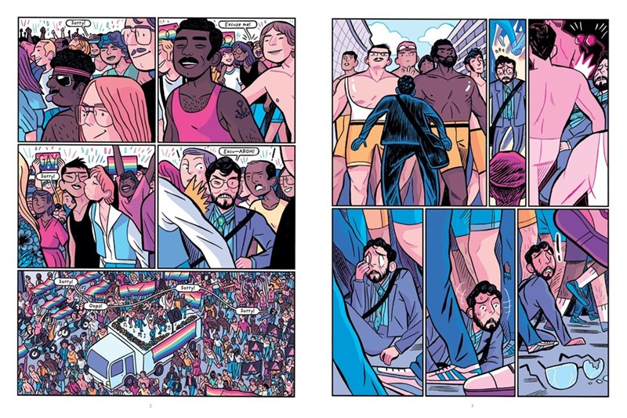
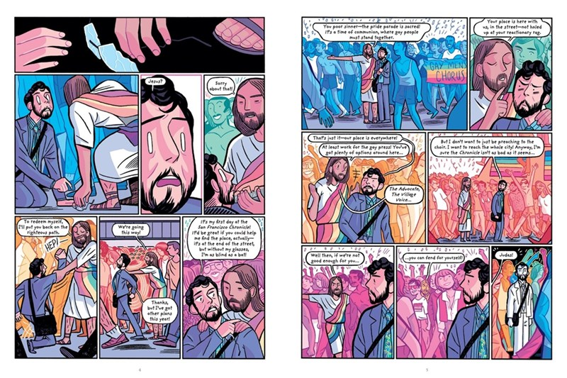
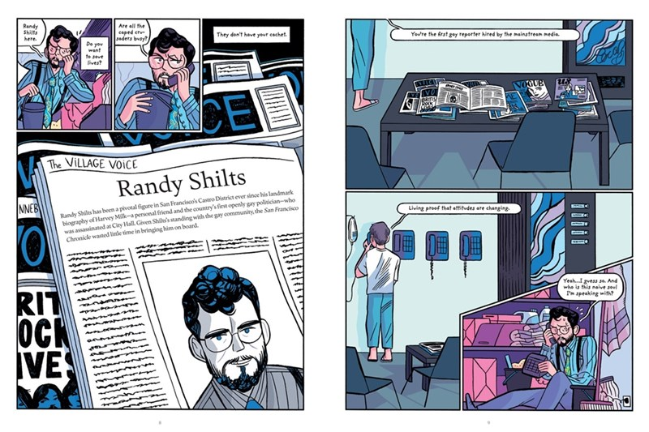
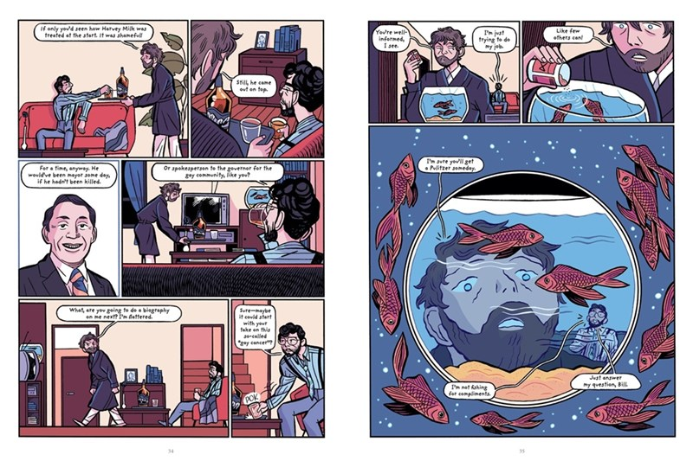
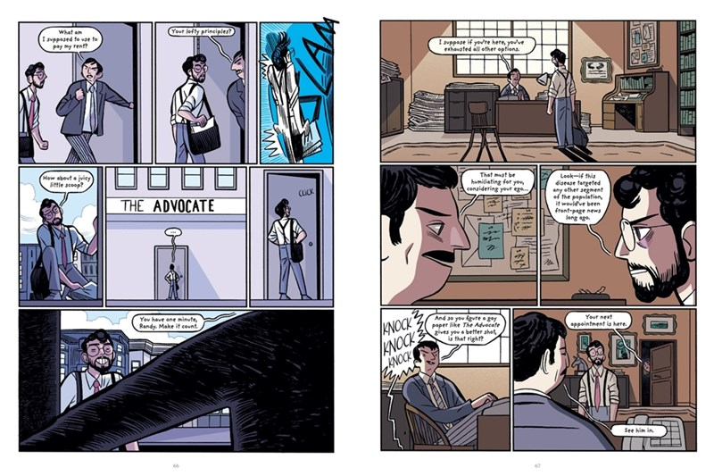
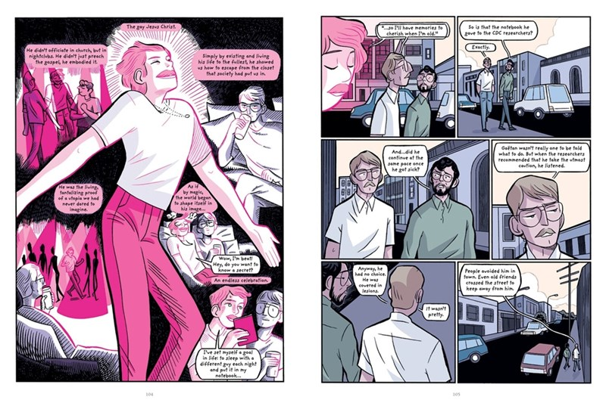

Slide 4
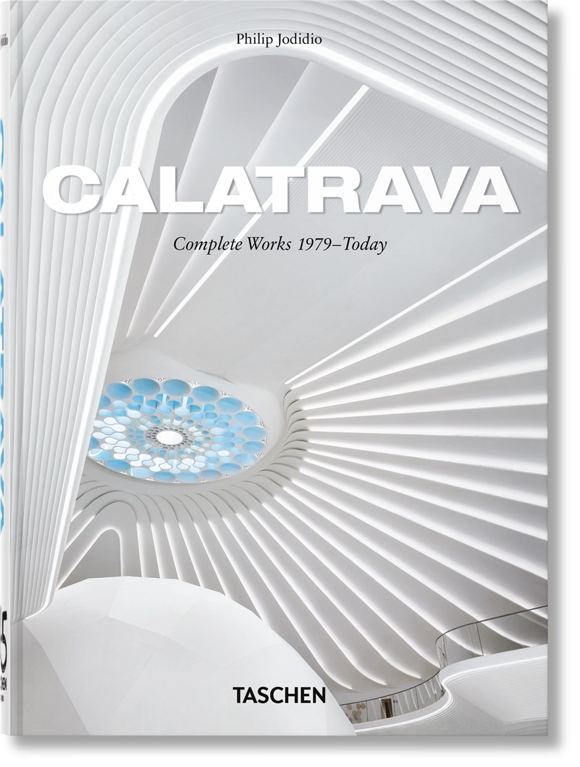
Calatrava. Complete Works 1979–Today. 45th Ed.
Philip Jodidio
Santiago Calatrava is a world-renowned architect, structural engineer, sculptor, and artist. From the Athens 2004 Olympic Sports Complex to the World Trade Center Transportation Hub in Manhattan, he exhibits a remarkable twin prowess for aesthetics and engineering, a simultaneous sensitivity to both the appearance and the anatomy of a structure.
His influences are wide-ranging: Auguste Rodin's approach to sculpture and architecture, principles of classicism and Greek Cycladic art, NASA space design, and a deep admiration for nature, which he regards as both mother and teacher. Thus, Calatrava's creations are at once aerodynamic and organic in their associations, with natural forms and human movement informing many of his projects. He takes a particular interest in the meeting point of equilibrium and dynamism.
This compact monograph gathers detailed entries, photography, and the original watercolor sketches that set Calatrava aside as a unique creative master. It includes many of his original collaborative input, and projects such as the Mediopadana Station in Reggio Emilia, Italy, the Museum of Tomorrow in Rio de Janeiro, as well as recent works like the UAE Pavilion at Expo 2020 in Dubai, St. Nicholas Greek Church at Ground Zero in New York and Constellation, a large sculpture at River Point Park in Chicago.
AU $54.99 | NZ $59.99
9783754404614
512 Pages
Hardcover
217 mm x 156 mm
TASCHEN

Slide 5
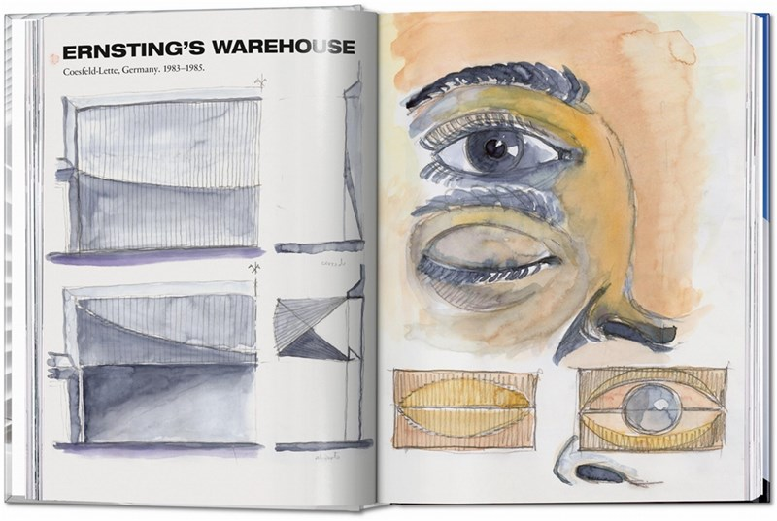
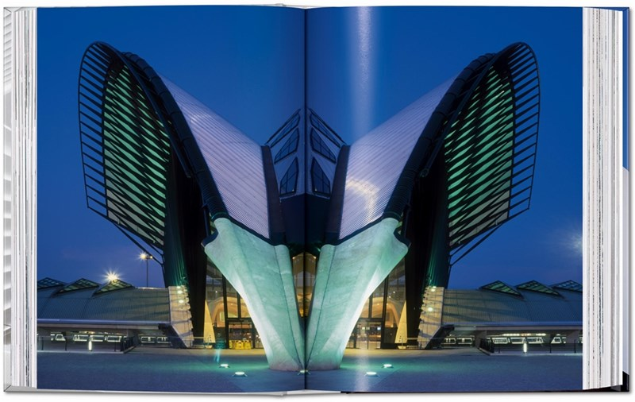
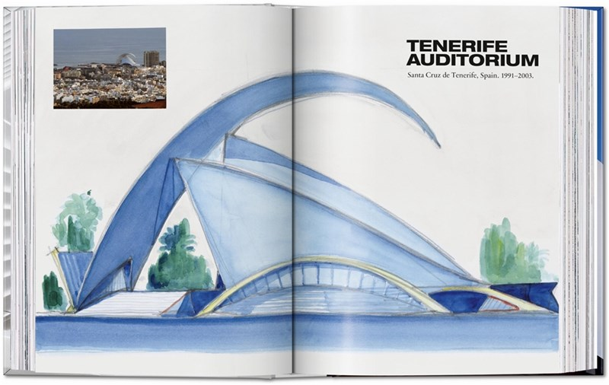
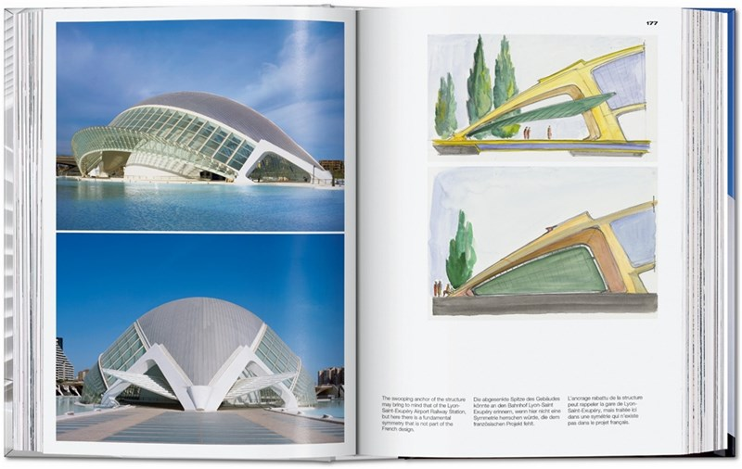
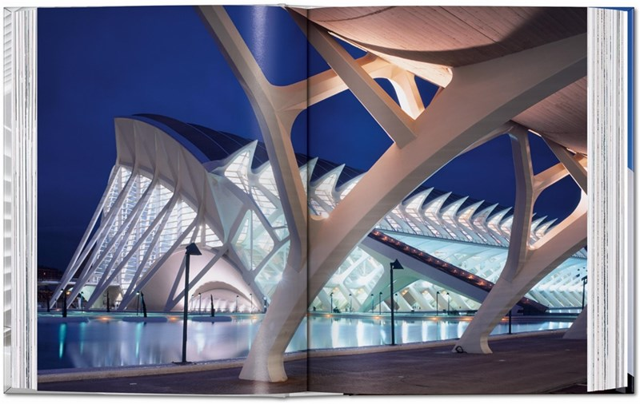
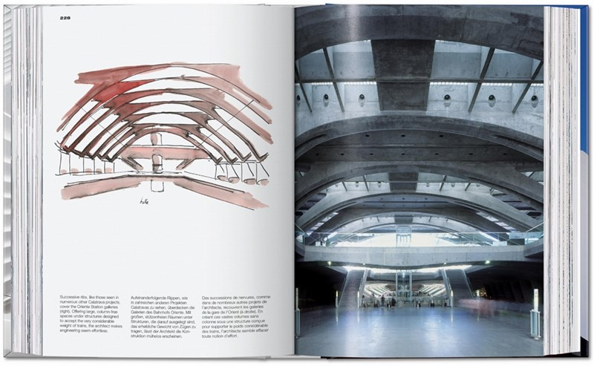

Slide 6
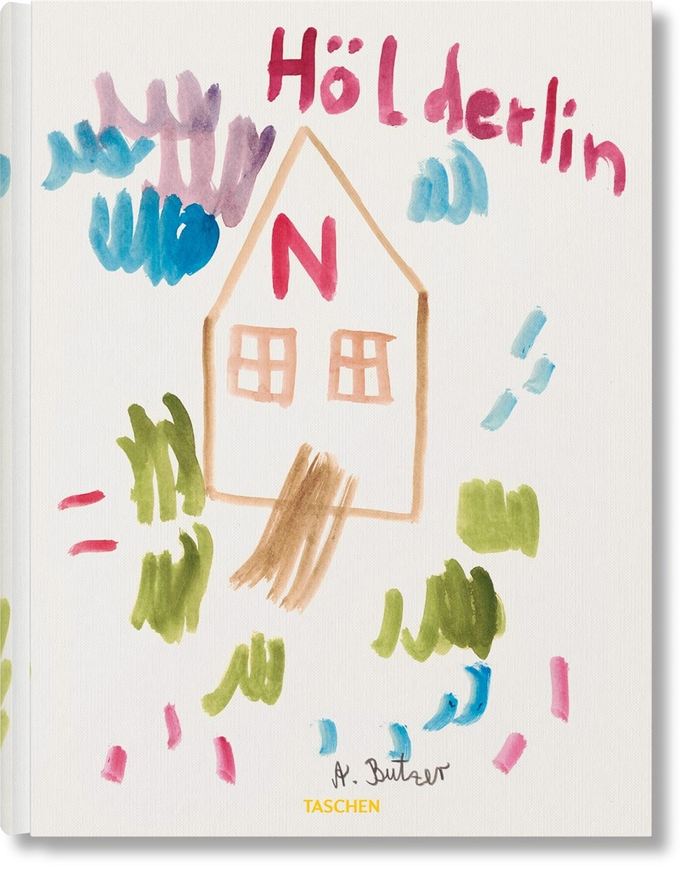
André Butzer. Friedrich Hölderlin.
Die Jahreszeiten / The Seasons
Friedrich Hölderlin
Friedrich Hölderlin is probably André Butzer's favorite poet and ranks alongside Walt Disney and Henri Matisse among his "favorite people ever." His identification with the poet goes even further, as Hölderlin's day of death is Butzer's own birthday.
In this artist's book, Butzer has compiled 47 poems written by Hölderlin between 1793 and 1843 on the four seasons. These poems link the cycle of the seasons with man's path of life like a parable: the autumnal fulfillment of summer's maturation, the blossoming of life in spring and the experienced barrenness of winter.
To accompany the poems, Butzer has created 40 watercolors. His iconic characters-the Wanderer, the Woman, the Peace-Siemens-cyclically fade and reappear in the delicate colors. Each figure, each thing, each stroke, each patch and each hue of color carries itself. Yet time and again, a fragile harmony emerges from their contrary bonding.
The book does neither adhere to the chronological everyday time nor the 'factual' succession of the seasons. Instead, Butzer has placed the poems and watercolors intuitively, forming open constellations. This corresponds to Hölderlin's wackily fantastic dating, in which a poem from 1843, for instance, can be attributed to 1758, 1648 or 1940.
AU $110.00 | NZ $120.00
9783754400159
204 Pages
Hardcover
333 mm x 248 mm
TASCHEN

Slide 7
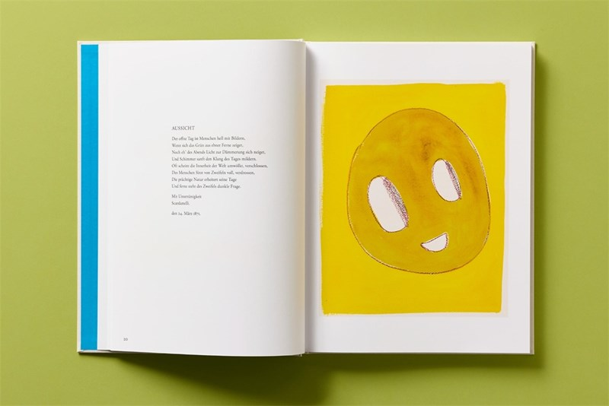
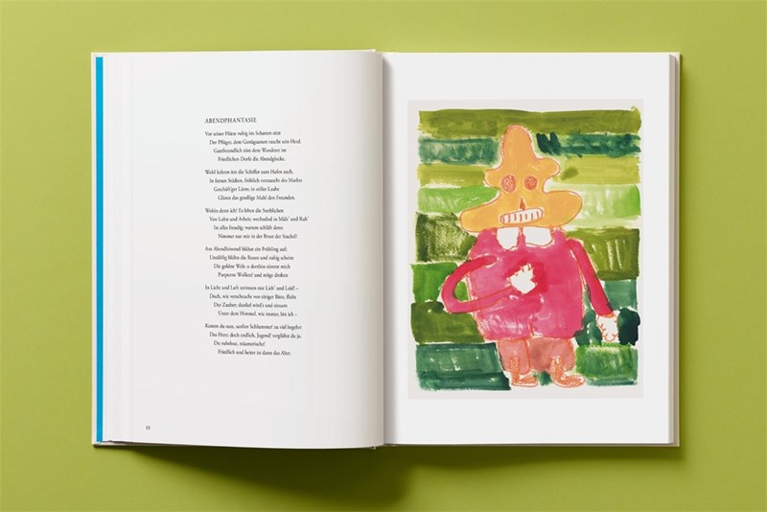
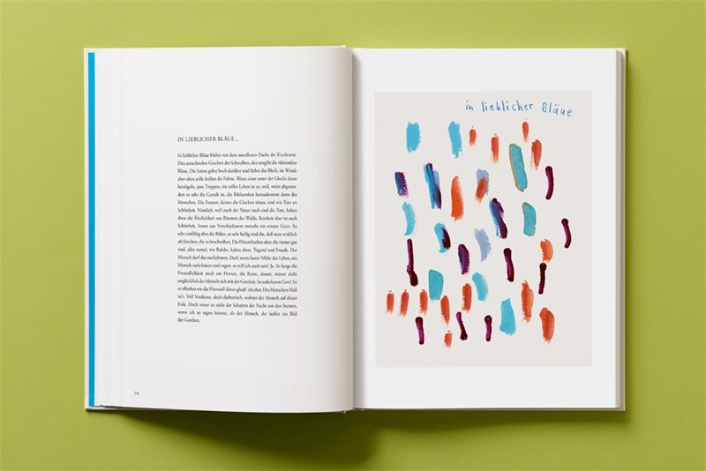
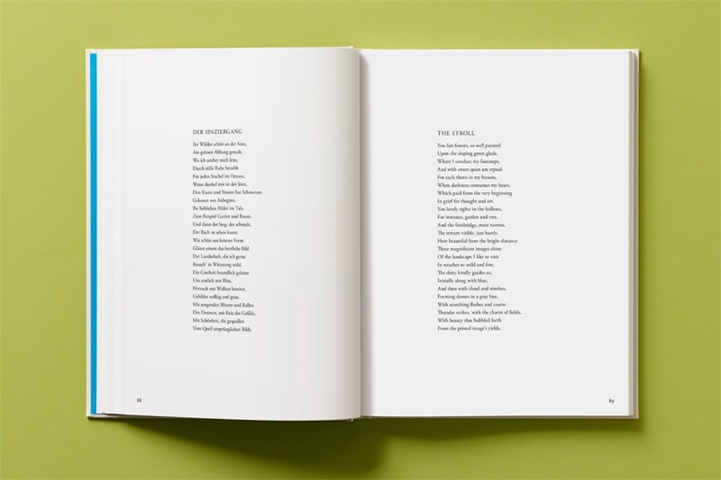
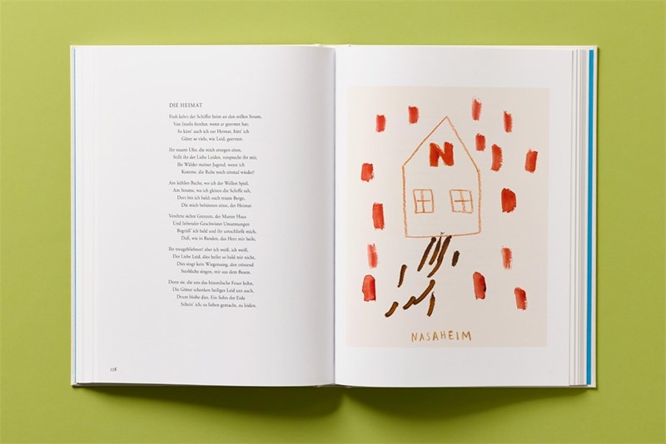
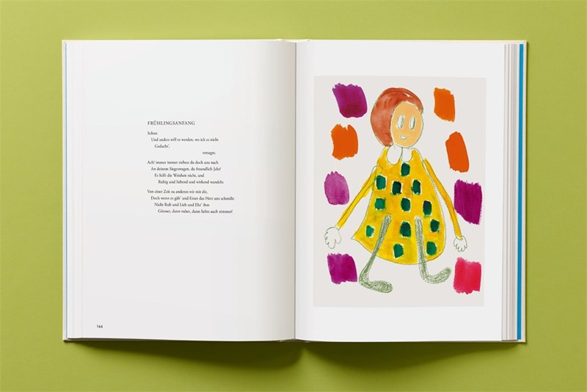

Slide 8

Earth Works
HOUSES BY BYOUNG CHO
Byoung Cho
A new monograph on Korea's most important architect, offering an exclusive look at his rarely published houses.
Earth Works: Houses by Byoung Cho offers a unique glimpse into the residential buildings of one of Korea's most influential architects. This visually stunning monograph combines photography, plans, drawings, paintings and models to provide an exclusive overview of this rarely published aspect of Byoung's work.
Focused entirely around fifteen private and rarely seen residences, the book takes as its starting point some of his earliest projects - Concrete Box House (2004) and Earth House (2009) - which explore the emotional impact of place through low-intervention and minimalist rural structures. At its core, this book aims to intertwine the theoretical underpinnings of land architecture with practical project descriptions, creating a holistic narrative that bridges the conceptual and the concrete.
A number of insightful texts by Byoung complement this elegant and poetic survey, exploring his architectural influences alongside the ideas of experience, perception and the Korean concepts of mak and bium (imperfection and emptiness).
AU $130.00 | NZ $145.00
9780500029367
324 Pages
Hardcover
280 mm x 223 mm
Thames and Hudson Ltd

Slide 9


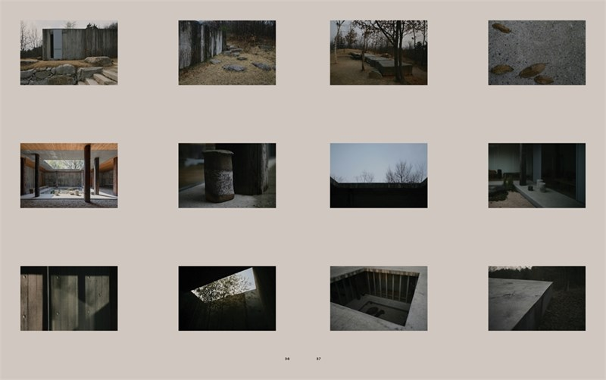

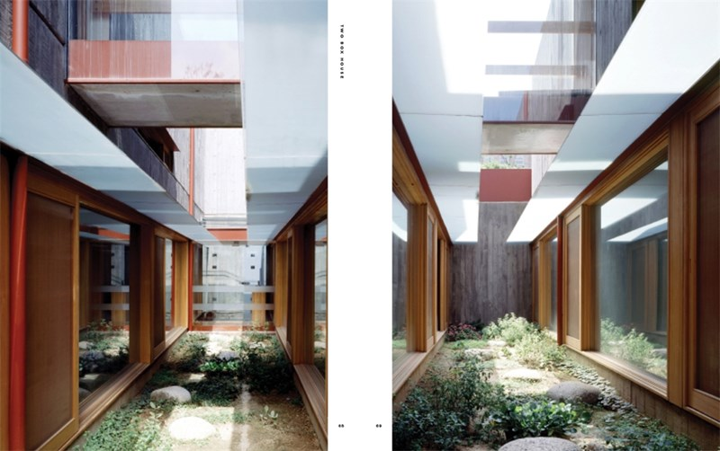
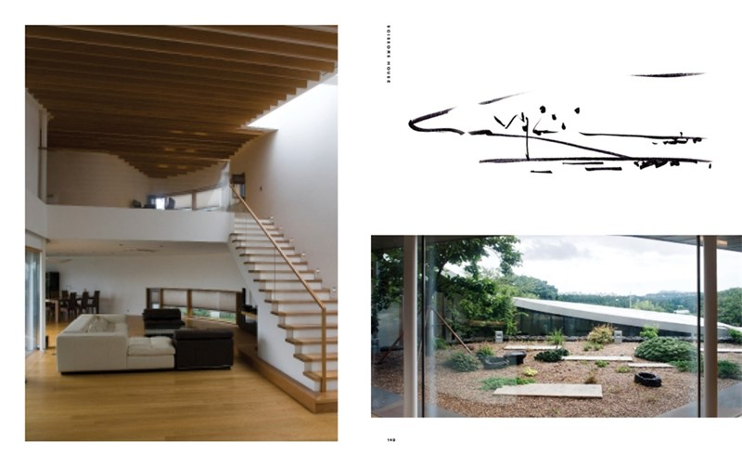

Slide 10
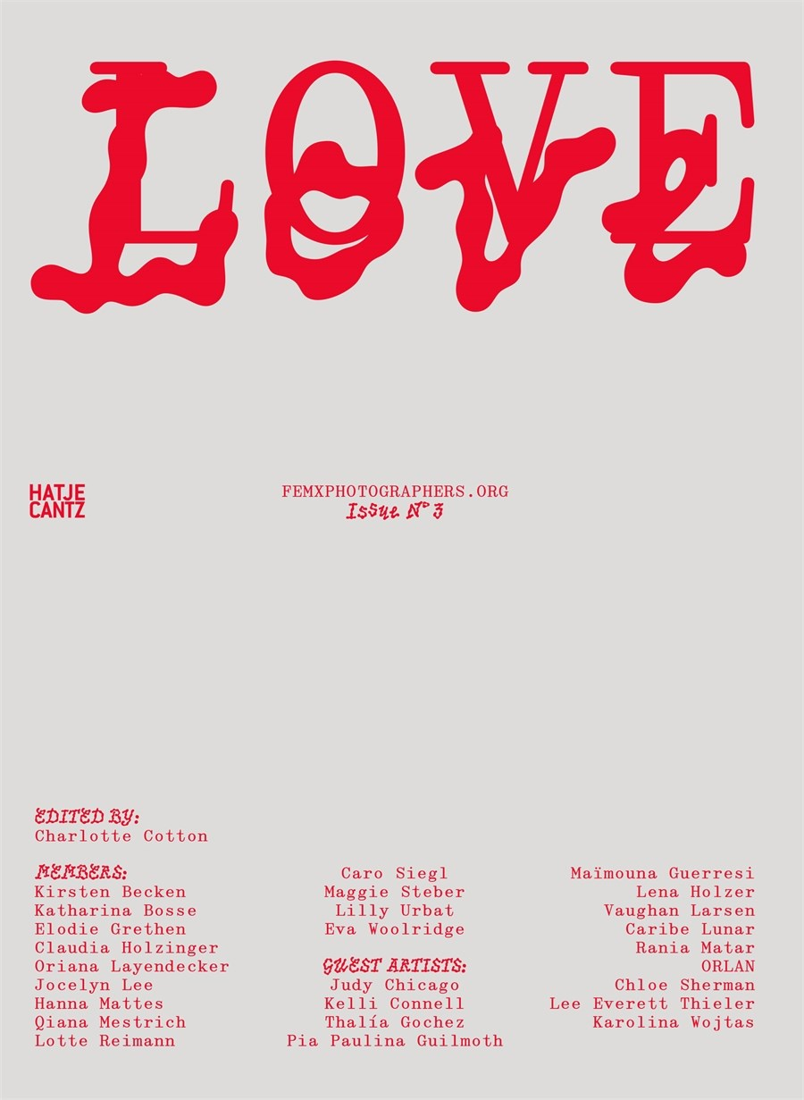
femxphotographers.org
LOVE
What does love look like when womxn photograph it?
This black-and-white volume brings together international artists who use the lens as a site of tenderness, power, loss, desire, and care. From staged intimacy to spontaneous encounters, from resistance to romanticism, these works show that love is not one image, but many.
The third publication by femxphotographers.org, this book continues their feminist and collective approach to photographic discourse and the disruption of the male gaze. Including poetry and text, it expands the field of visual storytelling to embrace the personal and political, the utopian and the everyday.
AU $74.99 | NZ $85.00
9783775761376
176 Pages
Paperback
241 mm x 184 mm
Hatje Cantz Verlag

Slide 11
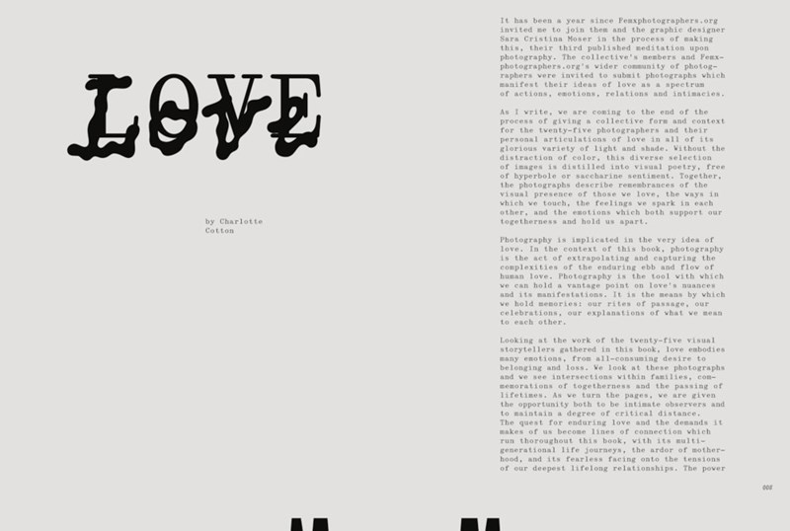


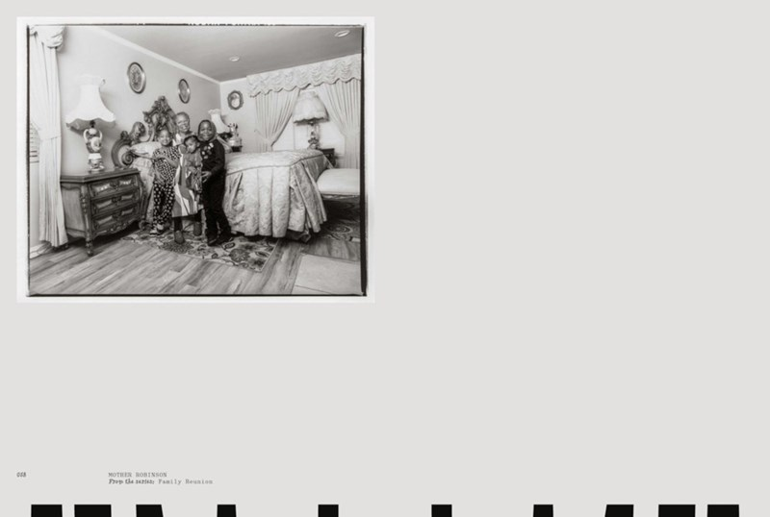

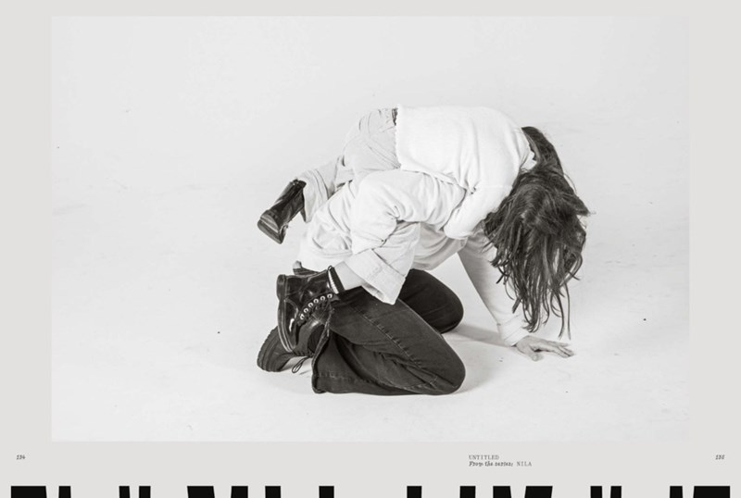

Slide 12
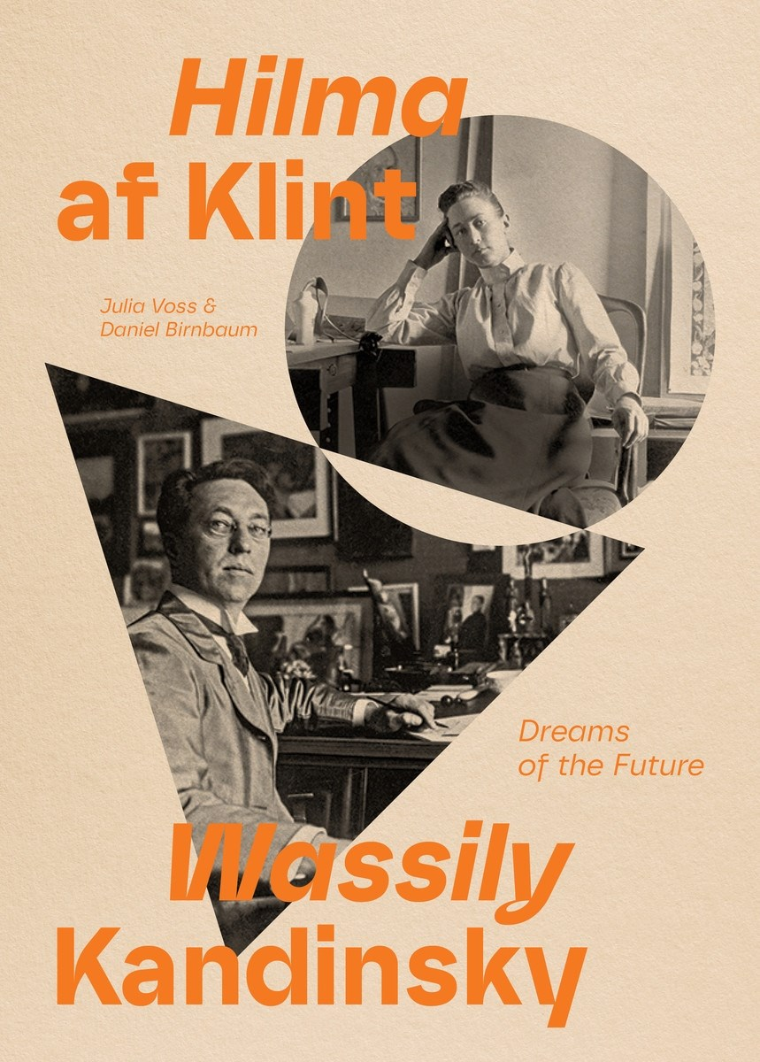
Hilma af Klint and Wassily Kandinsky
DREAMS OF THE FUTURE
Julia Voss
An important exploration of the lives and art of Hilma af Klint and Wassily Kandinsky, two pioneers of abstraction at the turn of the twentieth century
The Swedish artist Hilma af Klint is one of the art world's major rediscoveries of the twenty-first century. While the Russian artist Wassily Kandinsky has famously been credited for creating the first abstract artwork, this designation has been called into question with the resurfacing and renewed study of af Klint's nonfigurative paintings. In this captivating volume, the af Klint biographer and scholar Julia Voss and the curator and writer Daniel Birnbaum convey in depth the two artists' nearly parallel development away from figuration and into the liberating, mystical vision of art.
While there is no indication that these artists, who both died in 1944, ever met, this publication presents a dynamic and visual conversation between them. Through this engrossing account of the affinities and divergences between af Klint's and Kandinsky's lives and work-supported by more than 100 striking illustrations-we gain a deeper understanding of the forces that shaped their artistic trajectories. By examining the spiritual, sociopolitical, and personal contexts that influenced their practices, this book invites us to witness a pivotal moment in which the art world was forever changed.
AU $79.99 | NZ $90.00
9781644231586
208 Pages
Hardcover
222 mm x 159 mm
David Zwirner Books

Slide 13
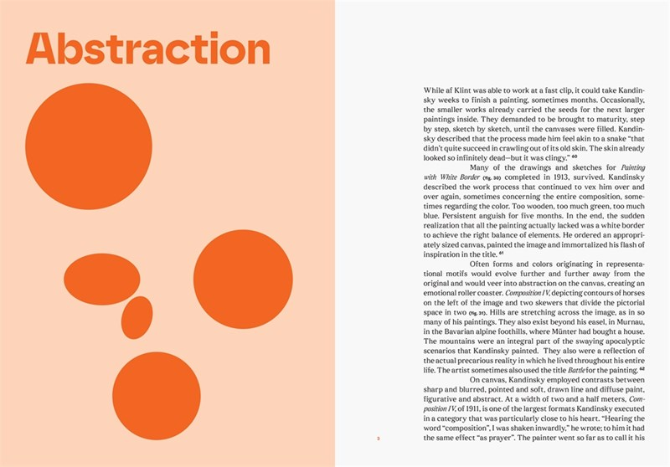
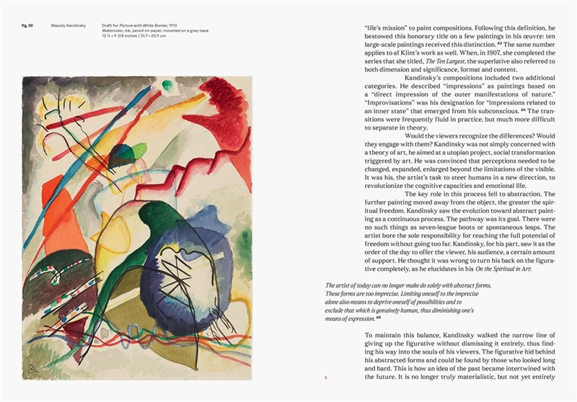
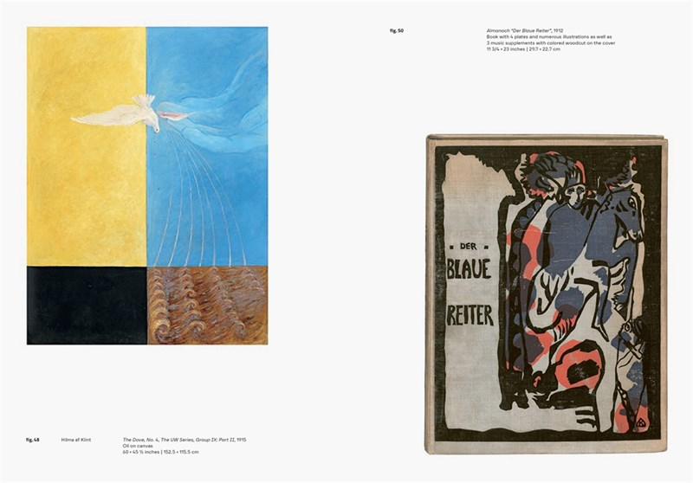

Slide 14
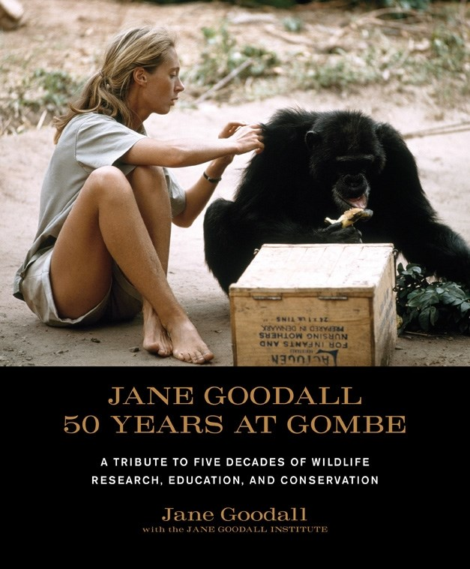
Jane Goodall: 50 Years at Gombe
A TRIBUTE TO FIVE DECADES OF WILDLIFE RESEARCH, EDUCATION, AND CONSERVATION
Jane Goodall
A great deal has happened since the publication of Jane Goodall: 40 Years at Gombe in 1999.
Most recently, endeavors at the Gombe field site have included landmark research related to AIDS progression; establishing programs to improve sanitation, health care, and education in neighboring Tanzanian communities; and partnering with local people to pursue reforestation initiatives.
The accomplishments of the past 10 years alone have given the Jane Goodall Institute a great deal to celebrate. In honor of the field site's 50th anniversary, STC is proud to release Jane Goodall: 50 Years at Gombe, a compelling pictorial tribute to Dr. Goodall's life, her studies of chimpanzee behavior, and her unflagging efforts to motivate people to make this world a better place.
With a new format, a modern design, more than a dozen new pho­tographs, and updated text throughout, this revised edition retraces five decades of compassion and discovery.
AU $54.99 | NZ $59.99
9781584798781
144 Pages
Hardcover
264 mm x 226 mm
Stewart, Tabori & Chang

Slide 15
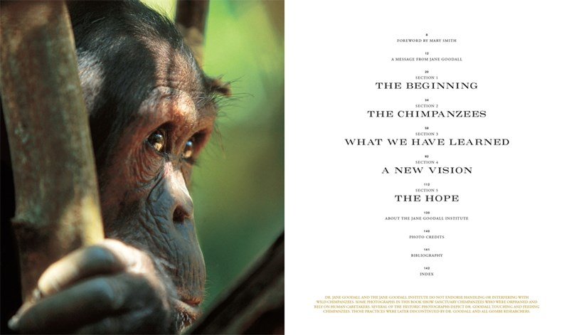
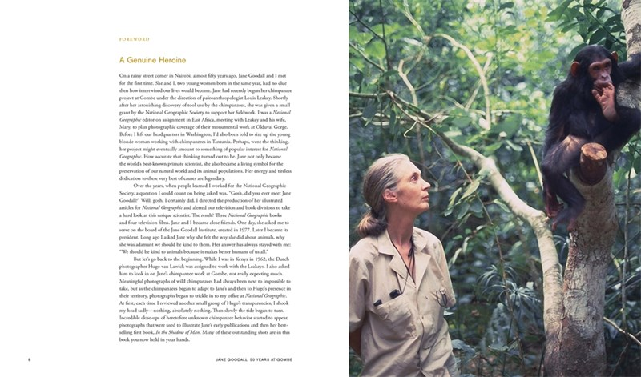
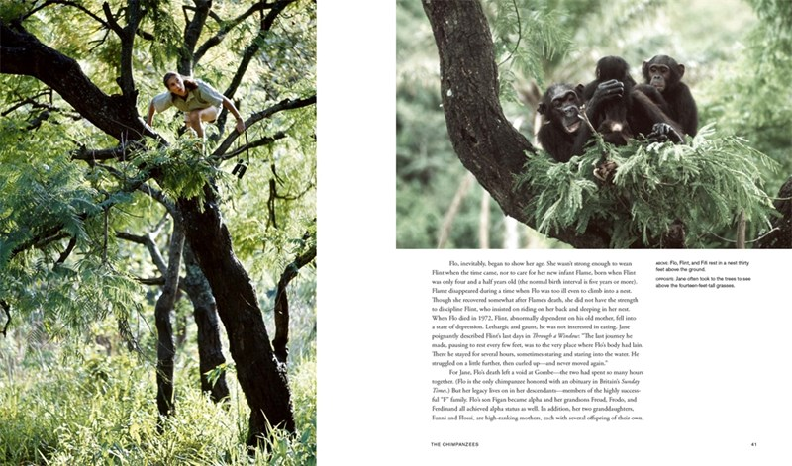
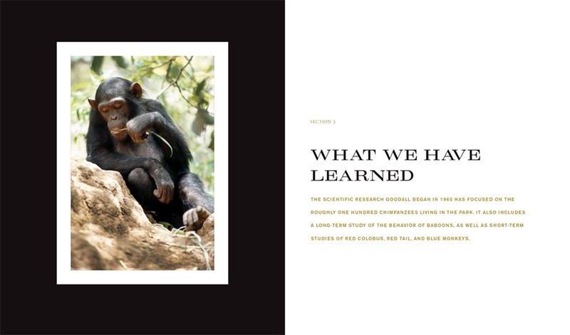
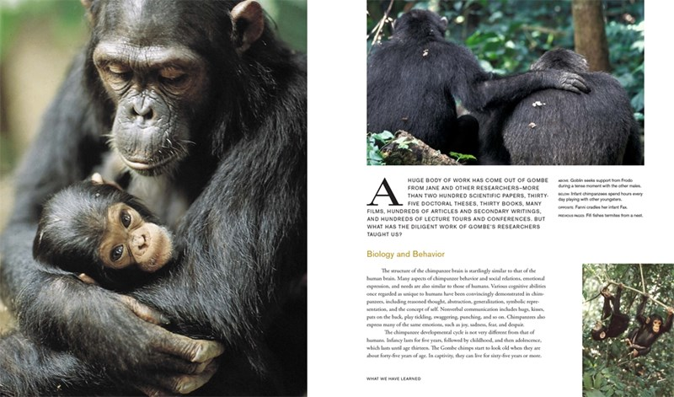
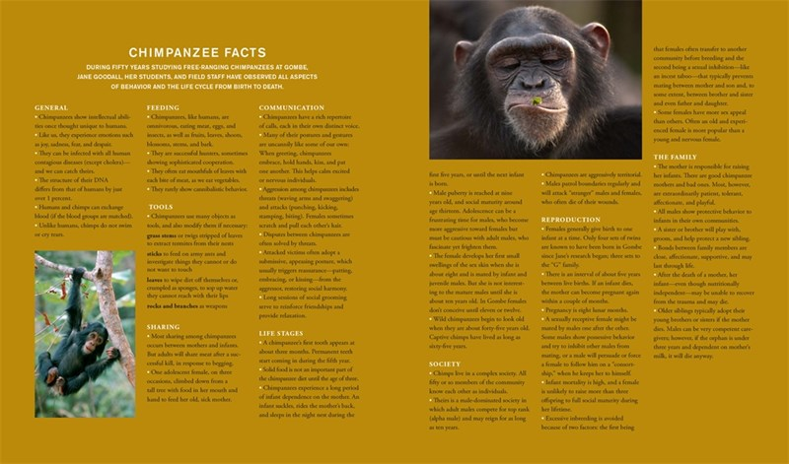

Slide 16

Karl Lagerfeld
AN ILLUSTRATED BIOGRAPHY
Alfons Kaiser
Written by Alfons Kaiser, a journalist and personal friend of Karl Lagerfeld, a graphic biography exploring the man behind the larger-than-life figure who became an iconic fashion brand in and of himself while defining an era at Chanel
Karl Lagerfeld stylized himself into a living logo and a myth of the fashion world. As a brand, his name is synonymous with luxury, and as a designer, he has worked for and influenced almost every major luxury brand since the beginning of his career, from his apprenticeship with Balmain, to Fendi, whose logo he designed, to his renowned tenure at Chanel from 1982–2000.
Now, FAZ editor Alfons Kaiser, who knew Lagerfeld personally, tells the story of the charismatic fashion designer in this new graphic biography. Using many previously unknown sources, this graphic novel explores every aspect of his colorful career.
From a youthful outsider in the northern German plains, to an urbane genius in Paris competing to make a name for himself against designers such as Yves Saint-Laurent, this personal look at Lagerfeld’s life paints a picture of a peerless designer, a tireless illustrator, an avid photographer, a passionate book collector, and a peerless workaholic.
AU $42.99 | NZ $46.99
9781419784460
104 Pages
Hardcover
260 mm x 191 mm
Abrams ComicArts

Slide 17
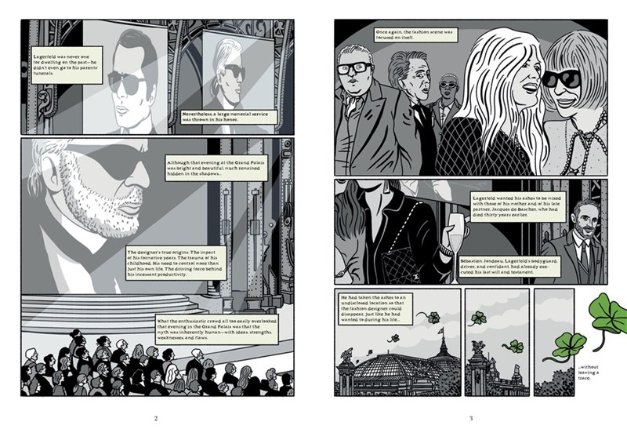
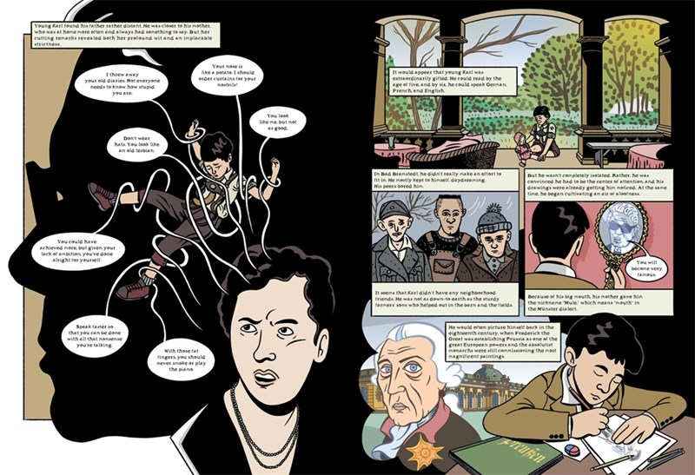
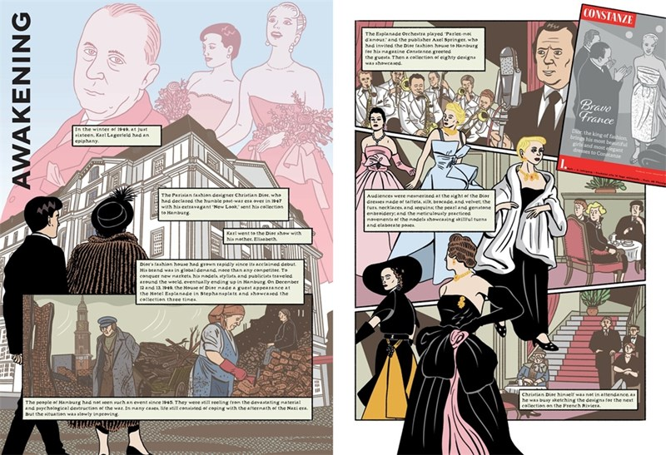
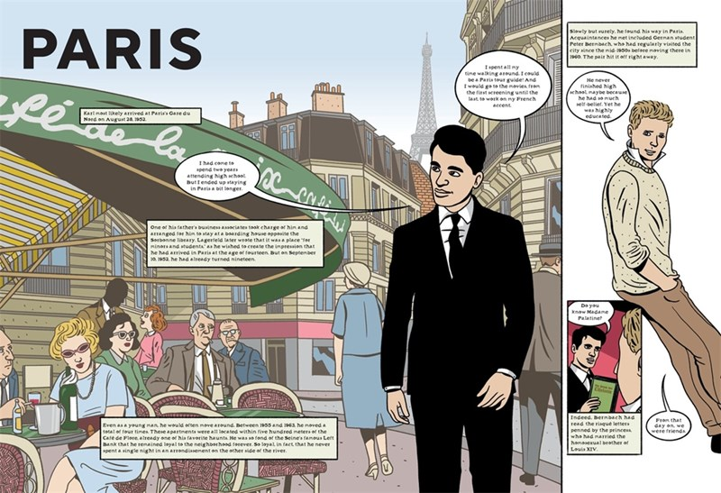
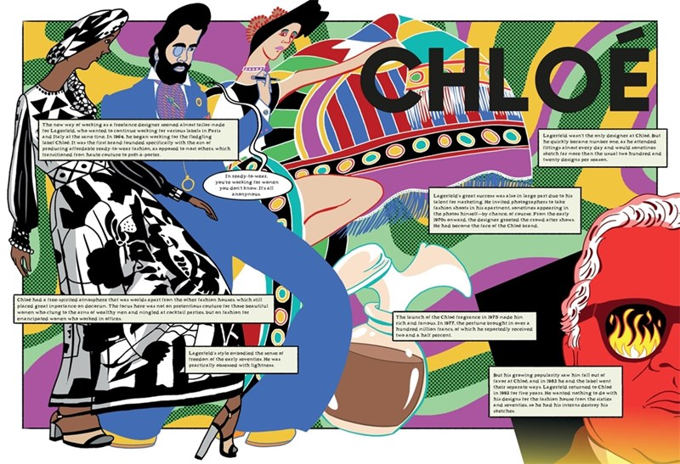
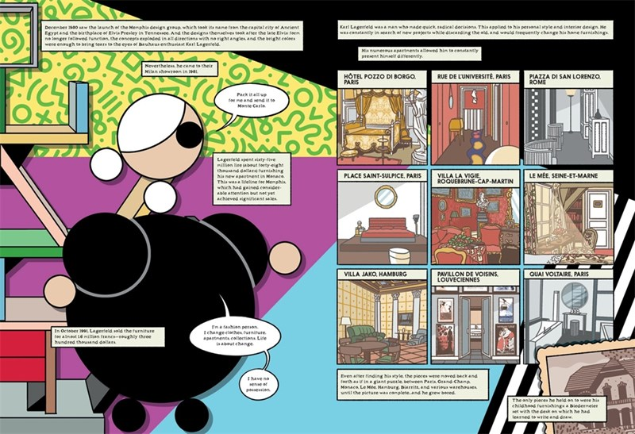

Slide 18

The Landscape of Man
SHAPING THE ENVIRONMENT FROM PREHISTORY TO THE PRESENT DAY
Geoffrey Jellicoe
An updated edition of the seminal text on landscape architecture from prehistory until the present day, now in full colour, with a new introduction and final chapter.
From small gardens to complete cities, humans have always moulded their environment to express or symbolize ideas - power, order, comfort, harmony, pleasure, mystery. Geoffrey and Susan Jellicoe link these ideas together and demonstrate that they are manifestations of a single process: humankind's instinct to shape its surroundings.
The ground covered includes ancient Mesopotamia, Greece, Rome, the Muslim world, medieval Europe, India, China, Japan, pre-Columbian America and the post-Renaissance West in all its phases, as well as planning and landscape architecture from 1945 up until the present day.
Re-designed throughout with a new contemporary look and feel, this landmark book by the renowned expert on landscape architecture looks set to be discovered by a new generation of readers keen to understand how we have got to where we are today.
AU $145.00 | NZ $160.00
9780500028247
440 Pages
Hardcover
282 mm x 230 mm
Thames and Hudson Ltd

Slide 19
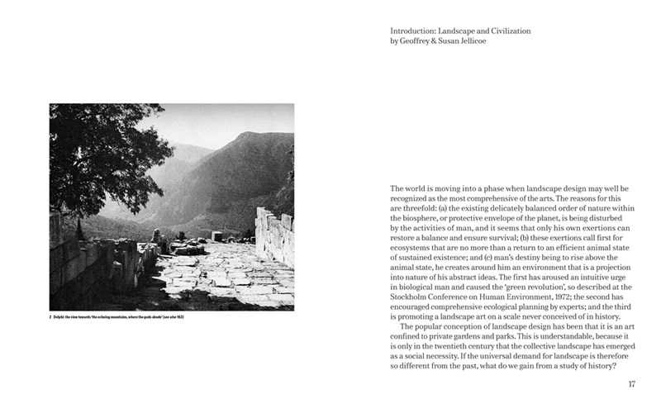
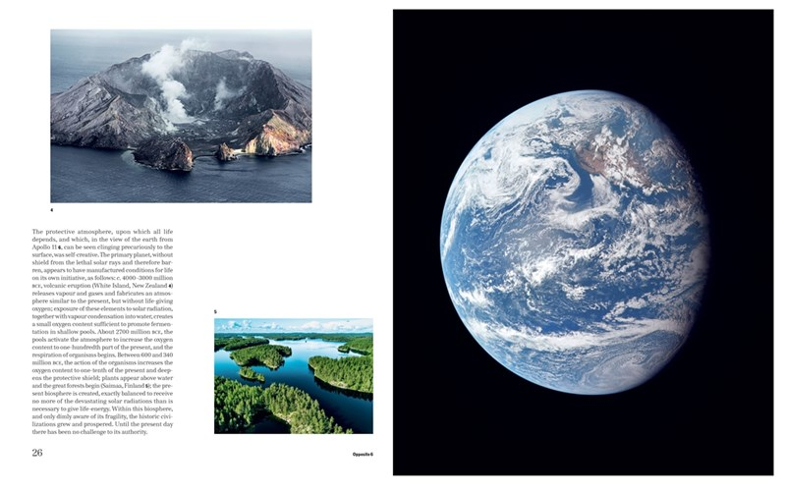
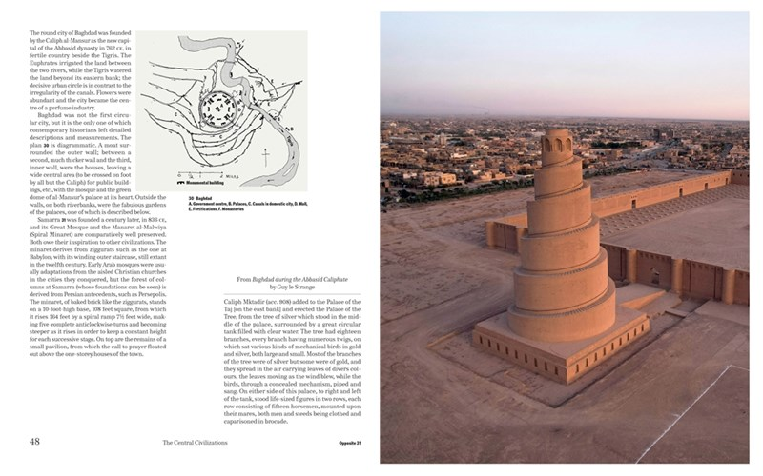
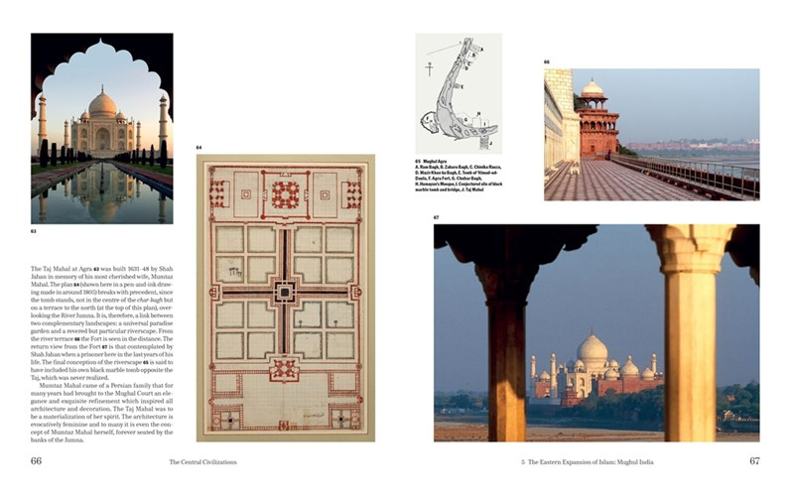

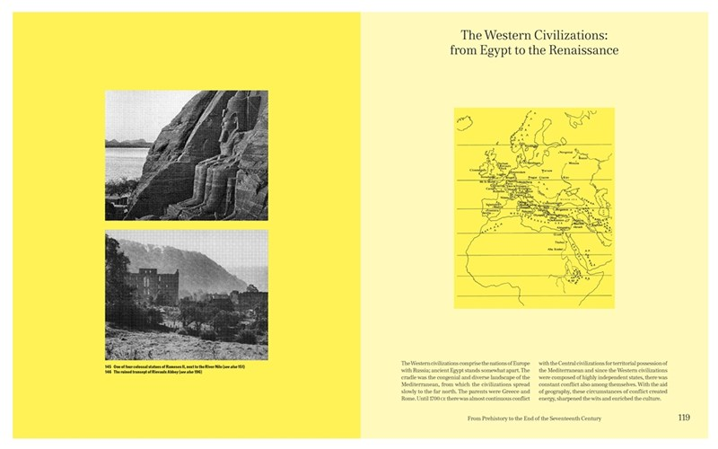

Slide 20
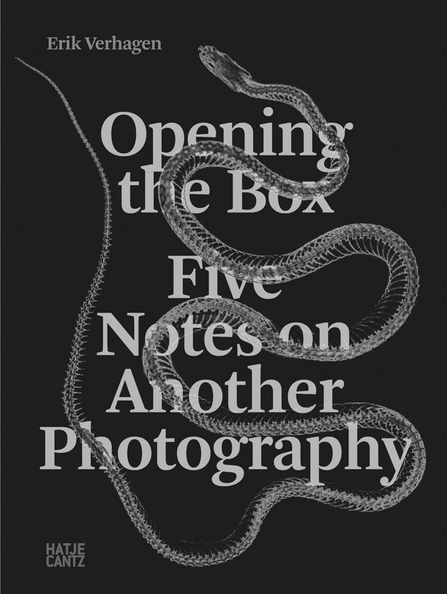
Opening the Box
FIVE NOTES ON ANOTHER PHOTOGRAPHY
Erik Verhagen
Photography historian and critic Erik Verhagen expands on the legacy of the exhibition La Boîte de Pandore by Jan Dibbets (born 1941), clarifying the artist's concept of "another photography" that highlights unconventional photographic practices.
Opening the Box: Five Notes on Another Photography is a thought-provoking exploration of photography beyond conventional boundaries. Expanding on the legacy of the exhibition La Boîte de Pandore, this book challenges traditional narratives by examining experimental, conceptual, and unconventional photographic practices.
Through five distinct notes, it navigates the medium's history, from 19th-century scientific and artistic experiments to contemporary digital and material transformations. By moving beyond the binary divide between documentary and ontological approaches, it opens new perspectives on what images can be.
A must-read for artists, scholars, and anyone interested in the evolving language of photography.
AU$120.00 | NZ$130.00
9783775760607
320 Pages
Paperback
240 mm x 170 mm
Hatje Cantz

Slide 21

Run
BOOK ONE
John Lewis, Andrew Aydin, L. Fury (Illustrated by), Nate Powell (Illustrated by)
First you march, then you run. From the #1 bestselling, award-winning team behind the March trilogy comes Run, the conclusion to their groundbreaking graphic novel series—now in paperback
To John Lewis, the civil rights movement came to an end with the signing of the Voting Rights Act on August 6, 1965. But that was after more than five years as one of the preeminent figures of the movement, leading sit-in protests and fighting segregation on interstate busways as an original Freedom Rider It was after helping organize the Mississippi Freedom Summer and the ensuing delegate challenge at the 1964 Democratic National Convention. And after coleading the march from Selma to Montgomery on what became known as “Bloody Sunday.”
In Run, Lewis and longtime collaborator Andrew Aydin reteamed with Nate Powell—the award-winning illustrator of the March trilogy—and were joined by L. Fury, who made an astonishing graphic novel debut to tell this often-overlooked chapter of civil rights history.
Urgently relevant for those who seek to understand American political conflict, Run has become required reading alongside the March trilogy—the first and only graphic novel to win the National Book Award.
AU $32.99 | NZ $36.99
9781419737107
160 Pages
Paperback
241 mm x 165 mm
Abrams ComicArts

Slide 22







Slide 23

The Secrets of Painting
THE HIDDEN ART OF THE MASTERPIECE FROM PREHISTORY TO TODAY
Lachlan Goudie
A new history of painting as told through the eyes and hands-on insights of a practising artist.
The secrets of painting lie above all in the physical elements from which an image is crafted. The nature of these elements has changed over time and across continents. And as each generation of painters exploits the new material and technical innovations of their era, they transform the character of their work and help propel the course of art history.
Goudie traces this story all the way back to the original 'big bang' in the story of art: the very first painting pigments, made from charcoal and minerals, that were used to paint extraordinary art on the walls of the caves at Chauvet 36,000 years ago. He goes on to explore the impact of numerous new inventions and discoveries over the centuries, including ink, fresco, egg tempera, oil paint, canvas, watercolour, gouache, impasto, tubes of manufactured oil paint, collage, household gloss, acrylic, digital media and AI.
Each chapter focuses on a technical turning point as embodied in the work of particular artist, including Giotto, Artemisia Gentileschi, Alma Thomas, Anselm Kiefer, David Hockney and many more.
AU $85.00 | NZ $95.00
9780500025116
384 Pages
Hardcover
246 mm x 186 mm
Thames and Hudson Ltd

Slide 24







Slide 25

Zaman: Iranian Photography
THE PIROUZ COLLECTION
The history of Iranian photography.
The Pirouz Collection, artistic project founded in 2021, aims to gather and present the history of photography in Iran. The collection is structured in three main sections: Qajar photography, amateur photography, and modern and contemporary photography. This book is the first edition of the collection.
Ali Bakhtiari is an Iranian curator and cultural researcher known for his significant contributions to modern and contemporary Iranian art. Over the years, Bakhtiari has curated numerous exhibitions at esteemed venues worldwide.
In 2012, he founded ABBookness, the first autonomous Middle Eastern project dedicated to the production of artist books. In addition, he has edited major monographs on veteran Iranian artists.
AU$120.00 | NZ $130.00
9783775760164
256 Pages
Hardcover
280 mm x 240 mm
Hatje Cantz

Slide 26




Slide 27

Baba Palooza
A PICTURE BOOK
A. D. Ghani
My Papi Has a Motorcycle meets Bilal Cooks Daal in this sweet father-daughter story that celebrates hardworking immigrant parents
When Aizah rides with her dad on Saturday mornings, she feels like a movie star—Baba in the driver’s seat, her in the back. Baba’s taxi seems brighter and the world seems bigger when they’re together.
Baba works long hours, so he can’t walk Aizah home from school and they rarely get to eat dinner together, but they still squeeze in family time however they can. So when Baba has to miss her school’s daddy-daughter dance, Aizah plans something SUPER-DUPER-EXTRA-SPECIAL to surprise him.
Spotlighting a Pakistani American Muslim family, this universal picture book is a proud love letter to working class parents, immigrants, and dads everywhere.
AU $29.99 | NZ $34.99
9781419777158
40 Pages | Ages 4 to 8
Hardcover
267 mm x 229 mm
Abrams Books for Young Readers

Slide 28




Slide 29

Great Minds of Science (Black Lives #1)
A NONFICTION GRAPHIC NOVEL
Tonya Bolden
Black Lives is an exciting new graphic novel series from award-winning author Tonya Bolden and illustrator David Wilkerson. Great Minds of Science celebrates the lives and contributions of Black scientists throughout history
This fun and accessible graphic novel for middle-grade readers brings to light the lives of great but lesser-known Black scientists. Great Minds of Science is a kid-friendly introduction to some of the greatest scientists in history—doctors, engineers, mathematicians, and biologists.
Each of them faced challenges as they rose to the top of their professions, but they didn’t back down. They kept experimenting and questioning and learning, and they made significant contributions in each of their scientific fields.
Black Lives is the new graphic novel series from award-winning author Tonya Bolden and illustrator David Wilkerson that celebrates the lives of Black innovators and legends and helps bring these histories to life.
Celebrate the lives and contributions of Black scientists throughout history with the inspiring Great Minds of Science.
AU $14.99 | NZ $19.99
9781419752704
128 Pages | Ages 8 to 12
Paperback
203 mm x 140 mm
Abrams Fanfare

Slide 30




Slide 31

Juneteenth (A We Celebrate Book)
A BOARD BOOK
Little Feminist
From the ALA Stonewall Award–winning team Little Feminist comes a gorgeous photographic board book celebrating Juneteenth
Freedom feels like hugs and kisses, unity, strength and pride.
Freedom feels like a million steps forward—together with every stride.
From award-winning indie publisher Little Feminist Press comes an engaging board book celebrating Juneteenth and its powerful history. Bursting with beautiful, community-sourced photographs, this board book features powerful images of Black joy, allyship from all demographics, and the many ways people can celebrate this important American holiday.
Showcasing real families and communities, young readers will see festivities and merriment in action as kids, their adoring adult caretakers, and their neighbors share stories, prepare meals, listen, hug, dance, show kindness, demonstrate bravery, and step in to help their families and communities. The book also includes family discussion questions and a note for grown-ups on how to use this book with young children.
AU $14.99 | NZ $19.99
9781419780127
24 Pages | Ages 1 to 4
Board Book
178 mm x 178 mm
Abrams Appleseed

Slide 32




Slide 33

Once Upon a Tail (Once Upon a Tail #1)
A HORSE AND DRAGON GRAPHIC NOVEL
Audrey Perrott
Full of heart and humor, this early reader graphic novel series stars two best friends in a fantastical medieval setting, perfect for fans of Narwhal and Jelly and Peter & Ernesto.
Wallace is a knightly horse who loves rules. Poppy is a free-spirit dragon who loves adventure.
These two unlikely pals disagree on most everything—but still manage to have a lot of fun-filled shenanigans together in the Land of La-Dee-Dah.
Told in three short and silly stories with subtle social-emotional themes, this young graphic novel follows the everyday adventures of two best buds as they step out of their comfort zones, discover hidden powers, and eat a LOT of banana pudding. With a high-interest fantasy setting, accessible reading level, and kid-perfect humor, this series is designed for emerging and reluctant readers alike.
AU $24.99 | NZ $29.99
9781419770722
72 Pages | Ages 6 to 9
Hardcover
210 mm x 152 mm
Abrams Fanfare

Slide 34




Slide 35

Penelope Positano Sees It All
A CHAPTER BOOK
Katie Cotugno
From bestselling author Katie Cotugno and illustrator Amy Jindra Hodgson comes a charming new chapter-book series about a plucky seven-year-old who can see things other people miss, perfect for fans of Ivy & Bean
For two hours every day, seven-year-old Penelope Positano wears an eye patch. Her eye muscles don’t quite match, and wearing the patch on her strong eye helps her less-strong eye catch up. And whenever she wears her eye patch, Penelope notices things that other people overlook.
The Positanos are getting a dog, and it’s Penelope’s job to find the perfect pup for her family. Her mom thinks they should pick the most obedient dog, and her dad wants the dog that likes his music the best, but Penelope’s not sure. Her best friend Gus said she would know which dog was meant to be hers, but the more Penelope looks, the more she worries that her dog isn’t out there.
It’s only with the encouragement of her grandma—and the help of her trusty eye patch—that Penelope realizes the perfect dog might be closer than she thinks.
AU $24.99 | NZ $29.99
9781419777950
80 Pages | Ages 6 to 9
Hardcover
210 mm x 152 mm
Amulet Books

Slide 36







Slide 37

Three Pieces of Broken Glass
A PICTURE BOOK
Emily Barth Isler
From award-winning creators Emily Barth Isler and Vesper Stamper, this luminous and moving story shows what it means to see the world in a hopeful light, even when it is broken
Three pieces of broken glass sit on Grandma Inge’s windowsill.
Even though they are small, sharp, and jagged, the light shines through them, casting beautiful rainbows on the wall.
When Inge’s great-granddaughter asks why Inge has kept these shards, she learns decades-old stories from her great-grandmother’s life—from the joy of glass breaking at her wedding to harrowing reminders of smashed windows during Kristallnacht. And she comes to understand why we hold onto our memories both happy and sad.
Evocative and soul-stirring, and with incandescent illustrations by Vesper Stamper, Three Pieces of Broken Glass—based on the personal history of author Emily Barth Isler—explores how we must seek to find beauty and strength in even the darkest, most broken times.
AU $32.99 | NZ $36.99
9781419778728
40 Pages | Ages 4 to 8
Hardcover
279 mm x 229 mm
Abrams Books for Young Readers

Slide 38







Slide 39

Unbreakable
A JAPANESE AMERICAN FAMILY IN AN AMERICAN INCARCERATION CAMP
Minoru Tonai
A powerful, emotional and ultimately uplifting picture book about the real-life experience of a Japanese American boy incarcerated with his family during World War II
Strength comes in the form of the small, smooth stone Min’s father gives him before being led away by FBI agents. In his absence, Min and his family do their best to keep their produce business afloat and earn enough support to get Min’s father released. But after the bombing of Pearl Harbor, they’re forced into an incarceration camp in Colorado.
Cowritten by Jolene Gutiérrez, author of Too Much! and Mamiachi & Me, and Minoru (Min) Tonai, an advocate for Japanese American rights, Unbreakable is ultimately an uplifting picture book based on Tonai’s harrowing real-life experiences. Illustrated by acclaimed illustrator Chris Sasaki, this picture book includes extensive back matter such as information on the American incarceration camps and the campaign to release Tonai’s father, a timeline, a bibliography, author and illustrator notes, and questions for further discussion perfect for caregivers and educators to further engage young readers.
AU $32.99 | NZ $36.99
9781419772894
48 Pages | Ages 4 to 8
Hardcover
216 mm x 267 mm
Abrams Books for Young Readers

Slide 40




Slide 41

What a Small Cat Needs
Natalia Shaloshvili
Sweet, tender, and perfect for the youngest picture book readers, this book from a standout, upcoming illustrator names a child’s need for trust, experience, and deep affection through the story of an adorable kitten.
What does a small cat need? Two little eyes, two little ears, big whiskers, and a tail, to start. What else does a small cat need? Maybe a walk in the flowers, a sip of milk, or a warm spot to laze around in the sun.
But above all else, what a small cat needs is... someone big or little—maybe someone just like you!—with cuddly arms and a huge heart to pet it and hear it purr. Yes, every cat needs that!
Author-illustrator Natalia Shaloshvili and translator Lena Traer, the team behind Miss Leoparda, return with another gorgeously illustrated picture book featuring charming animal characters about an important topic: our physical and emotional needs, in what we seek out in the world and what we can provide to each other.
AU $24.99 | NZ $29.99
9781592704774
40 Pages | Ages 3 to 6
Hardcover
246 mm x 195 mm
Enchanted Lion

Slide 42







Slide 43


