Slide 1


March 2026
KIDS’ & GIFT TITLES

Slide 2
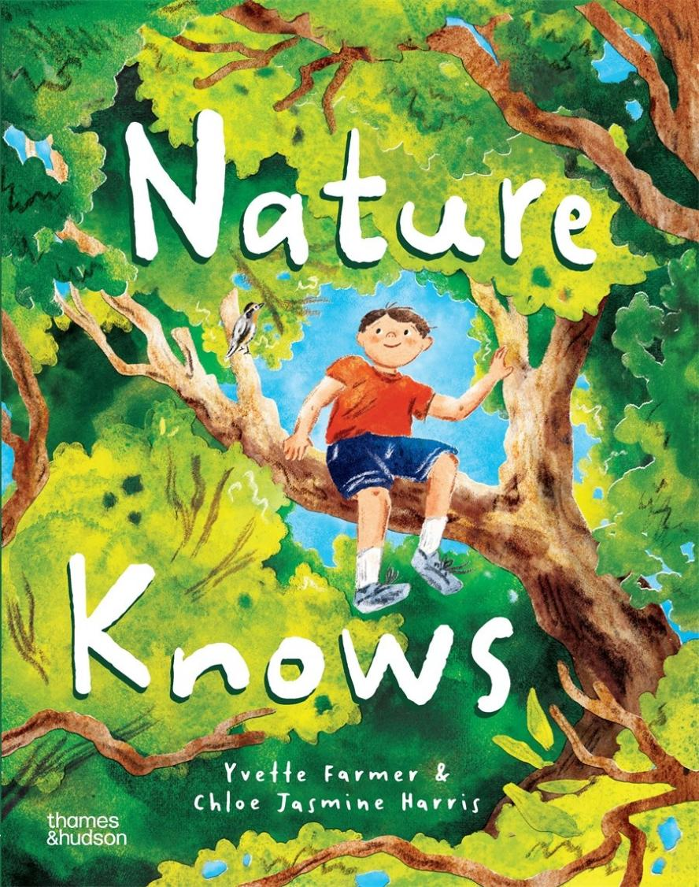

Slide 3

Nature Knows
Yvette Farmer and Chloe Jasmine Harris
A lyrical picture book narrative about escaping the hustle and bustle of everyday life and finding solace in nature.
Journey into the wild and discover what nature knows about calming busy minds and bringing us home to ourselves.
Taps into popular topics around children's wellbeing and nature immersion.
Includes scientific research based on the author’s research into children's wellbeing through nature-based play at the University of Western Sydney.
Features beautiful illustrations by rising talent Chloe Jasmine Harris.
Includes nature activities in the endmatter.
AGES 4-8
AU $26.99 | NZ $32.99
9781760765293
32 Pages
Hardcover
275 mm x 215 mm
Thames & Hudson Aust

Slide 4
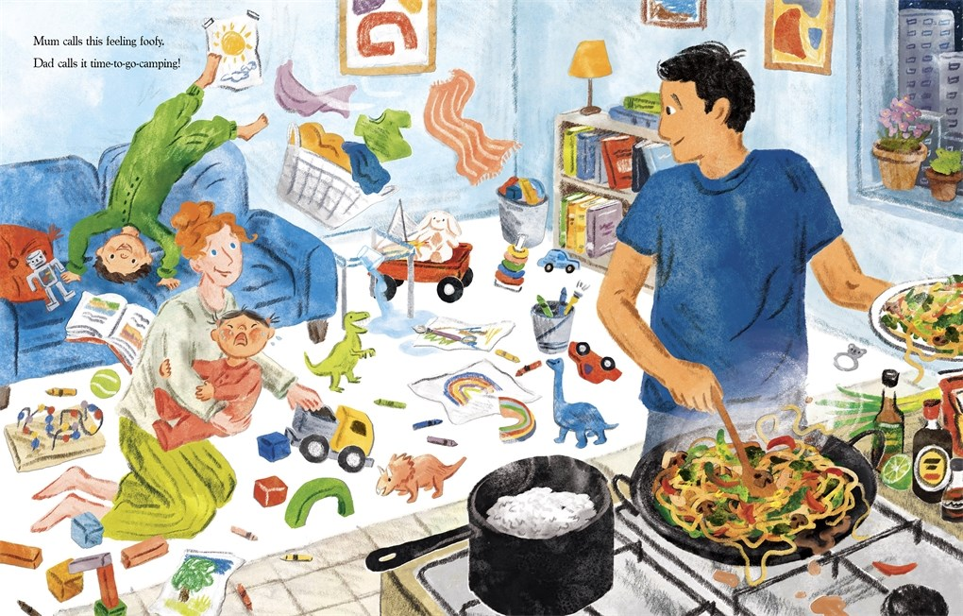

Slide 5
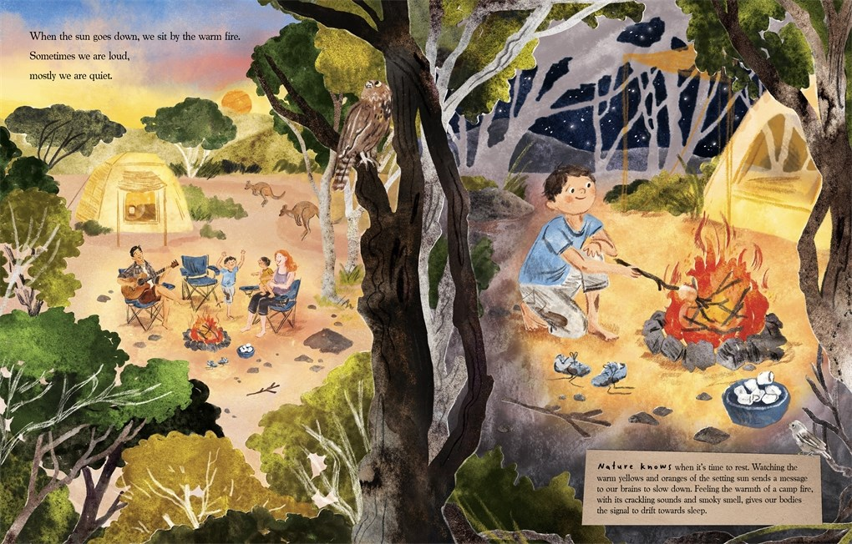

Slide 6
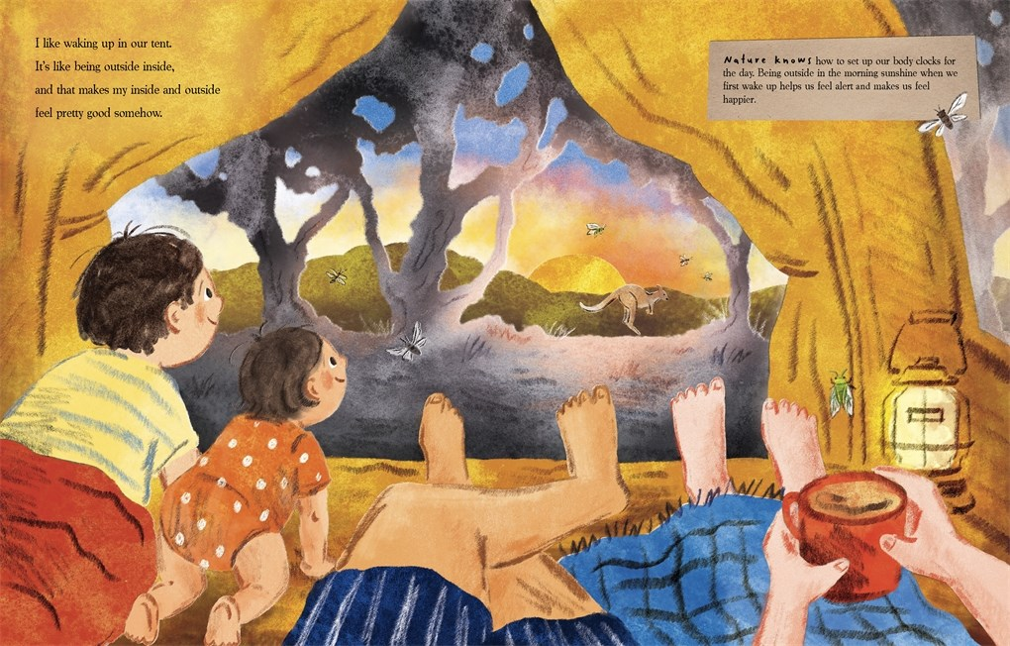

Slide 7
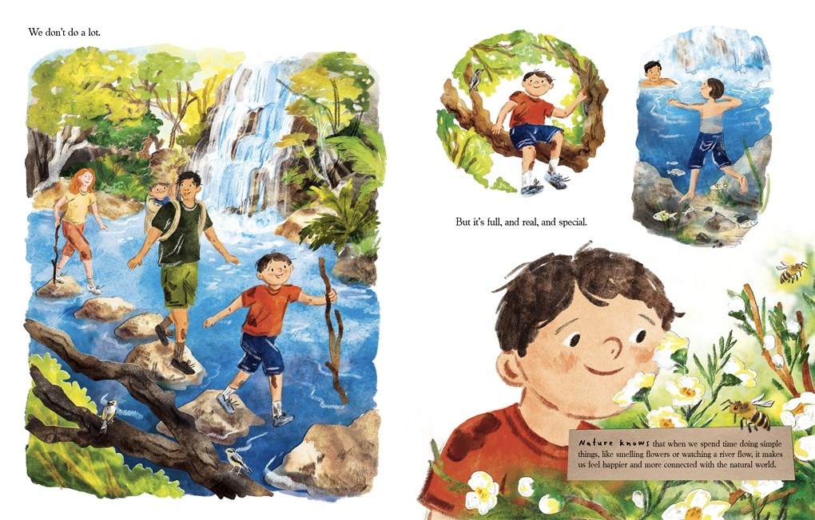

Slide 8
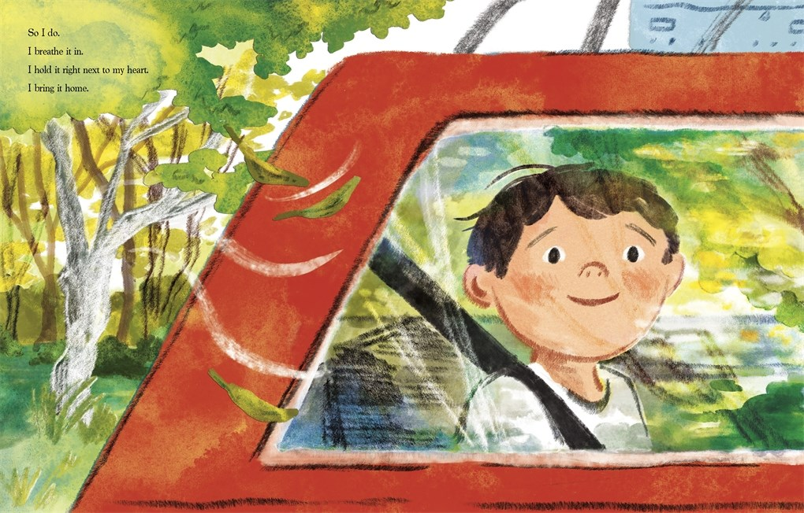

Slide 9
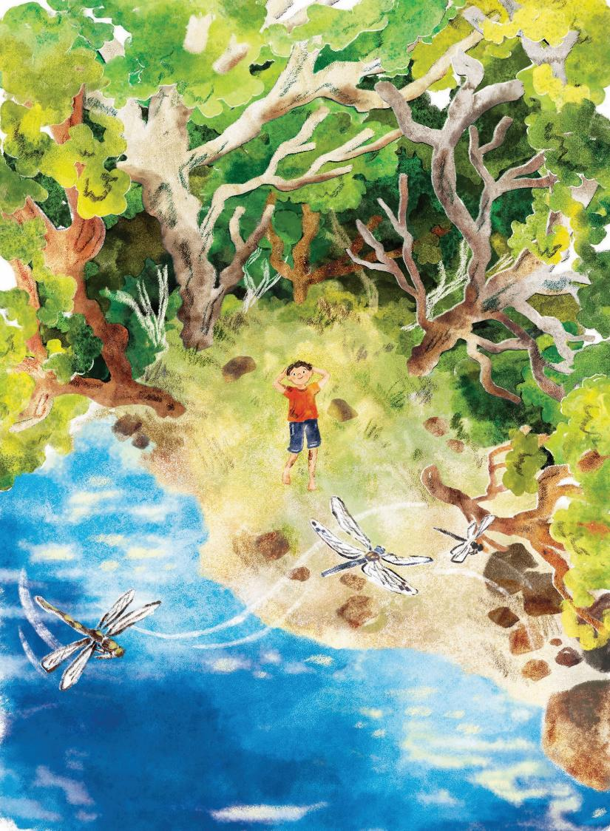
Nature Knows
Yvette Farmer and Chloe Jasmine Harris
KEY INFORMATION
Yvette Farmer is a teacher with a background in psychology and health science. She has taught university classes as well as primary school for many years and also has experience running workshops.
Yvette wrote Nature Knows after a camping trip with her own family. The experience of being in nature, disconnected from the digital world and from roads and shops and bright lights, gave her the space for her own creativity.
Chloe Jasmine Harris is a commercial and children’s illustrator. She loves building intricate worlds, telling stories and playing with movement and colour.
Chloe has illustrated four picture books, two of which, Henry Turnip and Maple the Brave, she both wrote and illustrated.
Yvette is located in Wollongong and Chloe is based in Sydney.
Pictured left: image from Nature Knows

Slide 10


Nature Knows
Yvette Farmer and Chloe Jasmine Harris
PROMOTIONAL CAMPAIGN
CAMPAIGN LEAD: Lucy Inglis – l.inglis@thameshudson.com.au
Pitching angles surrounding how nature benefits children, including mental health, ability to focus, connection to the environment, boosting creativity and fostering teamwork.
Pitching for review and extract in kids' media including Kids’ Book Review, Kids Corner and Magpies Magazine, as well as across kids’ book review sections and weekend supplements.
Pitching Yvette for author profiles across kids’ focused, lifestyle and broad media. Additionally pitching for radio and podcast interviews.
Pitching for story time events and writers festivals.
Pitching for partnerships and collaborations with aligned organisations including Women Want Adventure and Timbernook Sensational Experiences.
Influencer campaign targeting picture book, nature and education influencers.
Decal windows to be designed by the illustrator Chloe Jasmine Harris
Pictured top left: Yvette Farmer, photo credit: Michelle Heldon
Pictured bottom left: Chloe Jasmine Harris

Slide 11
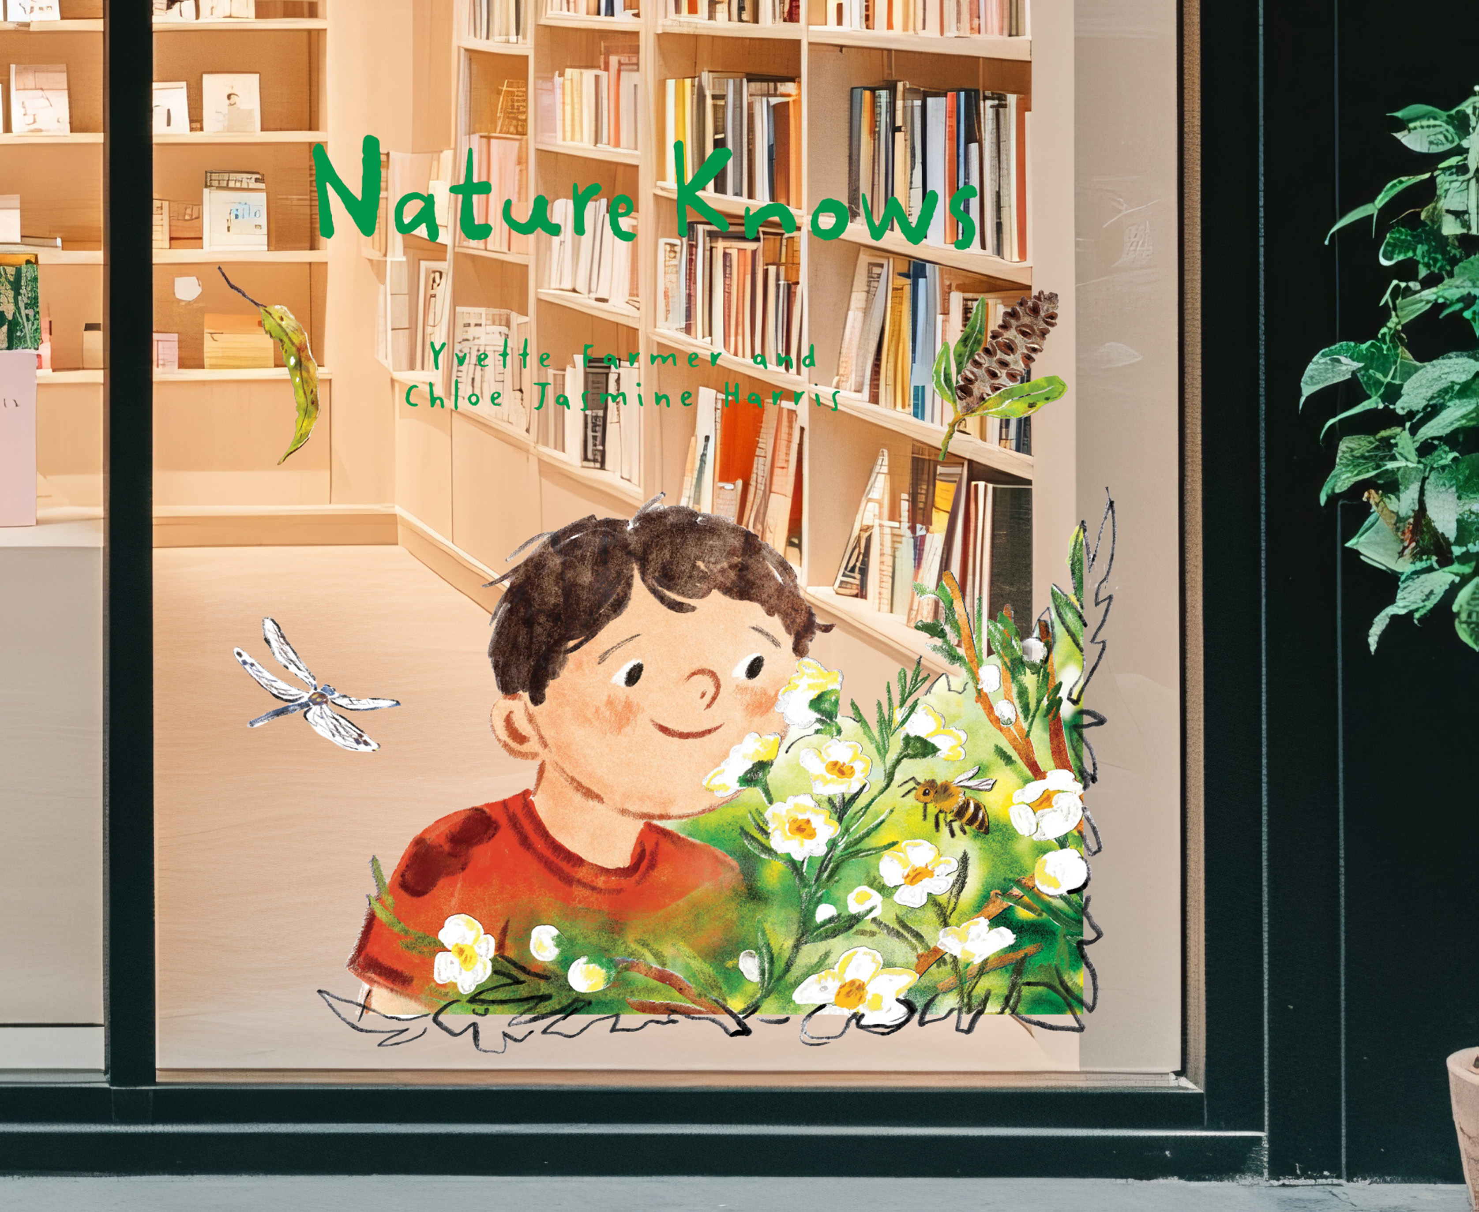
Nature Knows
Yvette Farmer and Chloe Jasmine Harris
POS AVAILABLE
Modular window decal
1.4 m full size
Title and leaves (20x25 cm) and child with flowers
(115x80 cm)
Order via your T&H rep or Rachel: r.chopping@thameshudson.com.au
AU $26.99 | NZ $32.99
9781760765293
32 Pages
Hardcover
275 mm x 215 mm
Thames & Hudson Aust

Slide 12
Nature Knows
Yvette Farmer and Chloe Jasmine Harris
A lyrical picture book narrative about escaping the hustle and bustle of everyday life and finding solace in nature.
Journey into the wild and discover what nature knows about calming busy minds and bringing us home to ourselves.
Taps into popular topics around children's wellbeing and nature immersion.
Includes scientific research based on the author’s research into children's wellbeing through nature-based play at the University of Western Sydney.
Features beautiful illustrations by rising talent Chloe Jasmine Harris.
Includes nature activities in the endmatter.
AGES 4-8
AU $26.99 | NZ $32.99
9781760765293
32 Pages
Hardcover
275 mm x 215 mm
Thames & Hudson Aust

Slide 13
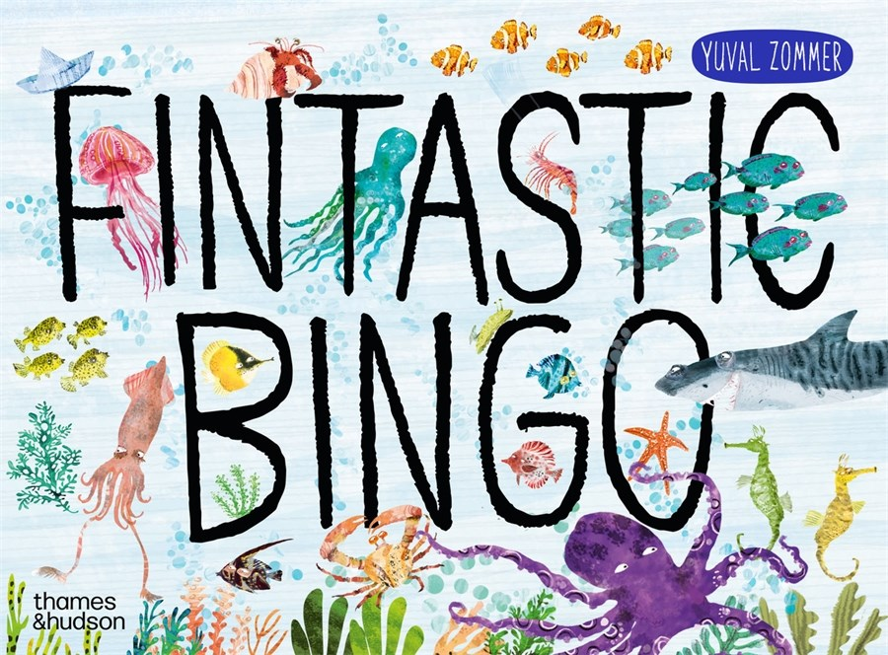

Slide 14
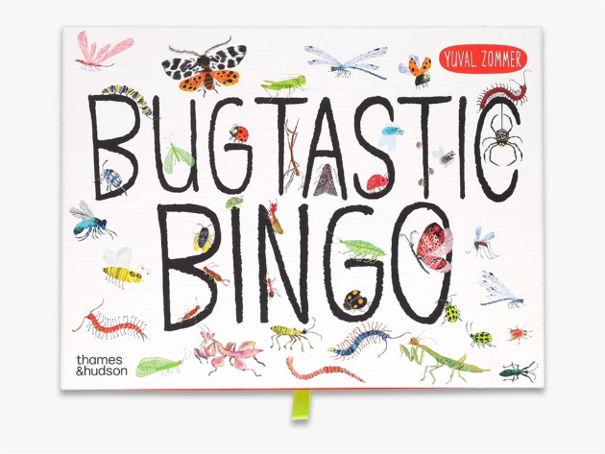
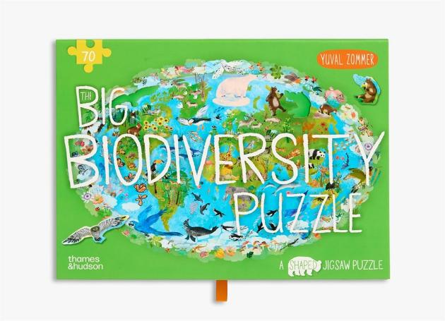
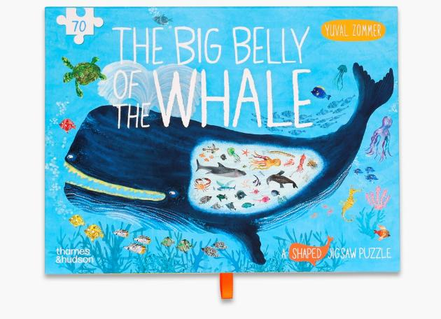
ALSO AVAILABLE
9780500421123
9780500421147
9780500421116

Slide 15
Fintastic Bingo
A GAME FOR ALL AGES
Yuval Zommer
Fintastic Bingo plunges the family-favourite game into the deep sea, featuring forty-eight shimmery and surprising sea creatures by Yuval Zommer.
Discover the fintastic creatures of the ocean as you excitedly wait to shout 'Bingo!' You may be familiar with the turtle, seal and clownfish, but can you spot the mandarin dragonet, narwhal and gulper eel? Open the box to reveal a game board, six doublesided player cards, forty-eight sea creature tokens, 120 shell counters and a booklet filled with claw-some facts.
Do you know why a seahorse has two skeletons? Or why a female anglerfish has a light bulb hanging from her head? Or exactly how big a blue whale is? Learn the answers to these questions and much more while you play.
Fintastic Bingo is the follow-up to Bugtastic Bingo, and features Yuval Zommer's much-loved sea illustrations.
AGES 4-8
AU $36.99 | NZ $39.99
9780500421130
12 Pages
Jigsaw Puzzle
288 mm x 216 mm
Thames and Hudson Ltd

Slide 16
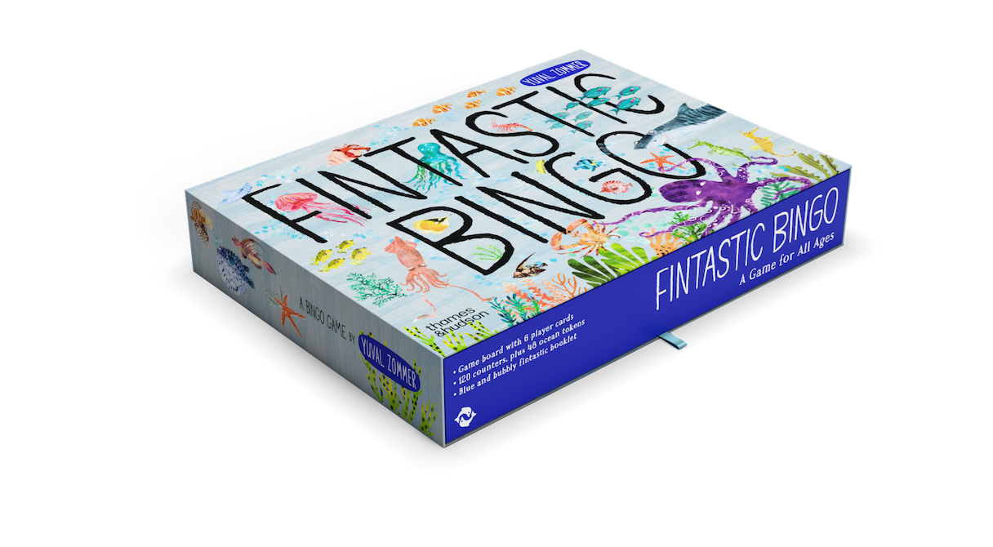

Slide 17
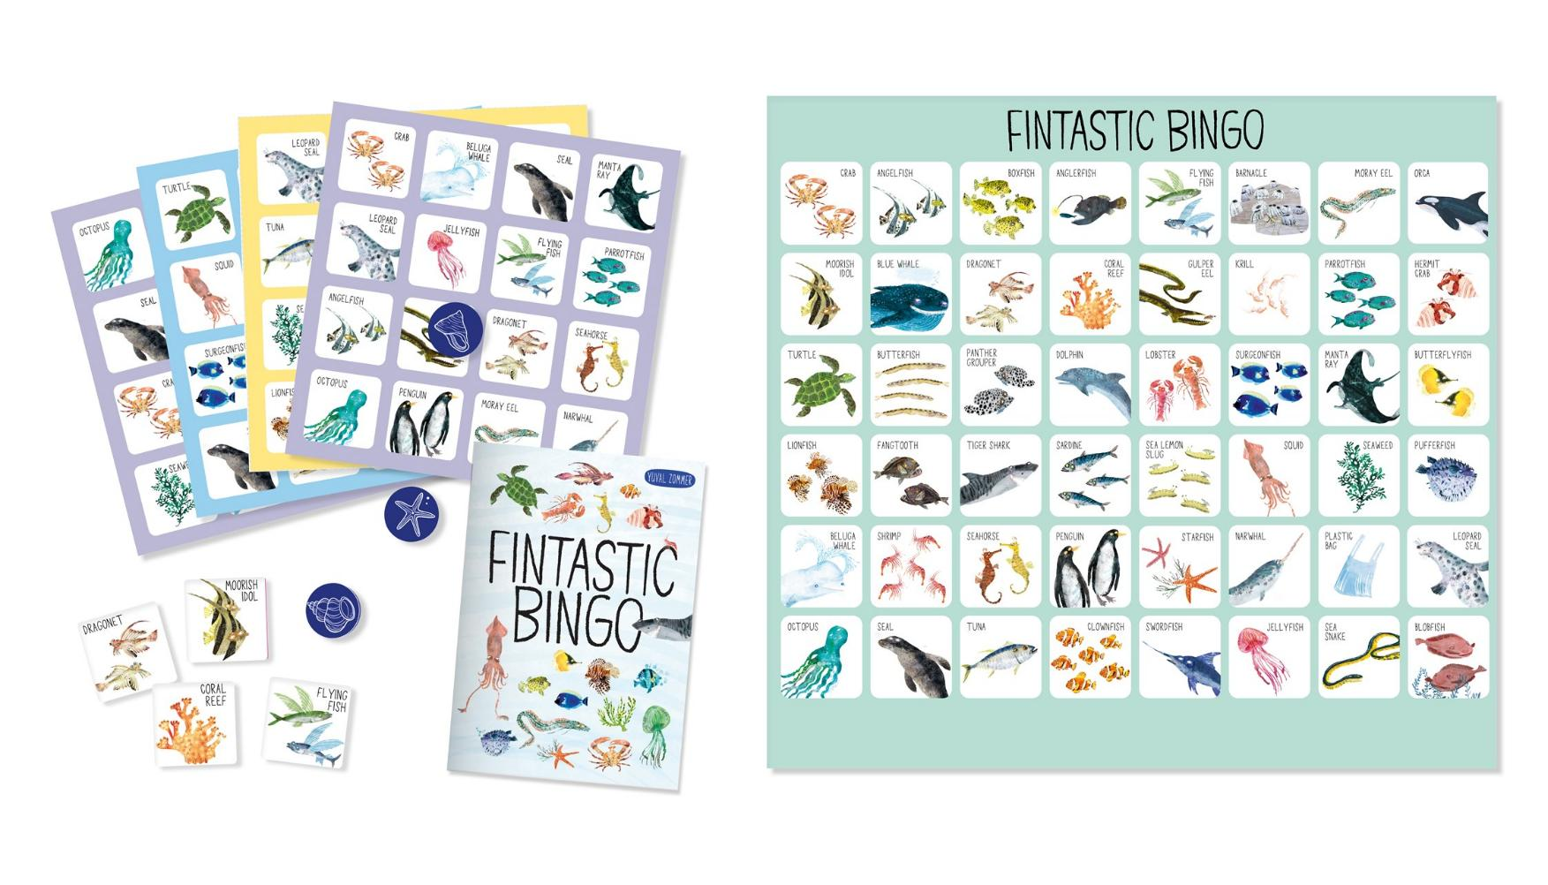

Slide 18
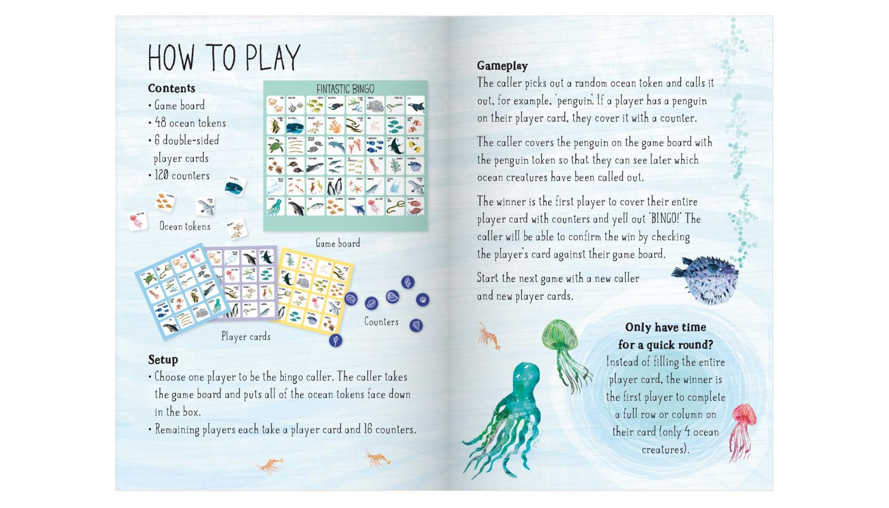

Slide 19
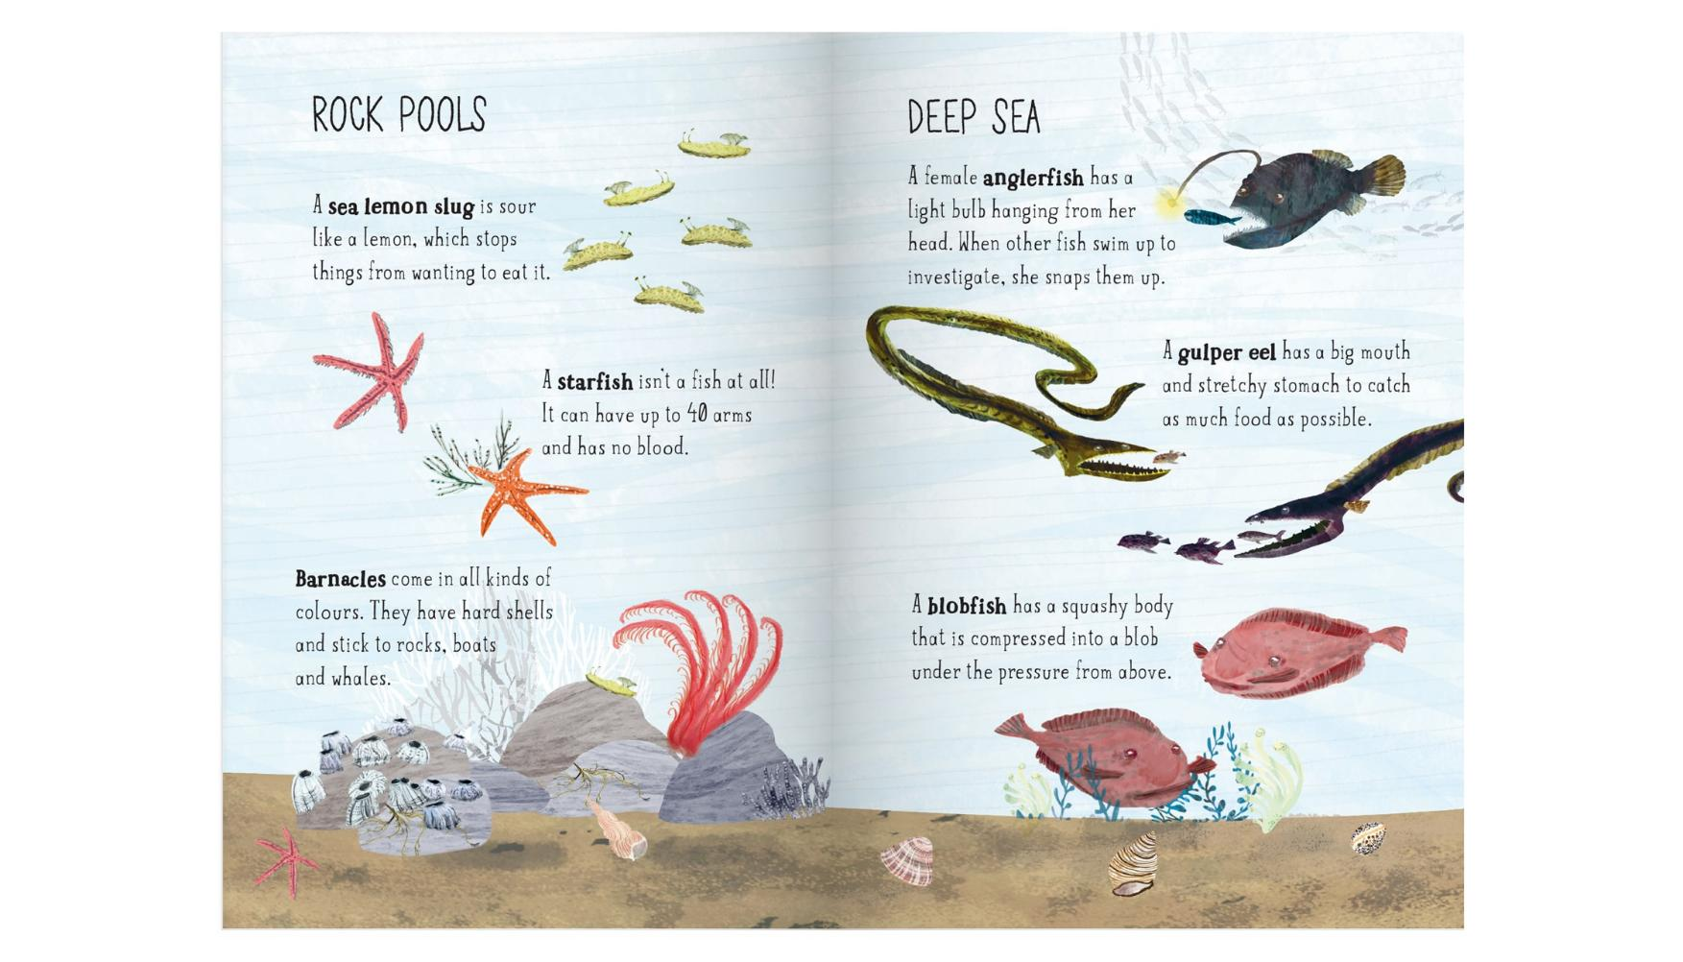

Slide 20
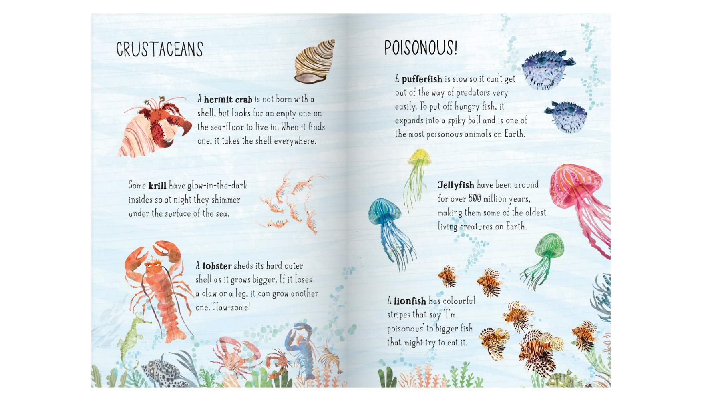

Slide 21
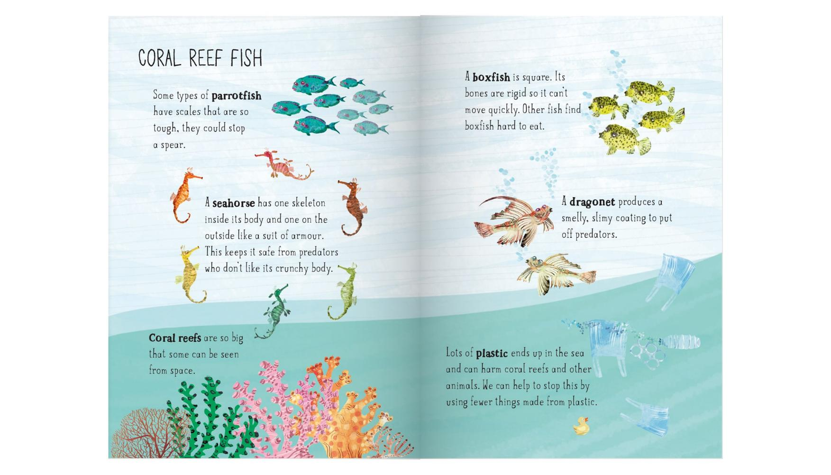

Slide 22
Fintastic Bingo
A GAME FOR ALL AGES
Yuval Zommer
Fintastic Bingo plunges the family-favourite game into the deep sea, featuring forty-eight shimmery and surprising sea creatures by Yuval Zommer.
Discover the fintastic creatures of the ocean as you excitedly wait to shout 'Bingo!' You may be familiar with the turtle, seal and clownfish, but can you spot the mandarin dragonet, narwhal and gulper eel? Open the box to reveal a game board, six doublesided player cards, forty-eight sea creature tokens, 120 shell counters and a booklet filled with claw-some facts.
Do you know why a seahorse has two skeletons? Or why a female anglerfish has a light bulb hanging from her head? Or exactly how big a blue whale is? Learn the answers to these questions and much more while you play.
Fintastic Bingo is the follow-up to Bugtastic Bingo, and features Yuval Zommer's much-loved sea illustrations.
AGES 4-8
AU $36.99 | NZ $39.99
9780500421130
12 Pages
Jigsaw Puzzle
288 mm x 216 mm
Thames and Hudson Ltd

Slide 23
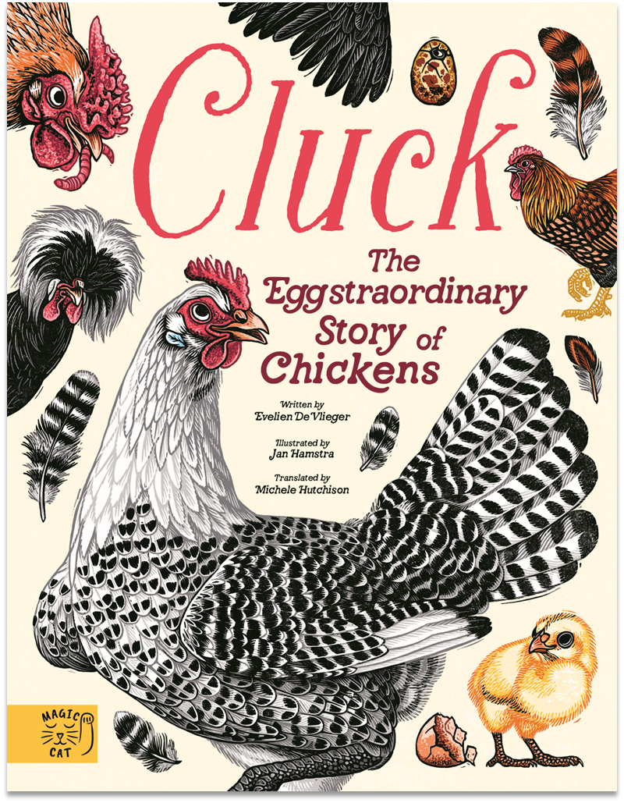

Slide 24
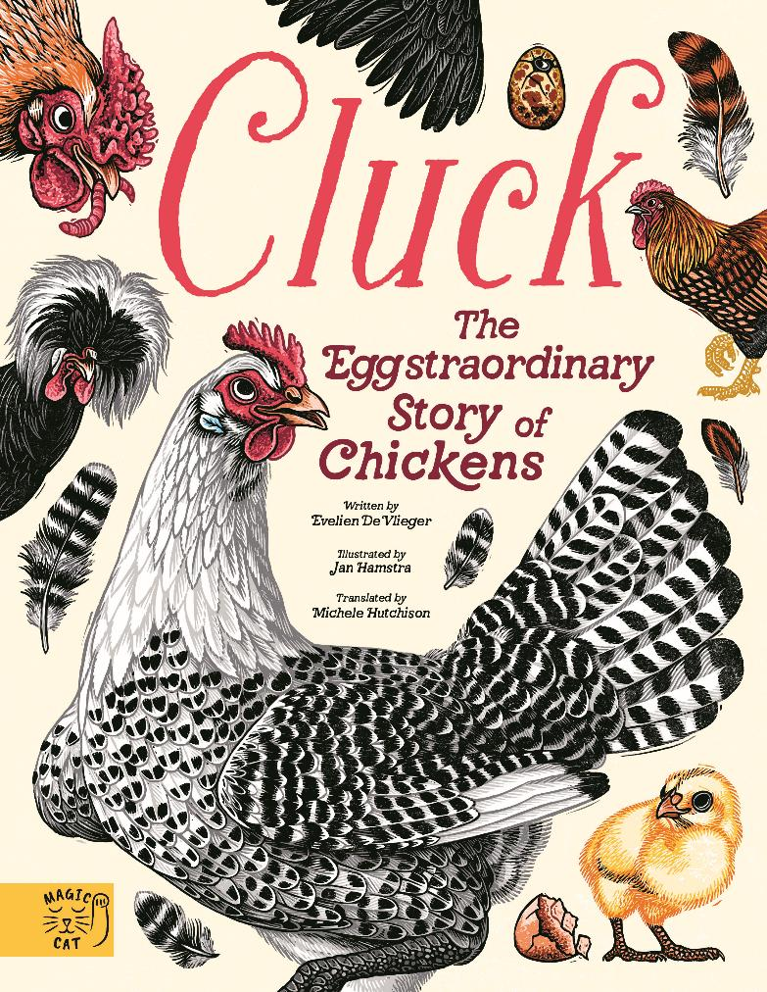
Cluck!
THE EGGSTRAORDINARY STORY OF CHICKENS
Evelien De Vlieger and Jan Hamstra
A quirky book that tells the eggstraordinary story of chickens - from their dinosaur origins to their anatomy, history and behaviours - presented as a beautifully illustrated gift edition.
This comprehensive handbook is the ideal guide for budding ornithologists and keepers of garden flocks.
Fully illustrated throughout, Cluck! invites young readers (and their grown-ups) on an engaging journey to discover the fascinating world of chickens.
Explore the wide variety of chicken breeds, uncover how they think and feel, learn the terminology for their anatomy, delve into their history and find out which types of eggs different breeds lay. You'll also discover how to 'speak chicken', along with tips on handling and caring for these characterful birds.
With lively, playful text and intricate, colourful linocut illustrations, this visual encyclopaedia celebrates chickens in all their feathered glory.
AGES 7-12
AU $34.99 | NZ $39.99
9781917366588
80 Pages
Hardcover
270 mm x 210 mm
Magic Cat Publishing

Slide 25
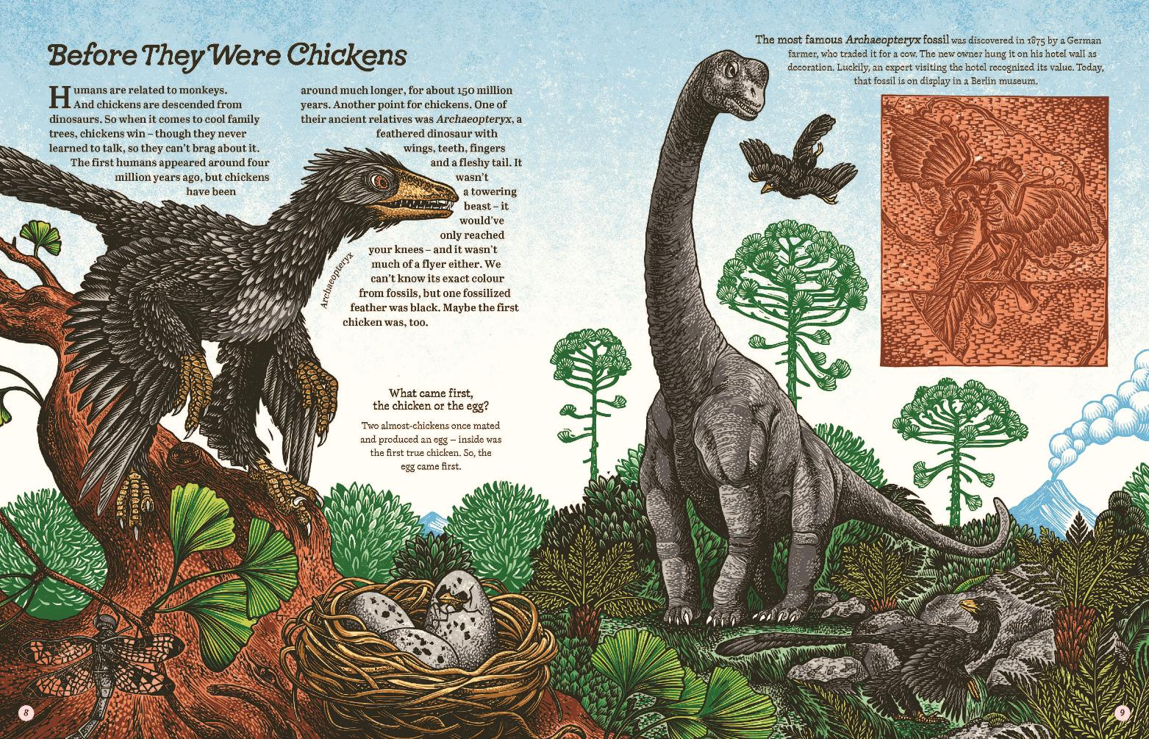

Slide 26
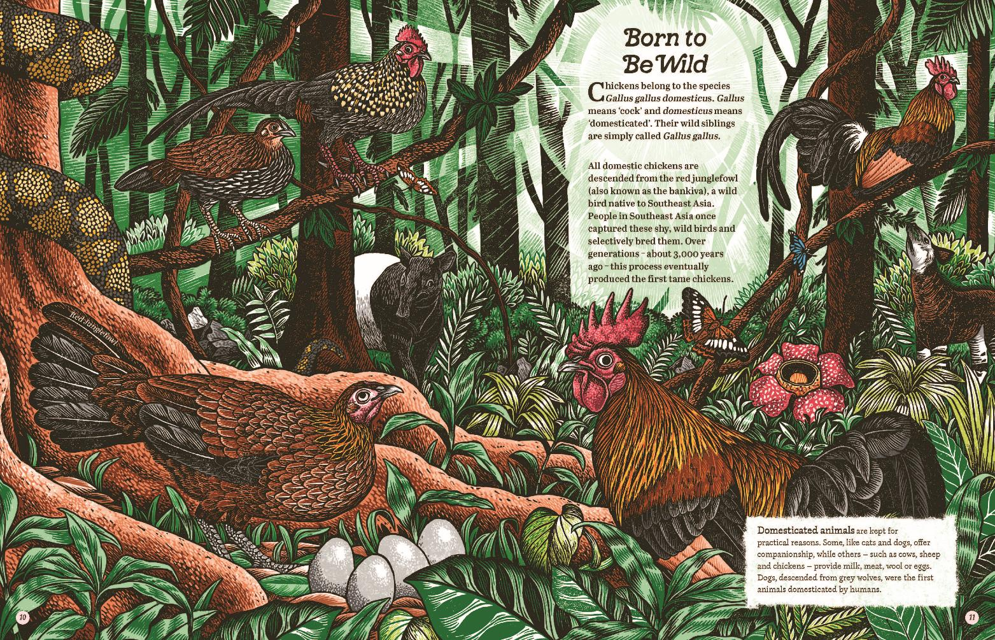

Slide 27
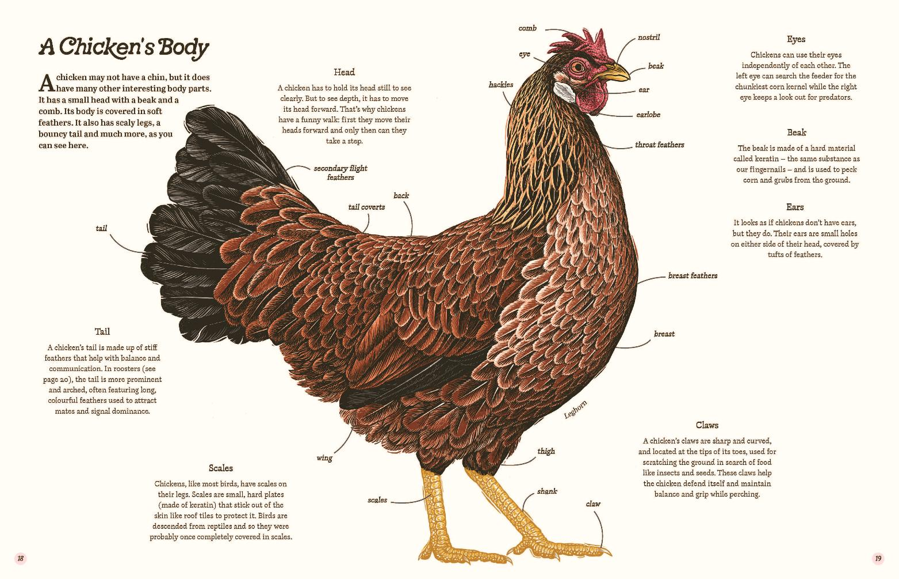

Slide 28
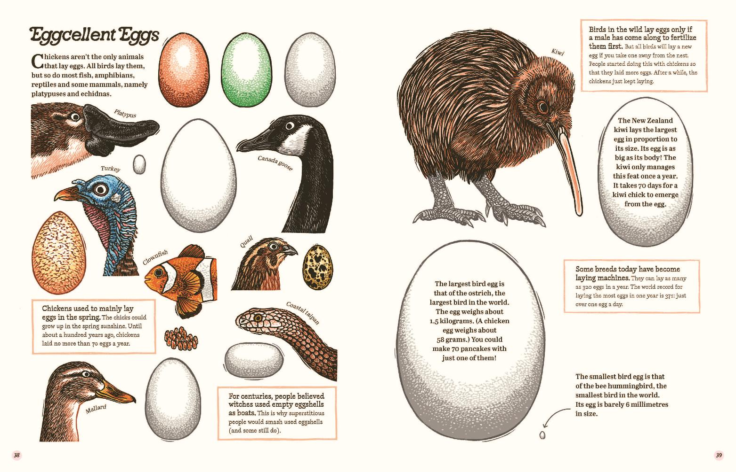

Slide 29
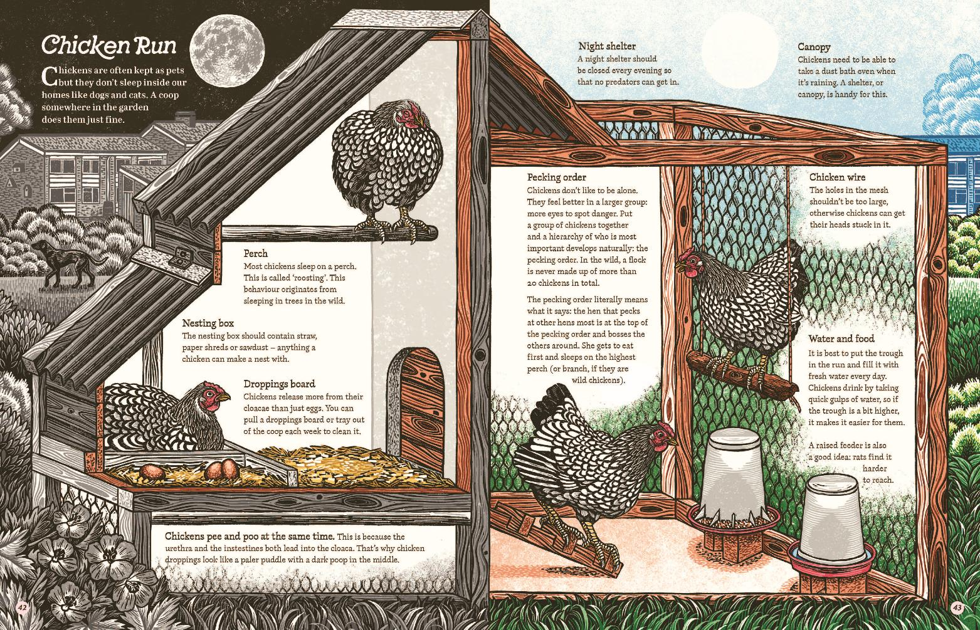

Slide 30
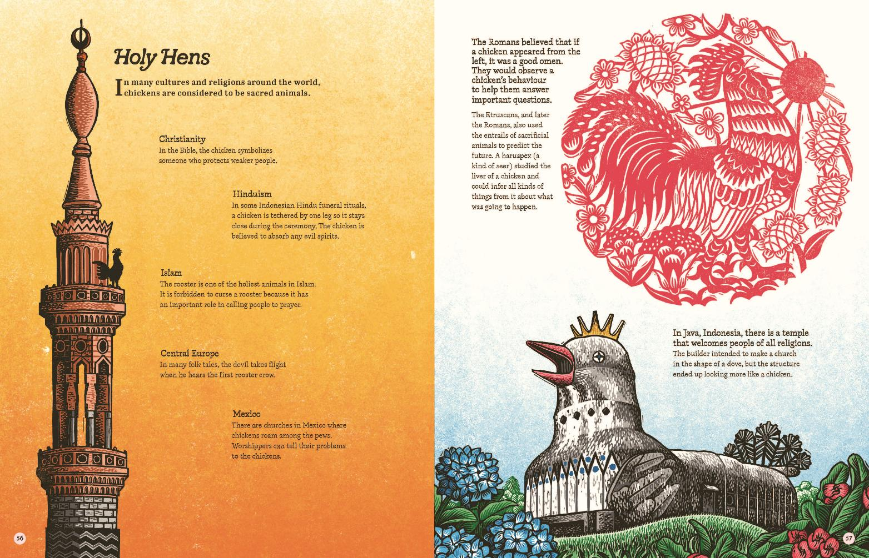

Slide 31
Cluck!
THE EGGSTRAORDINARY STORY OF CHICKENS
Evelien De Vlieger and Jan Hamstra
A quirky book that tells the eggstraordinary story of chickens - from their dinosaur origins to their anatomy, history and behaviours - presented as a beautifully illustrated gift edition.
This comprehensive handbook is the ideal guide for budding ornithologists and keepers of garden flocks.
Fully illustrated throughout, Cluck! invites young readers (and their grown-ups) on an engaging journey to discover the fascinating world of chickens.
Explore the wide variety of chicken breeds, uncover how they think and feel, learn the terminology for their anatomy, delve into their history and find out which types of eggs different breeds lay. You'll also discover how to 'speak chicken', along with tips on handling and caring for these characterful birds.
With lively, playful text and intricate, colourful linocut illustrations, this visual encyclopaedia celebrates chickens in all their feathered glory.
AGES 7-12
AU $34.99 | NZ $39.99
9781917366588
80 Pages
Hardcover
270 mm x 210 mm
Magic Cat Publishing

Slide 32
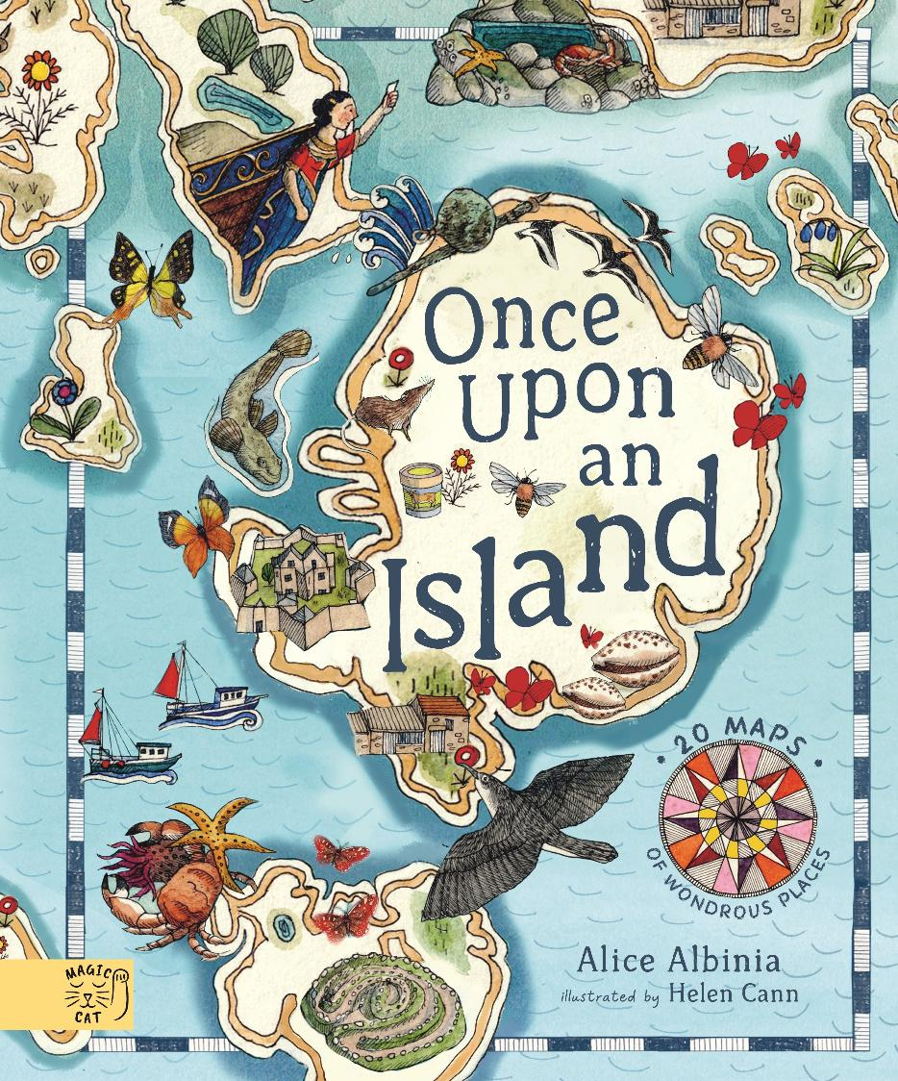

Slide 33

Once Upon An Island
AN ATLAS OF ISLANDS FROM AROUND THE WORLD
Alice Albinia
Award-winning historian Alice Albinia takes readers on a journey across oceans and centuries, uncovering the secrets of 20 fascinating islands - each vividly brought to life through first-hand stories and illustrated maps.
Discover 20 wondrous islands - from the rugged landscape of the Orkney islands that people of the Stone Age once called home, to the sunny coasts of the Isles of Scilly. This captivating journey reveals islands as places of wonder and warning, rich with histories that have shaped the world far beyond their shores.
Perfect for curious explorers, map lovers and anyone enchanted by the magic of faraway places, Once Upon an Island is an unforgettable voyage through geography, history and story.
Featuring first person narratives and read-aloud maps, all brought to life with beautiful illustrations by Helen Cann. Fully checked and approved by the Indigenous editors association.
AGES 7-12
AU $37.99 | NZ $39.99
9781917044349
64 Pages
Hardcover
310 mm x 256 mm
Magic Cat Publishing

Slide 34
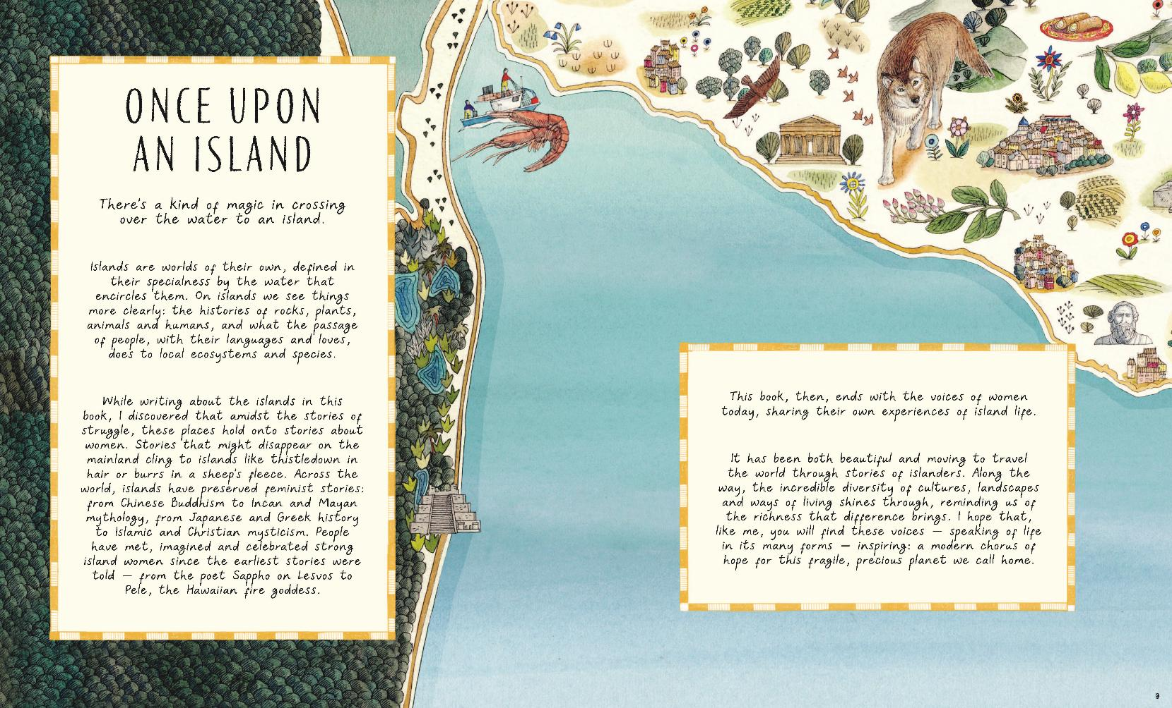

Slide 35
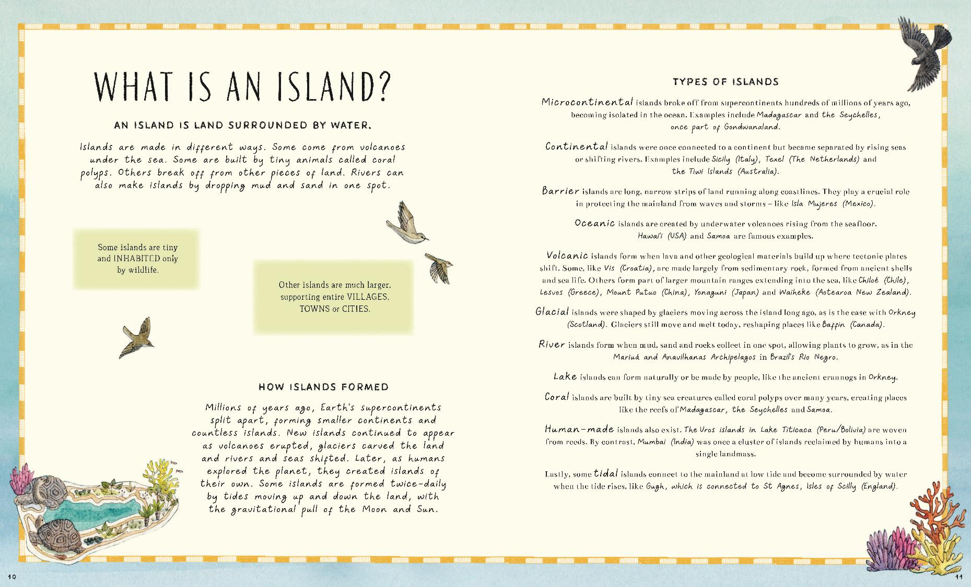

Slide 36
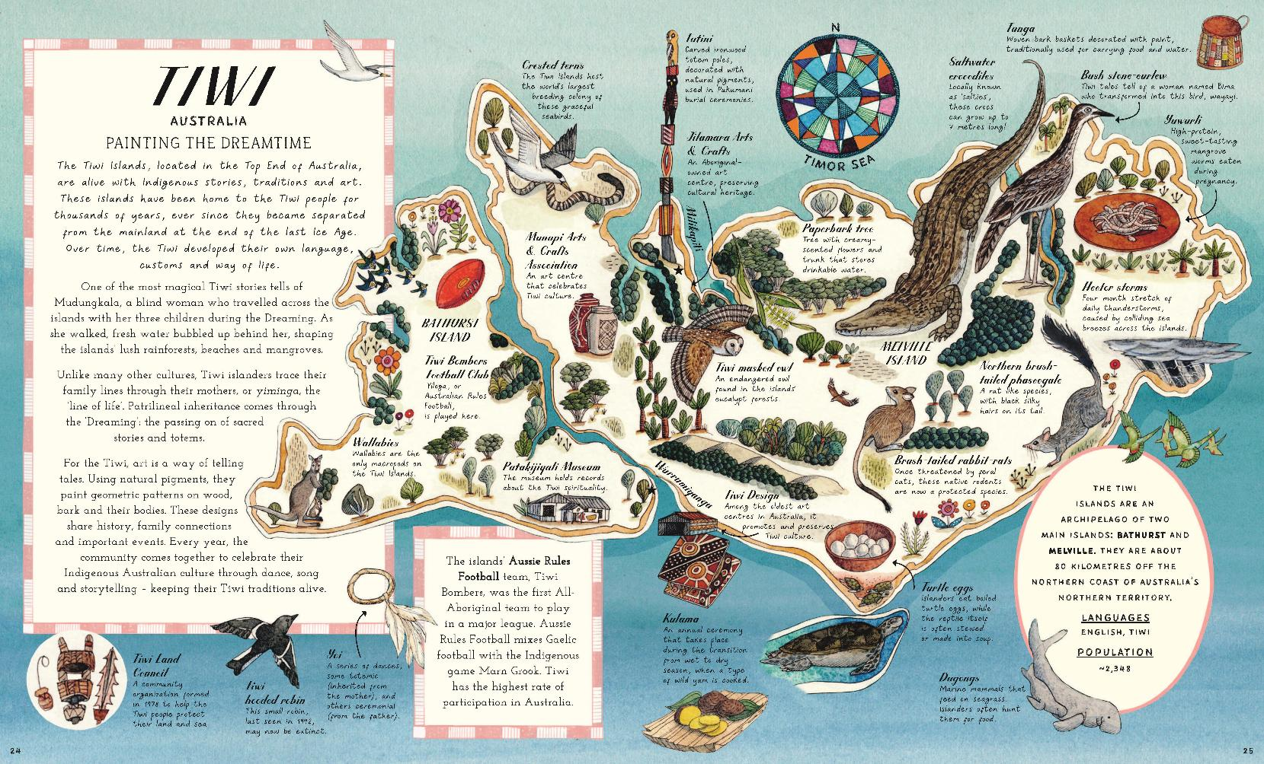

Slide 37
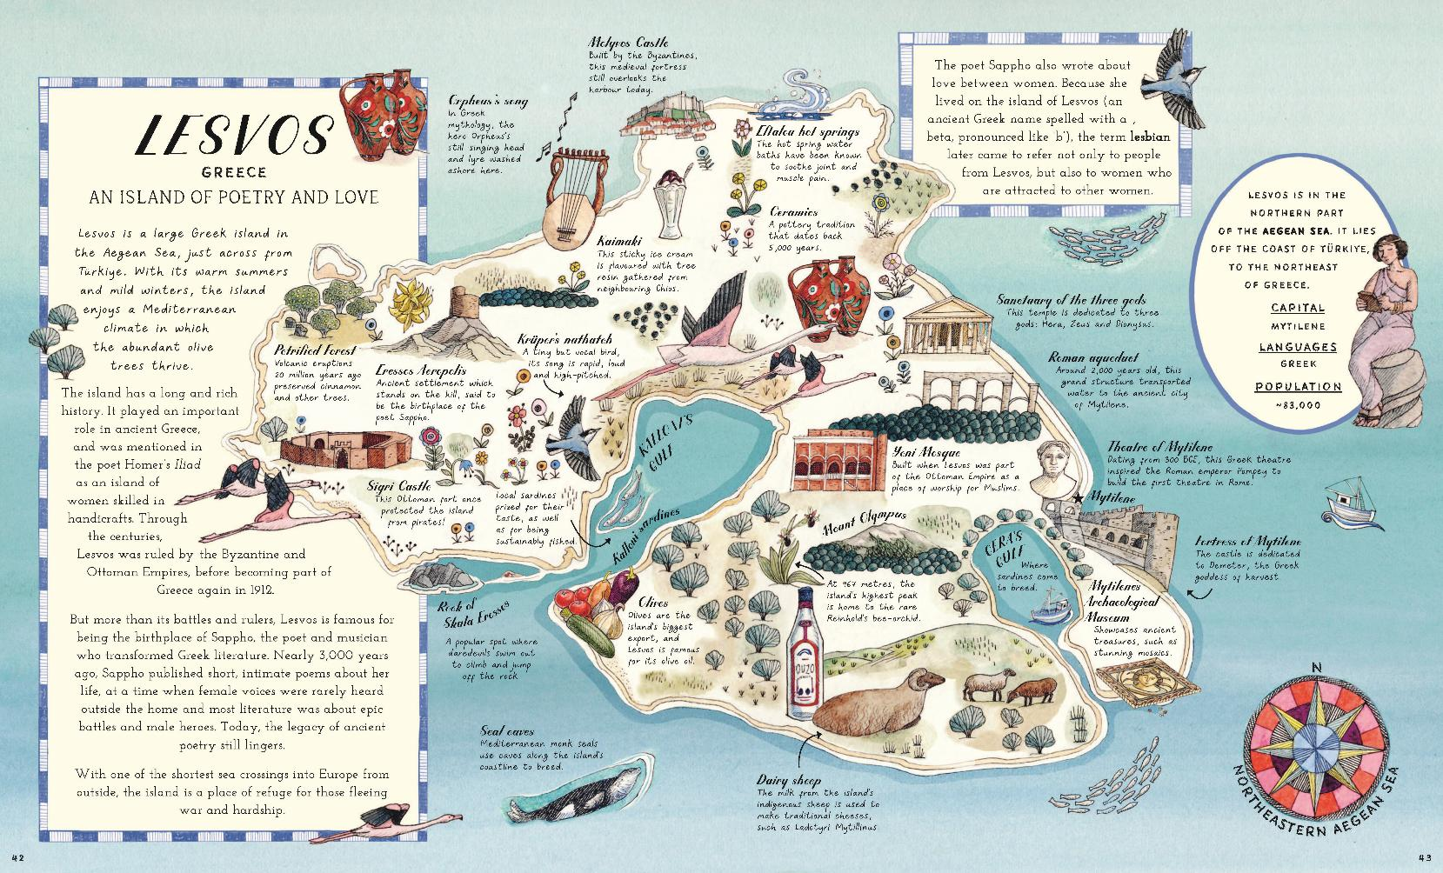

Slide 38
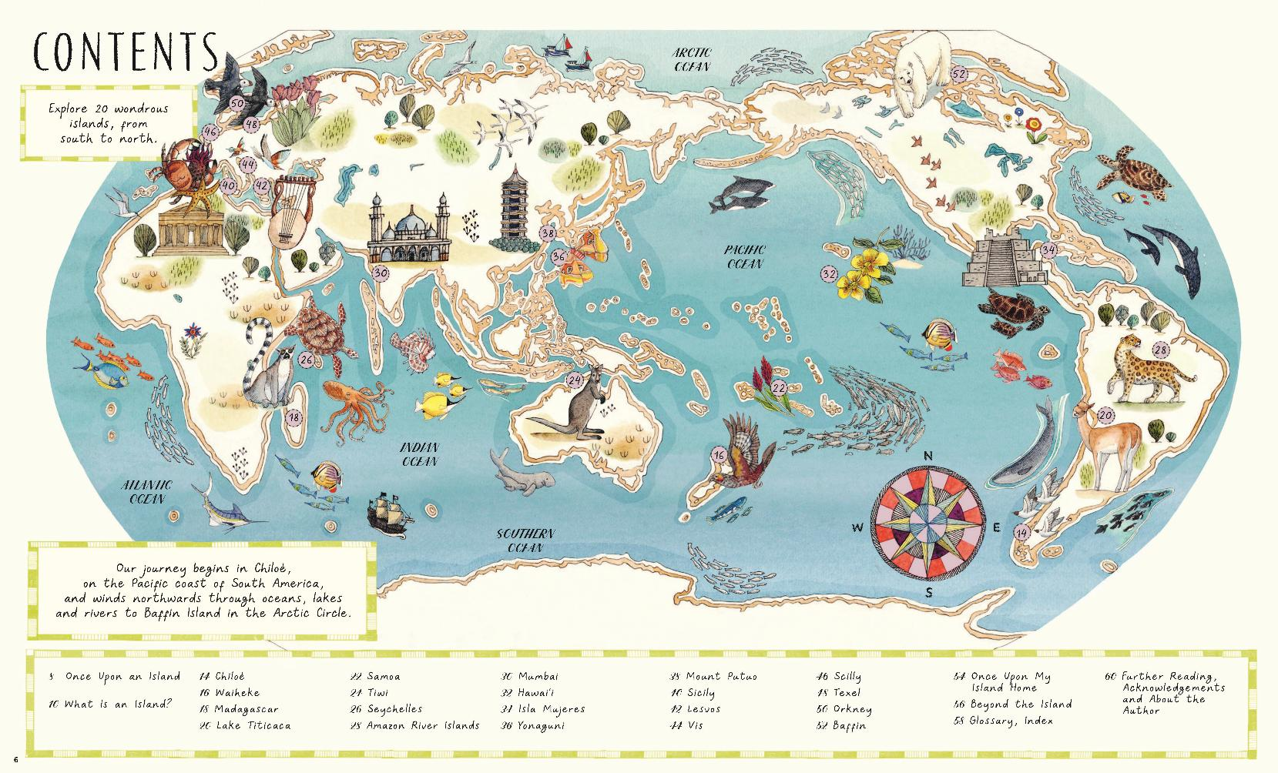

Slide 39
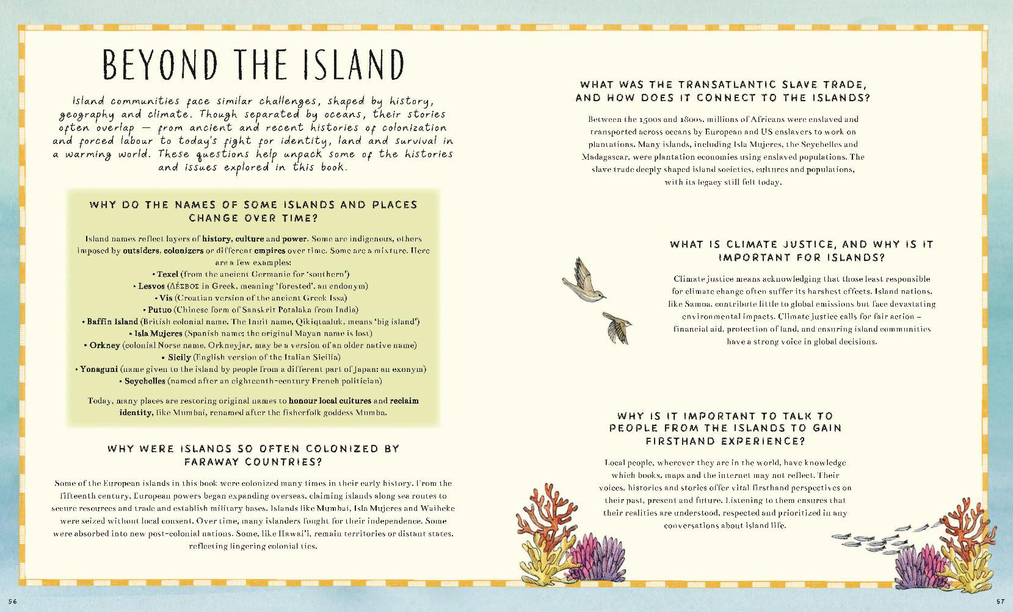

Slide 40
Once Upon An Island
AN ATLAS OF ISLANDS FROM AROUND THE WORLD
Alice Albinia
Award-winning historian Alice Albinia takes readers on a journey across oceans and centuries, uncovering the secrets of 20 fascinating islands - each vividly brought to life through first-hand stories and illustrated maps.
Discover 20 wondrous islands - from the rugged landscape of the Orkney islands that people of the Stone Age once called home, to the sunny coasts of the Isles of Scilly. This captivating journey reveals islands as places of wonder and warning, rich with histories that have shaped the world far beyond their shores.
Perfect for curious explorers, map lovers and anyone enchanted by the magic of faraway places, Once Upon an Island is an unforgettable voyage through geography, history and story.
Featuring first person narratives and read-aloud maps, all brought to life with beautiful illustrations by Helen Cann. Fully checked and approved by the Indigenous editors association.
AGES 7-12
AU $37.99 | NZ $39.99
9781917044349
64 Pages
Hardcover
310 mm x 256 mm
Magic Cat Publishing

Slide 41
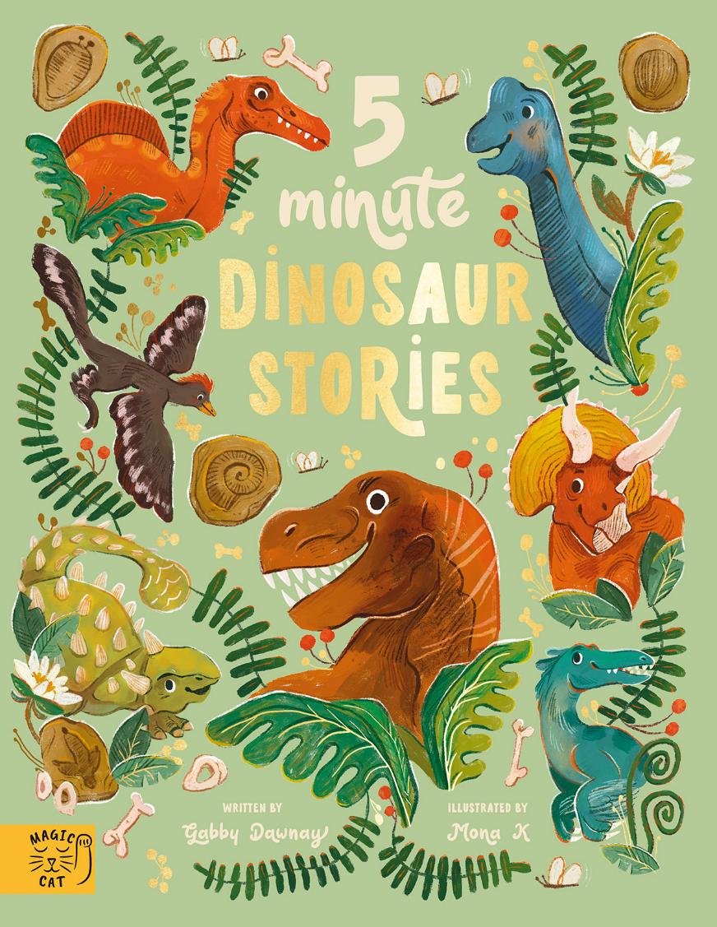

Slide 42

5 Minute Dinosaur Stories
Gabby Dawnay
Explore the prehistoric world with this lavish read-aloud collection of non-fiction stories.
Each read-aloud, 5-minute rhyming story tells the tale of a different dinosaur; from flighty and feathered Anchiornis to lumbering giant Brachiosaurus.
Nine stories include:
- The very FIRST dinosaur
- Slow, spiky STEGOSAURUS
- BRACHIOSAURUS is tallest of all
- ANCHIORNIS soars on high
- Swamp-dwelling SPINOSAURUS
- Killer-clawed VELOCIRAPTOR
- King TYRANNOSAURUS REX
- Three-horned TRICERATOPS
- Club-wielding ANKYLOSAURUS
At the end of each story, explore an informative 'all about' page and learn further information about dinosaurs.
Written by science writer and poet Gabby Dawnay, this is a gorgeously illustrated gift to inform and delight the youngest dinosaur fans.
AGES 4-7
AU $34.99| NZ $39.99
9781917366267
96 Pages
Hardcover
270 mm x 210 mm
Magic Cat Publishing

Slide 43
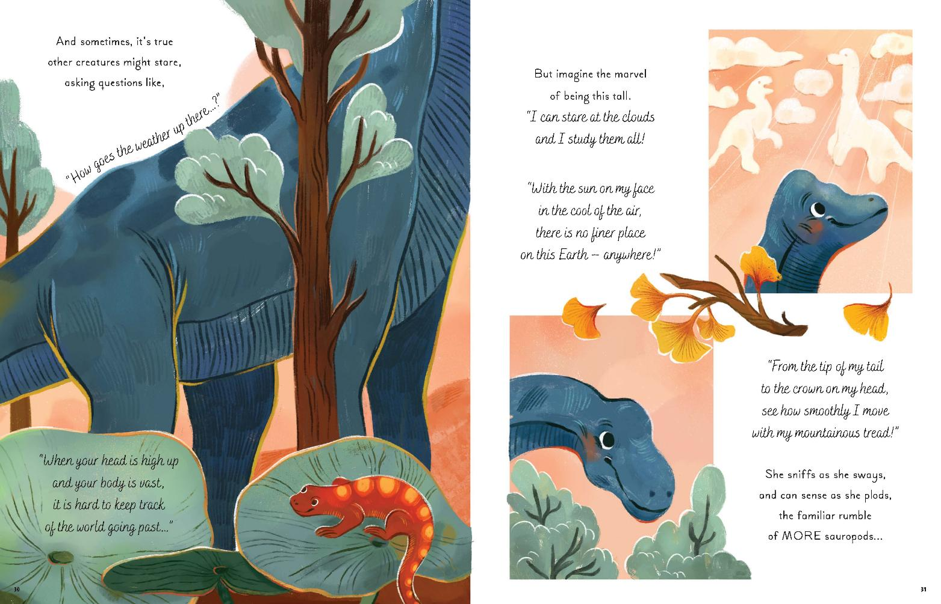

Slide 44
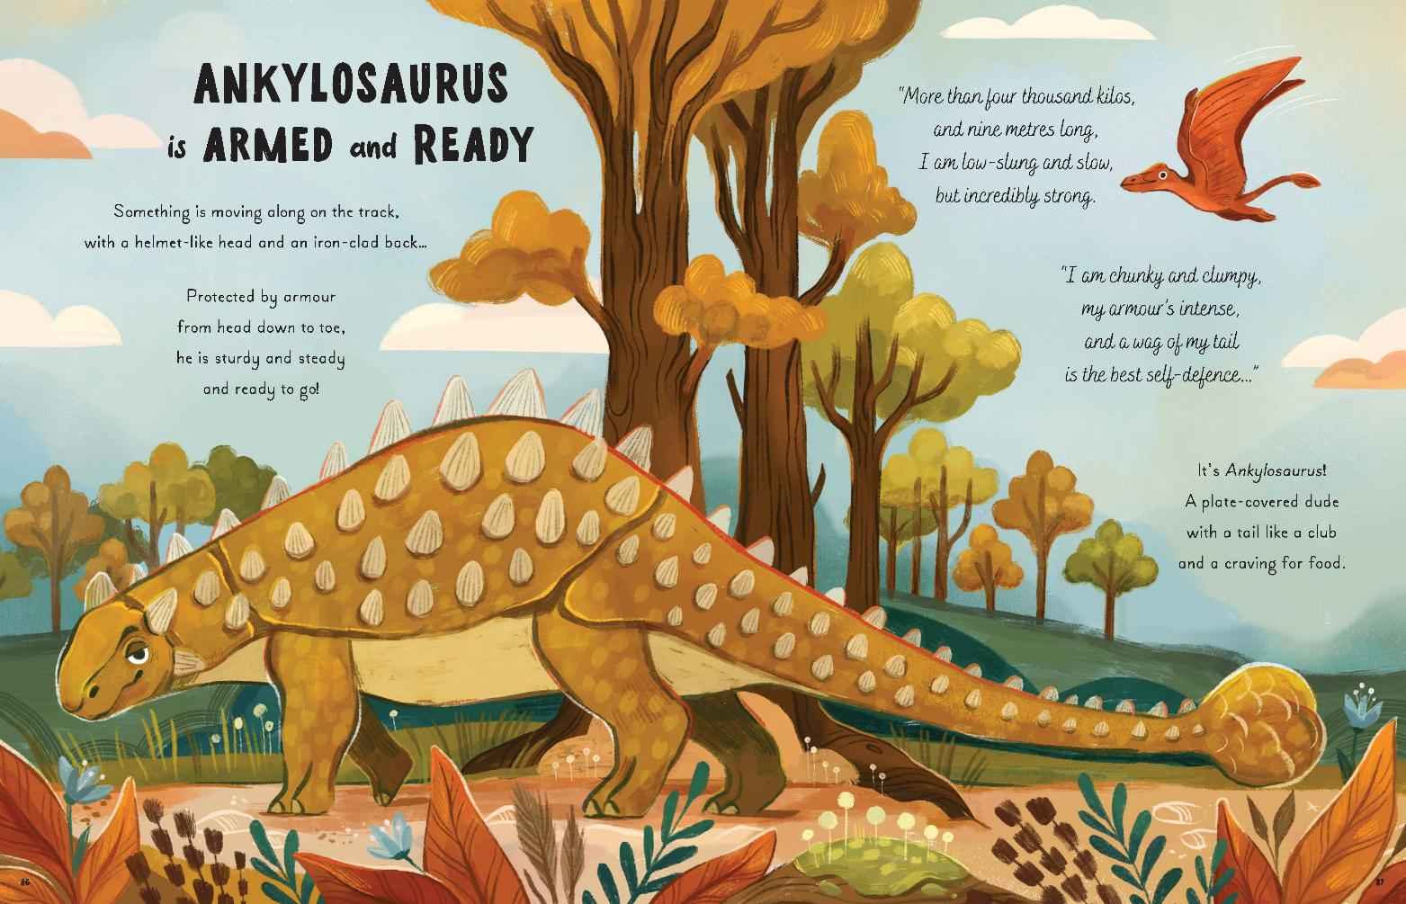

Slide 45
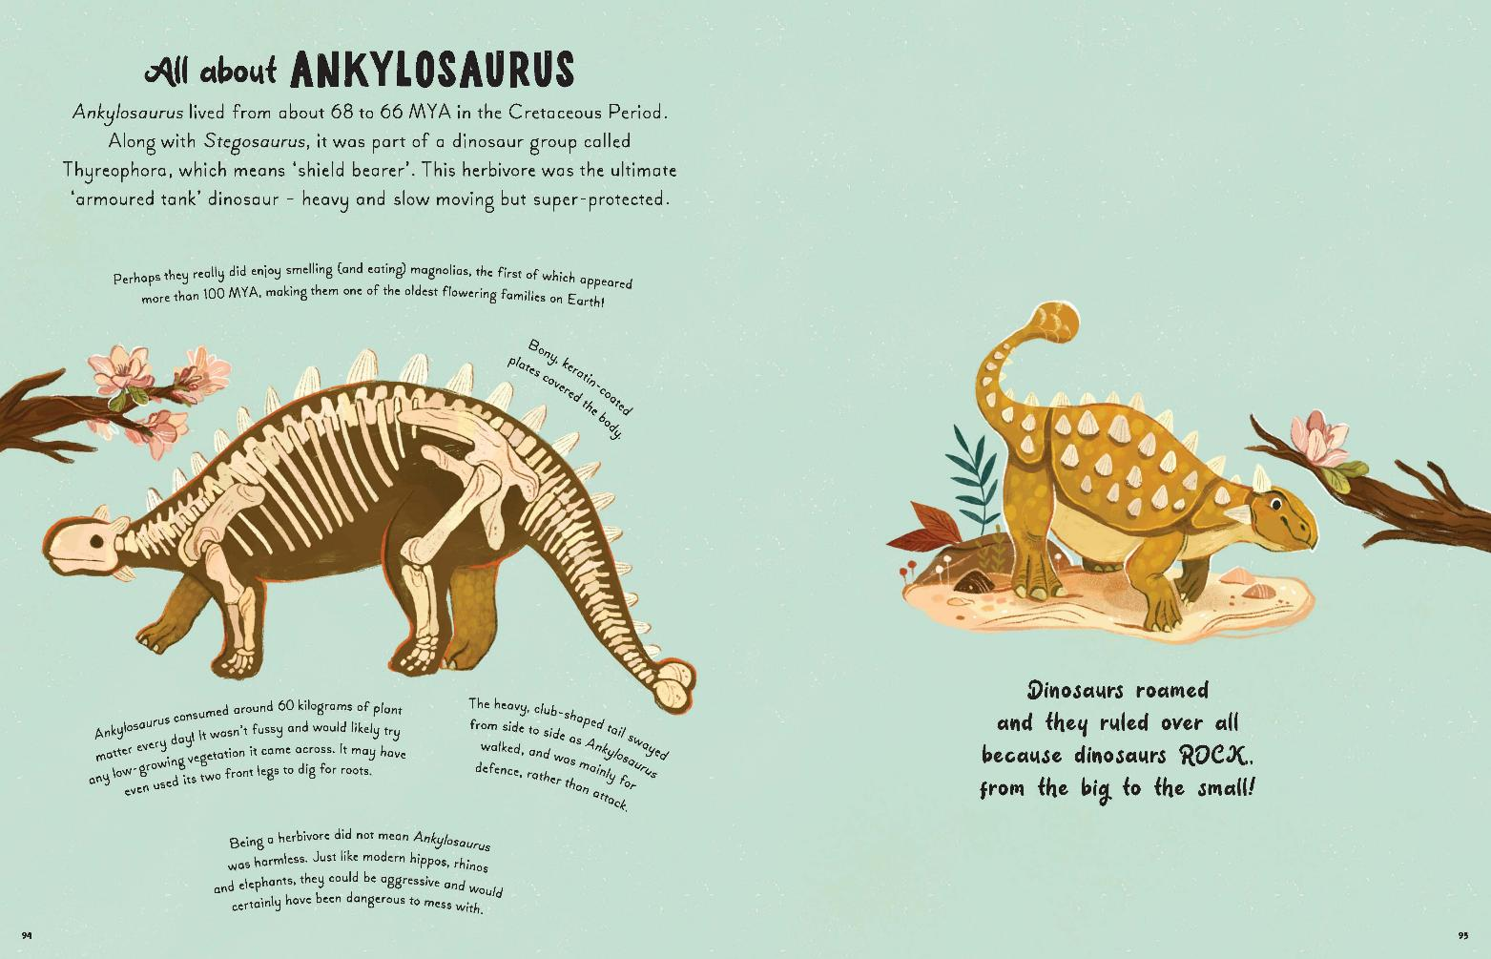

Slide 46
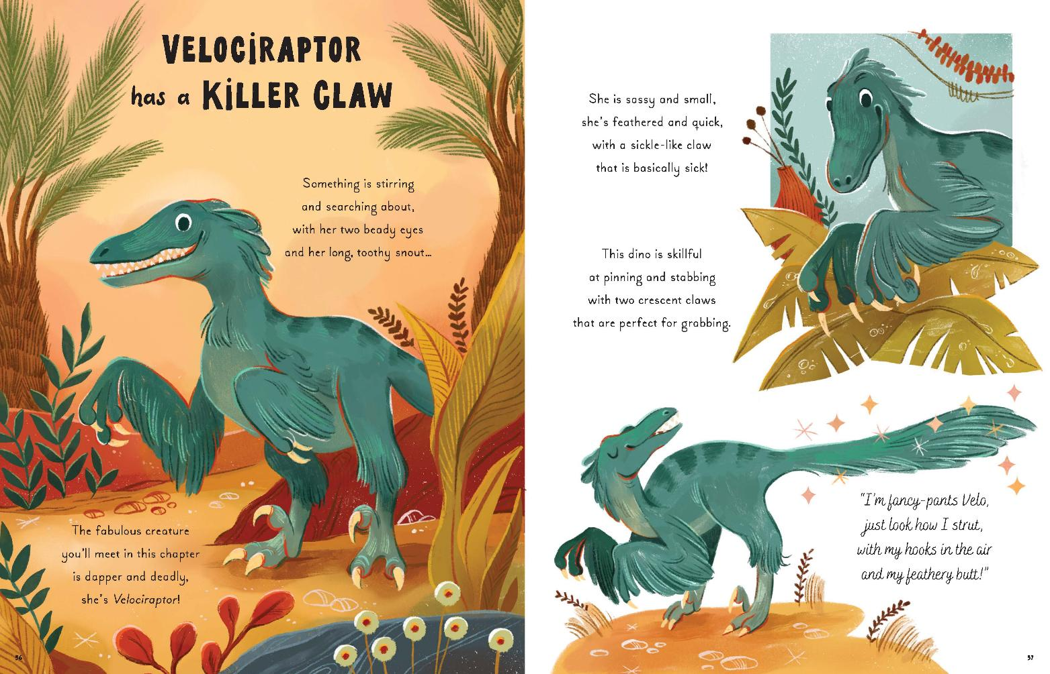

Slide 47
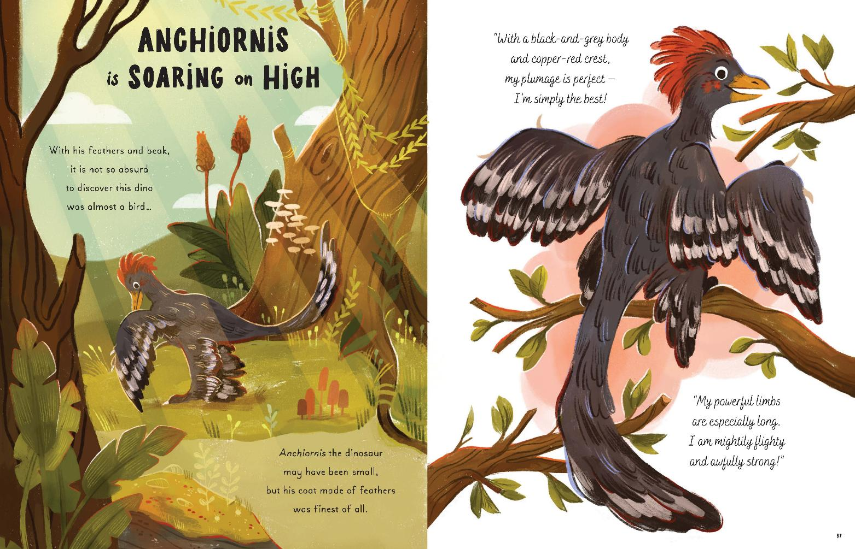

Slide 48
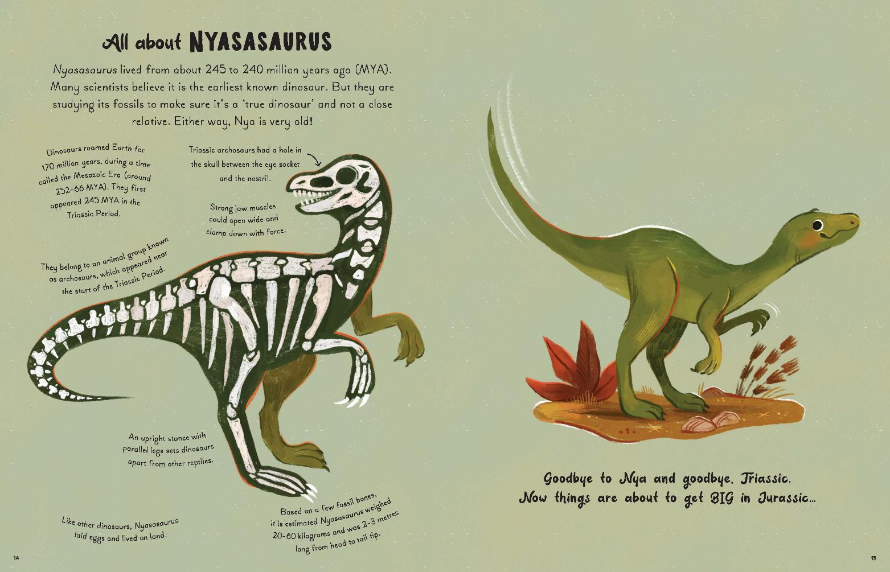

Slide 49
5 Minute Dinosaur Stories
Gabby Dawnay
Explore the prehistoric world with this lavish read-aloud collection of non-fiction stories.
Each read-aloud, 5-minute rhyming story tells the tale of a different dinosaur; from flighty and feathered Anchiornis to lumbering giant Brachiosaurus.
Nine stories include:
- The very FIRST dinosaur
- Slow, spiky STEGOSAURUS
- BRACHIOSAURUS is tallest of all
- ANCHIORNIS soars on high
- Swamp-dwelling SPINOSAURUS
- Killer-clawed VELOCIRAPTOR
- King TYRANNOSAURUS REX
- Three-horned TRICERATOPS
- Club-wielding ANKYLOSAURUS
At the end of each story, explore an informative 'all about' page and learn further information about dinosaurs.
Written by science writer and poet Gabby Dawnay, this is a gorgeously illustrated gift to inform and delight the youngest dinosaur fans.
AGES 4-7
AU $34.99| NZ $39.99
9781917366267
96 Pages
Hardcover
270 mm x 210 mm
Magic Cat Publishing

Slide 50
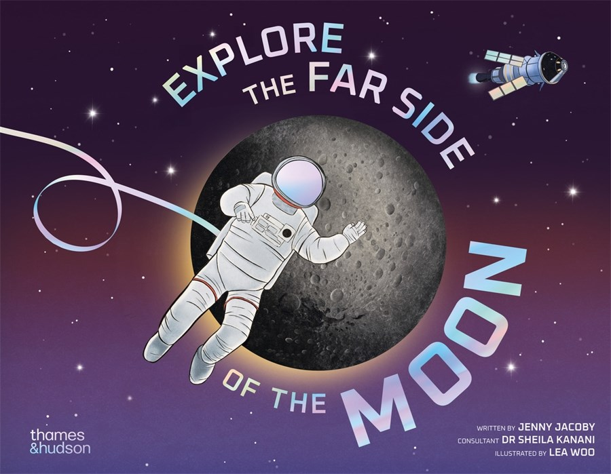

Slide 51
Explore the Far Side of the Moon
Jenny Jacoby
Readers are taken on an imaginary space mission to explore the far side of the Moon for the first time in human history.
In this adventure into deep space, readers will be the first astronauts to set foot on the far side of the Moon, where the light is low, temperatures are extreme and the surface is pitted with craters that are so deep they have never been exposed to sunlight. What lies within may reveal incredible secrets about our universe, and provide a stepping stone to Mars and beyond...
Illustrated in a dreamy science-fiction style, Explore the Far Side of the Moon places readers in the moon boots of a mission specialist, appointed to undertake the first crewed mission to the far side of the Moon in human history.
With an introduction by planetary scientist Dr Sheila Kanani, the book starts by introducing the reader to their fellow crew members, providing guidance on what to pack, what to wear and how to prepare a space rocket for lift-off (not to mention an all-important briefing on how to go to the toilet in zero gravity).
Published in anticipation of NASA's launch of Artemis III, which will take the first woman and first person of colour to the Moon, the book will feed off the excitement of a new era of lunar missions.
AGES 7-10
AU $32.99 | NZ $36.99
9780500653814
64 Pages
Hardcover
232 mm x 292 mm
Thames and Hudson Ltd

Slide 52
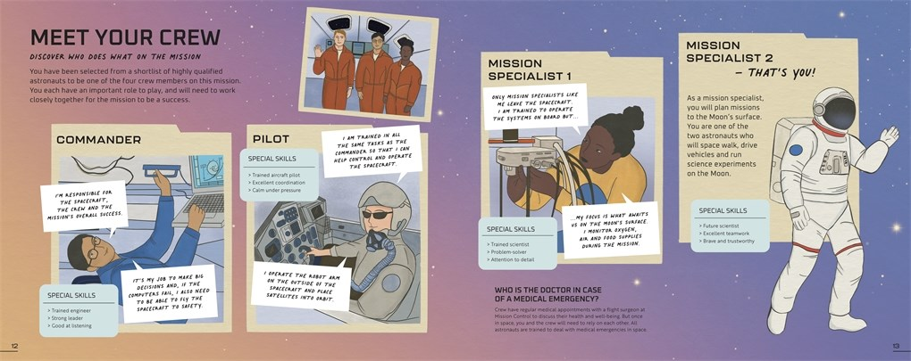

Slide 53
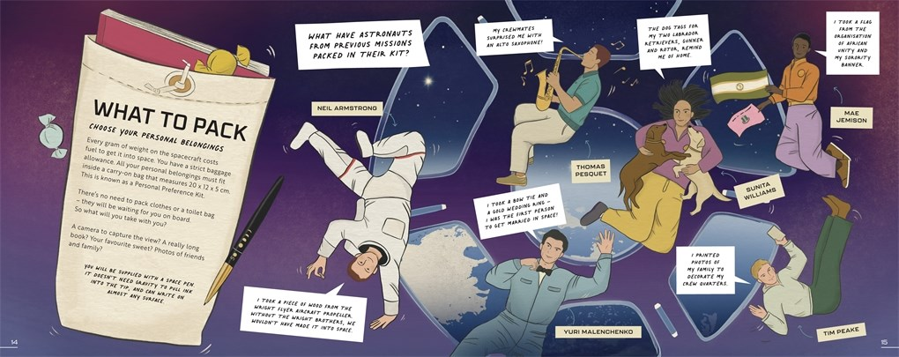

Slide 54
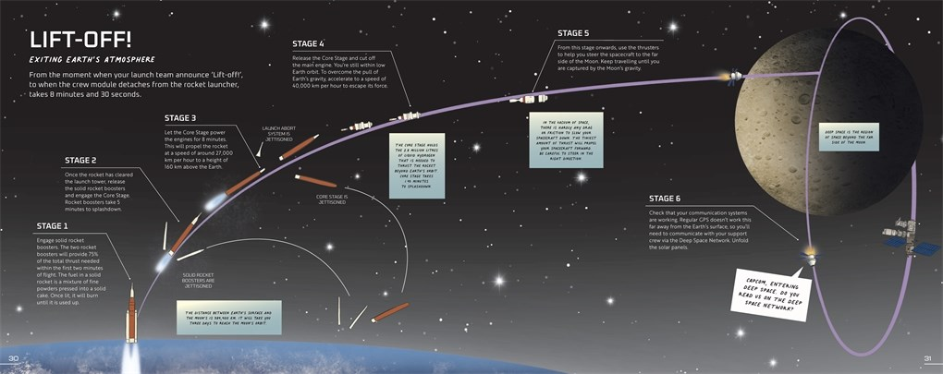

Slide 55
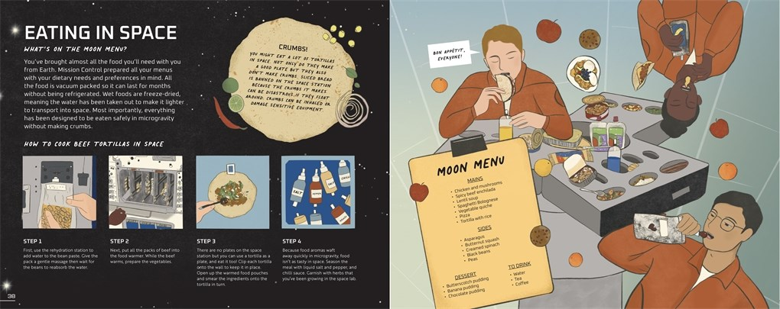

Slide 56
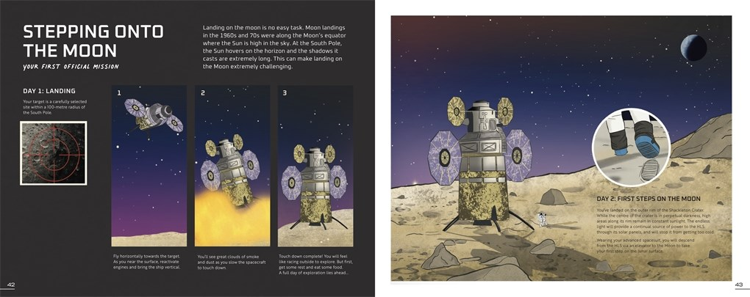

Slide 57
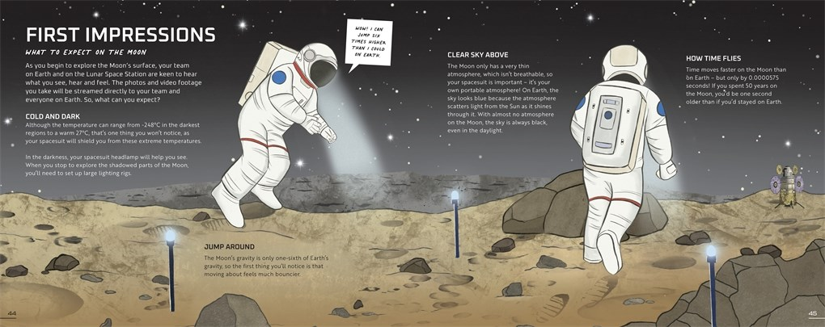

Slide 58
Explore the Far Side of the Moon
Jenny Jacoby
Readers are taken on an imaginary space mission to explore the far side of the Moon for the first time in human history.
In this adventure into deep space, readers will be the first astronauts to set foot on the far side of the Moon, where the light is low, temperatures are extreme and the surface is pitted with craters that are so deep they have never been exposed to sunlight. What lies within may reveal incredible secrets about our universe, and provide a stepping stone to Mars and beyond...
Illustrated in a dreamy science-fiction style, Explore the Far Side of the Moon places readers in the moon boots of a mission specialist, appointed to undertake the first crewed mission to the far side of the Moon in human history.
With an introduction by planetary scientist Dr Sheila Kanani, the book starts by introducing the reader to their fellow crew members, providing guidance on what to pack, what to wear and how to prepare a space rocket for lift-off (not to mention an all-important briefing on how to go to the toilet in zero gravity).
Published in anticipation of NASA's launch of Artemis III, which will take the first woman and first person of colour to the Moon, the book will feed off the excitement of a new era of lunar missions.
AGES 7-10
AU $32.99 | NZ $36.99
9780500653814
64 Pages
Hardcover
232 mm x 292 mm
Thames and Hudson Ltd

Slide 59
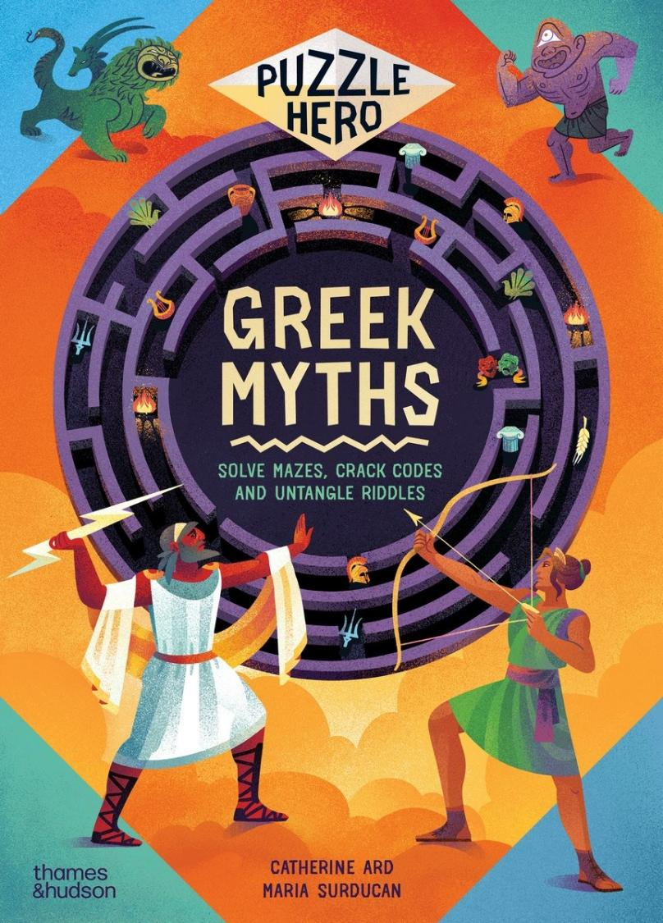

Slide 60

Greek Myths
SOLVE MAZES, CRACK CODES AND UNTANGLE RIDDLES
Catherine Ard
A book of Greek myths with a twist! Readers step into the shoes of a legendary hero to solve mazes, crack codes and untangle the riddles that bring lavishly illustrated retellings of classic tales to life.
By navigating mazes and labyrinths, cracking codes and solving riddles, they will guide Persephone out of the underworld so Spring can begin, join Jason and the Argonauts on their quest for the golden fleece and help Perseus avoid the terrifying gaze of the snake-haired gorgon Medusa, and much more.
Every spread features a Greek myth retold in snappy, relatable style by Catherine Ard, alongside a beautifully illustrated puzzle crafted by Maria Surducan, each written and designed to make readers feel like they are part of the story.
This innovative take on familiar and timeless tales is sure to engage and enthuse any reader, making this book the perfect read for puzzle-lovers, a brilliant introduction to mythology for newcomers and a fresh new angle for kids who already love these classic stories.
AGES 7-10
AU $32.99 | NZ $36.99
9780500653678
56 Pages
Hardcover
330 mm x 238 mm
Thames and Hudson Ltd

Slide 61
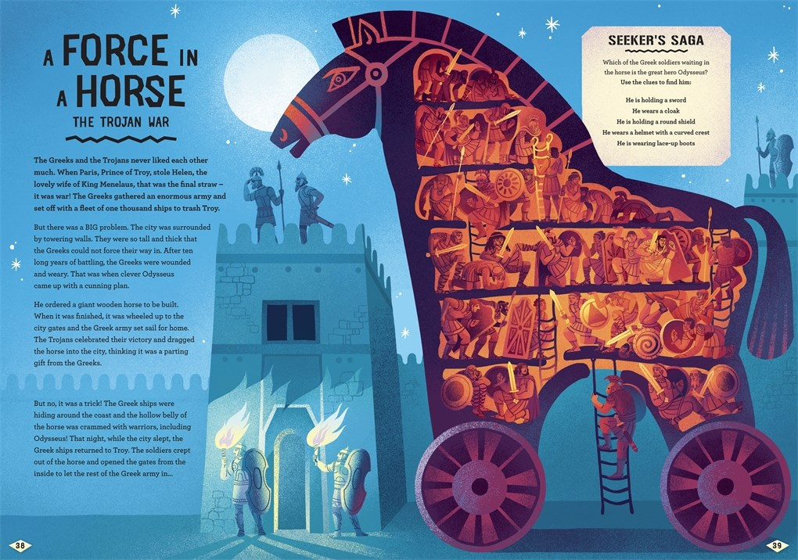

Slide 62
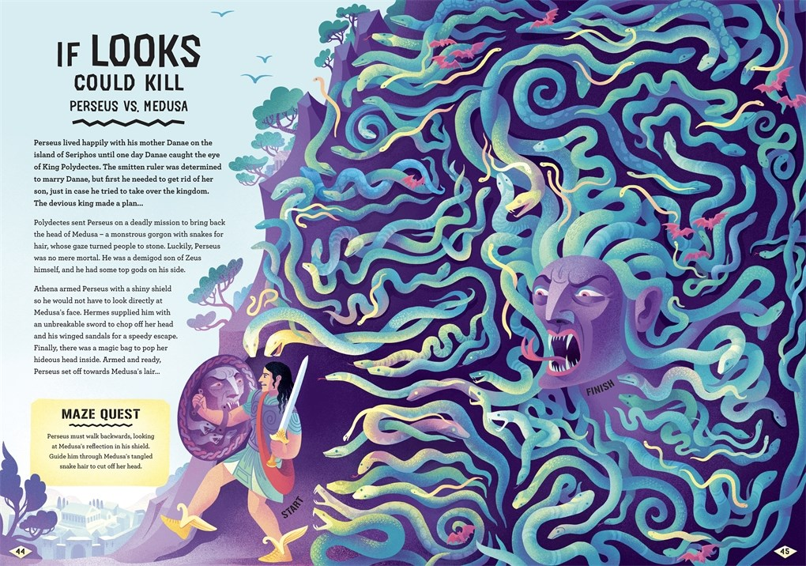

Slide 63


Slide 64


Slide 65


Slide 66


Slide 67
Greek Myths
SOLVE MAZES, CRACK CODES AND UNTANGLE RIDDLES
Catherine Ard
A book of Greek myths with a twist! Readers step into the shoes of a legendary hero to solve mazes, crack codes and untangle the riddles that bring lavishly illustrated retellings of classic tales to life.
By navigating mazes and labyrinths, cracking codes and solving riddles, they will guide Persephone out of the underworld so Spring can begin, join Jason and the Argonauts on their quest for the golden fleece and help Perseus avoid the terrifying gaze of the snake-haired gorgon Medusa, and much more.
Every spread features a Greek myth retold in snappy, relatable style by Catherine Ard, alongside a beautifully illustrated puzzle crafted by Maria Surducan, each written and designed to make readers feel like they are part of the story.
This innovative take on familiar and timeless tales is sure to engage and enthuse any reader, making this book the perfect read for puzzle-lovers, a brilliant introduction to mythology for newcomers and a fresh new angle for kids who already love these classic stories.
AGES 7-10
AU $32.99 | NZ $36.99
9780500653678
56 Pages
Hardcover
330 mm x 238 mm
Thames and Hudson Ltd

Slide 68


Slide 69

Lionel Messi's World Cup Triumph
(HISTORY'S GREATEST GAMES #1)
Chris Barish
This thrilling new nonfiction graphic novel series offers a front row seat to the greatest moments in sports history, starting with Lionel Messi and the incredible 2022 FIFA World Cup.
This exciting new graphic novel series offers a portal to the past, putting young readers in the middle of the most epic moments in sports history. Along with action-packed games and nail-biting victories, this series zooms out to explore the incredible backstories, social and political issues, and larger historical context that truly make these games the greatest in history.
While there are many books about Lionel Messi on the market, this will be the first graphic novel to tell his incredible story for middle-grade readers. Along with play-by-play scenes from actual games, Chris Barish expertly adds trivia, fun facts, and historical context that soccer fans will love.
With series like Nathan Hale’s Hazardous Tales and Big Ideas That Changed the World, Abrams has seen a huge appetite for action-packed nonfiction graphic novels, and they think History’s Greatest Games could be another breakout series in this space.
Publication is timed to coincide with the 2026 World Cup, which will take place in North America.
AGES 8-12
AU $21.99 | NZ $24.99
9781419779404
136 Pages
Paperback
203 mm x 140 mm
Abrams Fanfare

Slide 70


Slide 71


Slide 72


Slide 73


Slide 74


Slide 75


Slide 76
Lionel Messi's World Cup Triumph
(HISTORY'S GREATEST GAMES #1)
Chris Barish
This thrilling new nonfiction graphic novel series offers a front row seat to the greatest moments in sports history, starting with Lionel Messi and the incredible 2022 FIFA World Cup.
This exciting new graphic novel series offers a portal to the past, putting young readers in the middle of the most epic moments in sports history. Along with action-packed games and nail-biting victories, this series zooms out to explore the incredible backstories, social and political issues, and larger historical context that truly make these games the greatest in history.
While there are many books about Lionel Messi on the market, this will be the first graphic novel to tell his incredible story for middle-grade readers. Along with play-by-play scenes from actual games, Chris Barish expertly adds trivia, fun facts, and historical context that soccer fans will love.
With series like Nathan Hale’s Hazardous Tales and Big Ideas That Changed the World, Abrams has seen a huge appetite for action-packed nonfiction graphic novels, and they think History’s Greatest Games could be another breakout series in this space.
Publication is timed to coincide with the 2026 World Cup, which will take place in North America.
AGES 8-12
AU $21.99 | NZ $24.99
9781419779404
136 Pages
Paperback
203 mm x 140 mm
Abrams Fanfare

Slide 77


Slide 78
The Questioneers: What's That Colour?
A BOARD BOOK
Andrea Beaty
What’s That Colour? is a fun rhyming Questioneers concept board book starring Aaron Slater, Illustrator all about colors from the #1 New York Times bestselling creators of Ada Twist, Scientist and Rosie Revere, Engineer
Aaron has yellow. Rosie has red. Mix them together, it’s something new instead!
Aaron Slater, Illustrator and his fellow Questioners star in their first ever board book all about the dazzling world of colours. What happens when you mix yellow and blue? What about blue and red? What if you mix all the colours together?
Andrea Beaty and David Roberts—the #1 New York Times bestselling creators of the Questioneers series—are back with a delightfully rhyming and vibrantly illustrated board book, the first in a brand-new concepts series for preschoolers. Readers will join their favorite Questioneers as they explore numbers, shapes, and feelings in future board books.
AGES 0-4
AU $14.99 | NZ $19.99
9781419791192
20 Pages
Board Book
178 mm x 178 mm
Abrams Appleseed

Slide 79


Slide 80


Slide 81


Slide 82
The Questioneers: What's That Colour?
A BOARD BOOK
Andrea Beaty
What’s That Colour? is a fun rhyming Questioneers concept board book starring Aaron Slater, Illustrator all about colors from the #1 New York Times bestselling creators of Ada Twist, Scientist and Rosie Revere, Engineer
Aaron has yellow. Rosie has red. Mix them together, it’s something new instead!
Aaron Slater, Illustrator and his fellow Questioners star in their first ever board book all about the dazzling world of colours. What happens when you mix yellow and blue? What about blue and red? What if you mix all the colours together?
Andrea Beaty and David Roberts—the #1 New York Times bestselling creators of the Questioneers series—are back with a delightfully rhyming and vibrantly illustrated board book, the first in a brand-new concepts series for preschoolers. Readers will join their favorite Questioneers as they explore numbers, shapes, and feelings in future board books.
AGES 0-4
AU $14.99 | NZ $19.99
9781419791192
20 Pages
Board Book
178 mm x 178 mm
Abrams Appleseed

Slide 83


Slide 84

Mouse's Wood
Alice Melvin
A board edition of the book described by the Daily Telegraph as 'an utter gem'.
Written in a gentle rhyme that reflects the slow pace of Mouse's rambling journey, and illustrated in the inimitable style of Alice Melvin, Mouse's Wood is a heart-warming celebration of slow living in nature.
The highly popular, incredibly charming Mouse's Wood is now in board book format for the youngest of readers!
Celebrates living in connection with nature through the gentle tale of a mouse and his friends in the forest.
Hand-drawn and painted illustrations combine with novelty die-cut flaps to give the reader the experience of exploring Mouse's environment and his many animal friends and neighbors for themselves. The lift-the-flap format is highly interactive and engaging, allowing young readers to peek inside animals' homes.
A nature calendar completes the book, allowing children to discover the birds, insects, animals and plants living in harmony with the changing seasons.
The mouse books, featuring the artwork of award-winning illustrator Alice Melvin, have become a beloved series with young readers.
Brings this delightful story to younger readers.
Ages 3+
AU $21.99 | NZ $24.99
9780500653883
26 Pages
Board Book
211 mm x 173 mm
Thames and Hudson Ltd

Slide 85


Slide 86


Slide 87


Slide 88


Slide 89


Slide 90


Slide 91
Mouse's Wood
Alice Melvin
A board edition of the book described by the Daily Telegraph as 'an utter gem'.
Written in a gentle rhyme that reflects the slow pace of Mouse's rambling journey, and illustrated in the inimitable style of Alice Melvin, Mouse's Wood is a heart-warming celebration of slow living in nature.
The highly popular, incredibly charming Mouse's Wood is now in board book format for the youngest of readers!
Celebrates living in connection with nature through the gentle tale of a mouse and his friends in the forest.
Hand-drawn and painted illustrations combine with novelty die-cut flaps to give the reader the experience of exploring Mouse's environment and his many animal friends and neighbors for themselves. The lift-the-flap format is highly interactive and engaging, allowing young readers to peek inside animals' homes.
A nature calendar completes the book, allowing children to discover the birds, insects, animals and plants living in harmony with the changing seasons.
The mouse books, featuring the artwork of award-winning illustrator Alice Melvin, have become a beloved series with young readers.
Brings this delightful story to younger readers.
Ages 3+
AU $21.99 | NZ $24.99
9780500653883
26 Pages
Board Book
211 mm x 173 mm
Thames and Hudson Ltd

Slide 92


Slide 93
Odd Bugs (A Curious Crittters Board Book)
MEET NATURE'S WEIRDEST INSECTS
Laura Gehl
Meet nature’s oddballs in author Laura Gehl and illustrator Gareth Lucas’s engaging board book about some of the most unique insects in the world
Get ready to buzz with excitement! Odd Bugs introduces babies and toddlers to highly unusual creepy-crawlies, including a beautiful glasswing butterfly and the treacherous robber fly!
Lively rhyming verses provide the comforting repetition that little ones crave, even as their minds are opened to new and fascinating creatures from around the world. At the end of the book, readers will find photographs of each bug, along with more detailed factual information. The eight insects featured are the goliath beetle, Picasso moth, red-headed bush cricket, saddleback caterpillar, robber fly, glasswing butterfly, and the leaf insect.
Age-appropriate facts accompany a stunning illustration of each weird bug, and back matter offers photographs of each critter as well as more detailed information.
AGES 1-4
AU $14.99 | NZ $19.99
9781419783050
22 Pages
Board Book
178 mm x 178 mm
Abrams Appleseed

Slide 94


Slide 95


Slide 96


Slide 97


Slide 98
Odd Bugs (A Curious Crittters Board Book)
MEET NATURE'S WEIRDEST INSECTS
Laura Gehl
Meet nature’s oddballs in author Laura Gehl and illustrator Gareth Lucas’s engaging board book about some of the most unique insects in the world
Get ready to buzz with excitement! Odd Bugs introduces babies and toddlers to highly unusual creepy-crawlies, including a beautiful glasswing butterfly and the treacherous robber fly!
Lively rhyming verses provide the comforting repetition that little ones crave, even as their minds are opened to new and fascinating creatures from around the world. At the end of the book, readers will find photographs of each bug, along with more detailed factual information. The eight insects featured are the goliath beetle, Picasso moth, red-headed bush cricket, saddleback caterpillar, robber fly, glasswing butterfly, and the leaf insect.
Age-appropriate facts accompany a stunning illustration of each weird bug, and back matter offers photographs of each critter as well as more detailed information.
AGES 1-4
AU $14.99 | NZ $19.99
9781419783050
22 Pages
Board Book
178 mm x 178 mm
Abrams Appleseed

Slide 99


Slide 100
Who's Building? (Big Jobs for Little Babies)
A BOARD BOOK
Katrina Moore
The Big Jobs for Little Babies board book series explores dynamic careers based on baby’s favorite activities—in this case, building!
In Who’s Building?, take a look into the many vocations that involve building—from a sculptor forming a bear out of colorful clay to a bridge-creating civil engineer! With a fun, simple rhyme, five dramatic gatefold reveals, and a high-quality mirror on the final page of this sturdy board book, Who’s Building? will nurture the youngest explorer’s curiosity about the world and their own bright futures.
The Nerdy Babies board book series continues to have strong sales, and we hope to tap into the same market of explaining concepts in simple, concise ways.
This sturdy board book has five gatefolds, perfect for curious little hands, revealing what baby is building, and a sturdy, high-quality mirror on the final page so readers can see themselves in the various roles explored in the book.
AGES 1-3
AU $19.99 | NZ $21.99
9781419774621
22 Pages
Board Book
191 mm x 165 mm
Abrams Appleseed

Slide 101


Slide 102


Slide 103


Slide 104


Slide 105


Slide 106
Who's Building? (Big Jobs for Little Babies)
A BOARD BOOK
Katrina Moore
The Big Jobs for Little Babies board book series explores dynamic careers based on baby’s favorite activities—in this case, building!
In Who’s Building?, take a look into the many vocations that involve building—from a sculptor forming a bear out of colorful clay to a bridge-creating civil engineer! With a fun, simple rhyme, five dramatic gatefold reveals, and a high-quality mirror on the final page of this sturdy board book, Who’s Building? will nurture the youngest explorer’s curiosity about the world and their own bright futures.
The Nerdy Babies board book series continues to have strong sales, and we hope to tap into the same market of explaining concepts in simple, concise ways.
This sturdy board book has five gatefolds, perfect for curious little hands, revealing what baby is building, and a sturdy, high-quality mirror on the final page so readers can see themselves in the various roles explored in the book.
AGES 1-3
AU $19.99 | NZ $21.99
9781419774621
22 Pages
Board Book
191 mm x 165 mm
Abrams Appleseed

Slide 107


Slide 108



ALSO AVAILABLE
9781419764813
9781419770500
9781419778865

Slide 109

Spider-Man: Cosmic Chaos! (A Mighty Marvel Team-Up)
AN ORIGINAL GRAPHIC NOVEL
Mike Maihack
A third action-packed original story in the Mighty Marvel Team-Up graphic novel series by celebrated cartoonist Mike Maihack, featuring Spider-Man and the Guardians of the Galaxy!
In this third book in the Mighty Marvel Team-Up series, author and artist Mike Maihack tells another action-packed and hilarious story, placing Spider-Man in the crosshairs of some of Marvel’s most infamous cosmic characters!
Marvel Comics continues to be one of the most recognizable and biggest brands worldwide, with Spider-Man being one of the most popular characters in their stable. With more Spider-Man films slated to release in the coming years, Spider-Man will continue to be in the cultural conversation.
This is one of the only early-reader graphic novel series to come from Marvel, and fills an important gap in the market.
Author/artist Mike Maihack is an incredible talent and has already had a successful young readers series with Cleopatra in Space. His art style and humorous storytelling will appeal to both younger audiences and older fans of the brand.
AGES 6-9
AU $14.99 | NZ $19.99
9781419770524
96 Pages
Paperback
216 mm x 152 mm
Abrams Fanfare

Slide 110


Slide 111



ALSO AVAILABLE
9781419754609
9781419774997
9781419746581

Slide 112
X-Men: My Mighty Marvel First Book
Marvel Entertainment
The next super installment in the My Mighty Marvel First Book series featuring the world’s most extraordinary team—the X-Men—as drawn by one of the world’s most extraordinary creators!
Leap into action with the most astonishing group of heroes: the X-Men! Learn about Professor X, Cyclops, Jean Grey, Storm, Wolverine, and the other extraordinary mutants from Professor Xavier’s School for Gifted Youngsters. This bright and bold board book, with art from Dave Cockrum, teaches the youngest collector all about the X-Men’s super-powers, backstories, and enemies!
Featuring vivid colors and three special gatefolds that help the X-Men pop off the page, and a larger trim size fit for a Super Hero team, this fun-filled board book is perfect for new and longtime Marvel fans alike.
Retro hook: featuring classic art by marvel legend, Dave Cockrum, makes this a must-have for die-hard fans and collectors.
Unique format: with a larger, "team-sized" trim size, three gatefolds, and a bold design, this deluxe board book is perfect for comic-book fans to share with their little ones.
AGES 0-5
AU $21.99 | NZ $24.99
9781419788215
24 Pages
Board Book
216 mm x 191 mm
Abrams Appleseed

Slide 113


Slide 114
Alone & Together (A Die-Cut Peek-Through Picture Book)
Émilie Chazerand and Amandine Piu
Celebrate what makes being together special in this lively, touching ode to community and friendship featuring clever die-cuts to peek through.
The spare but powerful text in this joyful picture book explores why we need each other—our friends, families, neighbors, and communities—while also gently reassuring little ones that being alone is powerful, too. Charming art and clever peek-through die-cuts reveal surprising transformations with each page turn. Alone & Together teaches young readers that individual contributions combined with community cooperation make anything possible!
Appealing art: with its charming watercolor style, this art will appeal to fans of In My Heart by Jo Witek and Christine Roussey.
Evergreen subject: forming friendships and relationships is an important milestone in every child’s development. This book highlights how we are better and stronger as a group without diminishing the importance of alone time.
Novelty format: featuring a clever and surprising die-cut on every spread, this is a unique way to showcase the value of being by oneself as well as the importance of being with friends.
AGES 3-5
AU $29.99 | NZ $34.99
9781419783043
52 Pages
Hardcover
270 mm x 257 mm
Abrams Appleseed

Slide 115


Slide 116


Slide 117


Slide 118
Alone & Together (A Die-Cut Peek-Through Picture Book)
Émilie Chazerand and Amandine Piu
Celebrate what makes being together special in this lively, touching ode to community and friendship featuring clever die-cuts to peek through.
The spare but powerful text in this joyful picture book explores why we need each other—our friends, families, neighbors, and communities—while also gently reassuring little ones that being alone is powerful, too. Charming art and clever peek-through die-cuts reveal surprising transformations with each page turn. Alone & Together teaches young readers that individual contributions combined with community cooperation make anything possible!
Appealing art: with its charming watercolor style, this art will appeal to fans of In My Heart by Jo Witek and Christine Roussey.
Evergreen subject: forming friendships and relationships is an important milestone in every child’s development. This book highlights how we are better and stronger as a group without diminishing the importance of alone time.
Novelty format: featuring a clever and surprising die-cut on every spread, this is a unique way to showcase the value of being by oneself as well as the importance of being with friends.
AGES 3-5
AU $29.99 | NZ $34.99
9781419783043
52 Pages
Hardcover
270 mm x 257 mm
Abrams Appleseed

Slide 119


Slide 120

Mouse by the Sea
Alice Melvin
Alice Melvin's award-winning Mouse is back for another mindful adventure in nature.
Join Mouse on his summer holiday by the seaside. Each day brings new excitement, from sandcastles on the beach to ice creams on the promenade, sunbathing on the sand dunes to looking for treasures amongst the rock pools!
Beautifully detailed illustrations feature many plants and animals to identify, and the atmospheric rhyming text sets the scene for this perfect summer holiday.
The book also features a nature guide with fascinating facts about the different habitats and wildlife that Mouse has come across.
AGES 4-8
AU $19.99 | NZ $21.99
9780500660379
32 Pages
Paperback
295 mm x 245 mm
Thames and Hudson Ltd

Slide 121


Slide 122
The World to Come – A Times Book of the Year 2024
Robert Macfarlane
A stunning picture book collaboration from bestselling author Robert Macfarlane, actor Johnny Flynn and illustrator Emily Sutton
The Guardian Best Children's Books of 2024, The Times Best Children's Books of 2024, Waterstones Best Children's Books of 2024, Shortlisted for Foyles Book of the Year 2024, Shortlisted for Nibbies Illustrated Book of the Year 2025
Stunning picture book collaboration from bestselling author Robert Macfarlane, actor Johnny Flynn and illustrator Emily Sutton
On my way through the wood wound a thread through the dream...Take a lyrical journey with a father and son who walk together through an ever-changing landscape and discover a world to come that's filled with hope.
This beautiful book sings with a love of words and rhythm, and vividly conjures the magic of nature.
Astonishing artwork makes this picture book an instant classic· An all-star collaboration created by actor-musician Johnny Flynn, bestselling author Robert Macfarlane and award-winning illustrator Emily Sutton
AGES 4-8 | NOW IN PAPERBACK
AU $19.99 | NZ $21.99
9781917044554
32 Pages
Paperback
280 mm x 240 mm
Magic Cat Publishing

Slide 123


Slide 124


Slide 125


Slide 126


Slide 127


Slide 128


Slide 129
The World to Come – A Times Book of the Year 2024
Robert Macfarlane
A stunning picture book collaboration from bestselling author Robert Macfarlane, actor Johnny Flynn and illustrator Emily Sutton
The Guardian Best Children's Books of 2024, The Times Best Children's Books of 2024, Waterstones Best Children's Books of 2024, Shortlisted for Foyles Book of the Year 2024, Shortlisted for Nibbies Illustrated Book of the Year 2025
Stunning picture book collaboration from bestselling author Robert Macfarlane, actor Johnny Flynn and illustrator Emily Sutton
On my way through the wood wound a thread through the dream...Take a lyrical journey with a father and son who walk together through an ever-changing landscape and discover a world to come that's filled with hope.
This beautiful book sings with a love of words and rhythm, and vividly conjures the magic of nature.
Astonishing artwork makes this picture book an instant classic· An all-star collaboration created by actor-musician Johnny Flynn, bestselling author Robert Macfarlane and award-winning illustrator Emily Sutton
AGES 4-8 | NOW IN PAPERBACK
AU $19.99 | NZ $21.99
9781917044554
32 Pages
Paperback
280 mm x 240 mm
Magic Cat Publishing

Slide 130


Slide 131
Little Bunny's To-Do List (A Magical List Book)
A PICTURE BOOK
Helen Kemp Zax
From harvesting jellybeans to practicing mega-hops, the Easter Bunny will get through his daily to-do list one item at a time in this funny picture book that gently teaches time management.
Little Bunny is very busy from morning to night—good thing he has a to-do list! From stirring pots of pastel colors to dye eggs to knitting lambswool sweaters for tiny chicks, he has many tasks to complete before bedtime.
But it’ll all get done; one thing at a time. And when all his tasks are finally completed, Little Bunny is rewarded with a fantastically finished list and a warm cup of parsley tea.
The textured glitter-stamped cover is so inviting that young readers will be eager to accompany Little Bunny during his very busy day, and they will be in for another sparkly surprise when they unfold a secret flap at the end of the book to see all the items in Little Bunny’s to-do list checked off in glittery ink!
Perfect for Easter or everyday read-alouds, Little Bunny’s To-Do List offers a gentle lesson on the importance of organisation.
The cover shines with glitter UV, and a gatefold at the end of the book flips down to reveal a completed to-do list, with each item checked off in sparkly glitter.
AGES 3-5
AU $21.99 | NZ $24.99
9781419779480
40 Pages
Hardcover
223 mm x 223 mm
Abrams Appleseed

Slide 132


Slide 133


Slide 134


Slide 135


Slide 136
Little Bunny's To-Do List (A Magical List Book)
A PICTURE BOOK
Helen Kemp Zax
From harvesting jellybeans to practicing mega-hops, the Easter Bunny will get through his daily to-do list one item at a time in this funny picture book that gently teaches time management.
Little Bunny is very busy from morning to night—good thing he has a to-do list! From stirring pots of pastel colors to dye eggs to knitting lambswool sweaters for tiny chicks, he has many tasks to complete before bedtime.
But it’ll all get done; one thing at a time. And when all his tasks are finally completed, Little Bunny is rewarded with a fantastically finished list and a warm cup of parsley tea.
The textured glitter-stamped cover is so inviting that young readers will be eager to accompany Little Bunny during his very busy day, and they will be in for another sparkly surprise when they unfold a secret flap at the end of the book to see all the items in Little Bunny’s to-do list checked off in glittery ink!
Perfect for Easter or everyday read-alouds, Little Bunny’s To-Do List offers a gentle lesson on the importance of organisation.
The cover shines with glitter UV, and a gatefold at the end of the book flips down to reveal a completed to-do list, with each item checked off in sparkly glitter.
AGES 3-5
AU $21.99 | NZ $24.99
9781419779480
40 Pages
Hardcover
223 mm x 223 mm
Abrams Appleseed

Slide 137


Slide 138

Time to Go, Sid!
A PICTURE BOOK
Isabel Greenberg
A “big kid” gets ready to go all on their own—and on their own timeline—in this hilarious and quirky picture book about a child’s growing independence and imagination, from bestselling author-illustrator Isabel Greenberg.
Imaginatively told through a child’s-eye view and full of entertaining moments that parents will relate to, this delightful picture book by Isabel Greenberg follows a headstrong child moving through their own world at their own pace, in their “I can do it myself!” phase.
Childhood milestone: Focuses on a universal stage of childhood where independent little ones begin to express their personalities and assert themselves. Sid’s parent gives them space to do things independently (sometimes with hilarious results).
Parent-child bonding: In a sweet, unexpected ending, the park trip is abandoned in favor of home playtime. Instead of getting frustrated at Sid’s delays, the parent joins in on the fun.
Laugh-out-loud: With quirky, irreverent humor reminiscent of Kate Beaton.
Distinctive art: Greenberg’s playful, bold style lends extra humor and whimsy to a memorably imaginative character.
AGES 4-8
AU $29.99 | NZ $34.99
9781419771095
32 Pages
Hardcover
274 mm x 226 mm
Abrams Books for Young Readers

Slide 139


Slide 140


Slide 141


Slide 142


Slide 143


Slide 144


Slide 145
Time to Go, Sid!
A PICTURE BOOK
Isabel Greenberg
A “big kid” gets ready to go all on their own—and on their own timeline—in this hilarious and quirky picture book about a child’s growing independence and imagination, from bestselling author-illustrator Isabel Greenberg.
Imaginatively told through a child’s-eye view and full of entertaining moments that parents will relate to, this delightful picture book by Isabel Greenberg follows a headstrong child moving through their own world at their own pace, in their “I can do it myself!” phase.
Childhood milestone: Focuses on a universal stage of childhood where independent little ones begin to express their personalities and assert themselves. Sid’s parent gives them space to do things independently (sometimes with hilarious results).
Parent-child bonding: In a sweet, unexpected ending, the park trip is abandoned in favor of home playtime. Instead of getting frustrated at Sid’s delays, the parent joins in on the fun.
Laugh-out-loud: With quirky, irreverent humor reminiscent of Kate Beaton.
Distinctive art: Greenberg’s playful, bold style lends extra humor and whimsy to a memorably imaginative character.
AGES 4-8
AU $29.99 | NZ $34.99
9781419771095
32 Pages
Hardcover
274 mm x 226 mm
Abrams Books for Young Readers

Slide 146


Slide 147

The Lucky Day (Seashell Key #3)
A CHAPTER BOOK
Lourdes Heuer
The Lucky Day is the third book from author Lourdes Heuer and award-winning illustrator Lynnor Bontigao’s young chapter-book series—perfect for fans of Princess in Black and Mercy Watson—about a diverse community of kids living in a beautiful seaside town.
It’s the last day of school before spring break, but there’s still so much to do! Mateo is on a mission to catch a leprechaun, and Sasha and Sophia can’t wait to work on their school garden. Elena just wants to read about dinosaurs, but when she finds a secret map in her textbook, she’ll need all her friends to help her find the treasure of Seashell Key—and make a treasure map of their own!
Filled with a vibrant cast and lots of spring fun, this is a great addition to an utterly charming chapter-book series.
Building series: Book 1 was named a Best Book of the Year by the Chicago Public Library, and Book 2 was called “a great first chapter book for kids just moving on from early readers” by School Library Journal.
Popular category: Young, full-color chapter books are popular with emerging readers, and this is a masterfully written and charming addition to the category.
Literacy builder: Short sentences, repetition, reader questions, and more make this series “ideal for sensitive beginning readers” (Kirkus).
AGES 5-8
AU $14.99 | NZ $19.99
9781419767531
80 Pages
Paperback
210 mm x 152 mm
Amulet Paperbacks

Slide 148


Slide 149


Slide 150


Slide 151


Slide 152


Slide 153


Slide 154
The Lucky Day (Seashell Key #3)
A CHAPTER BOOK
Lourdes Heuer
The Lucky Day is the third book from author Lourdes Heuer and award-winning illustrator Lynnor Bontigao’s young chapter-book series—perfect for fans of Princess in Black and Mercy Watson—about a diverse community of kids living in a beautiful seaside town.
It’s the last day of school before spring break, but there’s still so much to do! Mateo is on a mission to catch a leprechaun, and Sasha and Sophia can’t wait to work on their school garden. Elena just wants to read about dinosaurs, but when she finds a secret map in her textbook, she’ll need all her friends to help her find the treasure of Seashell Key—and make a treasure map of their own!
Filled with a vibrant cast and lots of spring fun, this is a great addition to an utterly charming chapter-book series.
Building series: Book 1 was named a Best Book of the Year by the Chicago Public Library, and Book 2 was called “a great first chapter book for kids just moving on from early readers” by School Library Journal.
Popular category: Young, full-color chapter books are popular with emerging readers, and this is a masterfully written and charming addition to the category.
Literacy builder: Short sentences, repetition, reader questions, and more make this series “ideal for sensitive beginning readers” (Kirkus).
AGES 5-8
AU $14.99 | NZ $19.99
9781419767531
80 Pages
Paperback
210 mm x 152 mm
Amulet Paperbacks

Slide 155


Slide 156

Pen Pals (Dino Poet #2)
A GRAPHIC NOVEL!
Tom Angleberger
From New York Times bestselling author Tom Angleberger, creator of the Origami Yoda series, comes a hilarious young graphic novel adventure through the land of the dinosaurs.
Dino Poet wants to help Frog write his first poem, but there’s a problem—Frog doesn’t think he’s a writer! What if his poems are bad? What if he can’t come up with ideas?
From the incomparable mind of New York Times bestselling author Tom Angleberger, this hilarious graphic novel series is a rollicking romp through the land of the dinosaurs and a celebration of the poets that live in all of us.
Superstar author: Tom Angleberger is the author of the bestselling Origami Yoda series, the Qwikpick Papers series, and the Flytrap Files series, among many other beloved books for young readers. He’s a dynamic promoter, and kids love him.
Poetry primer: This silly story serves as an accessible introduction to poetry for young readers, encouraging them to overcome fears of writing “bad” poems.
Growing format: Early graphic novels are on the rise with the success of Fox & Rabbit (over 32,000 gross sales across formats), Batcat (over 35,000 copies sold across all formats), and Astrid and Stella (over 40,000 copies sold across formats), with no signs of slowing down.
AGES 5-8
AU $24.99 | NZ $29.99
9781419772825
96 Pages
Hardcover
210 mm x 152 mm
Abrams Fanfare

Slide 157


Slide 158


Slide 159


Slide 160


Slide 161


Slide 162


Slide 163
Pen Pals (Dino Poet #2)
A GRAPHIC NOVEL!
Tom Angleberger
From New York Times bestselling author Tom Angleberger, creator of the Origami Yoda series, comes a hilarious young graphic novel adventure through the land of the dinosaurs.
Dino Poet wants to help Frog write his first poem, but there’s a problem—Frog doesn’t think he’s a writer! What if his poems are bad? What if he can’t come up with ideas?
From the incomparable mind of New York Times bestselling author Tom Angleberger, this hilarious graphic novel series is a rollicking romp through the land of the dinosaurs and a celebration of the poets that live in all of us.
Superstar author: Tom Angleberger is the author of the bestselling Origami Yoda series, the Qwikpick Papers series, and the Flytrap Files series, among many other beloved books for young readers. He’s a dynamic promoter, and kids love him.
Poetry primer: This silly story serves as an accessible introduction to poetry for young readers, encouraging them to overcome fears of writing “bad” poems.
Growing format: Early graphic novels are on the rise with the success of Fox & Rabbit (over 32,000 gross sales across formats), Batcat (over 35,000 copies sold across all formats), and Astrid and Stella (over 40,000 copies sold across formats), with no signs of slowing down.
AGES 5-8
AU $24.99 | NZ $29.99
9781419772825
96 Pages
Hardcover
210 mm x 152 mm
Abrams Fanfare

Slide 164


Slide 165

Cute 'n' Cozy Colouring World
Zenny Abanales
This chunky little colouring book is a package of cuteness. Make a little time for yourself, and lose yourself in its pages!
This chunky little colouring book is a package of cuteness. Make a little time for yourself, and lose yourself in its pages!
Looking for a calming escape from stress? Welcome to a cozy world of absolute cuteness! IN these pages, you'll discover bunnies reading books, bunnies doing the gardening and bunnies lying in hammocks surrounded by flowers.
Zenny's designs are small, simple and quick to complete, making this a perfect for a young adult audience looking for a break from their phone. With over 100 inviting illustrations, it's a world of relaxing fun!
Hits the trend: escapist cosy colouring strikes a chord with Gen Z.
Quick to complete: simple designs meet the need for easy 20-minute creative activities.
Chunky format is perfect for this topic: this adorable package will appeal to the audience.
Shares branding with Sticker Therapy: Zenny's art works equally well in sticker or colouring form.
AU $21.99 | NZ $24.99
9781837761135
224 Pages
Paperback
165 mm x 135 mm
Skittledog

Slide 166

ALSO AVAILABLE
9781837760985

Slide 167


Slide 168


Slide 169


Slide 170


Slide 171


Slide 172


Slide 173
Cute 'n' Cozy Colouring World
Zenny Abanales
This chunky little colouring book is a package of cuteness. Make a little time for yourself, and lose yourself in its pages!
This chunky little colouring book is a package of cuteness. Make a little time for yourself, and lose yourself in its pages!
Looking for a calming escape from stress? Welcome to a cozy world of absolute cuteness! IN these pages, you'll discover bunnies reading books, bunnies doing the gardening and bunnies lying in hammocks surrounded by flowers.
Zenny's designs are small, simple and quick to complete, making this a perfect for a young adult audience looking for a break from their phone. With over 100 inviting illustrations, it's a world of relaxing fun!
Hits the trend: escapist cosy colouring strikes a chord with Gen Z.
Quick to complete: simple designs meet the need for easy 20-minute creative activities.
Chunky format is perfect for this topic: this adorable package will appeal to the audience.
Shares branding with Sticker Therapy: Zenny's art works equally well in sticker or colouring form.
AU $21.99 | NZ $24.99
9781837761135
224 Pages
Paperback
165 mm x 135 mm
Skittledog

Slide 174


Slide 175

Alice's Adventures
A 1000-PIECE JIGSAW PUZZLE INSPIRED BY LEWIS CARROLL'S CLASSIC STORIES
Maria Rivans
Tumble down the rabbit-hole into a fantastical puzzling adventure, featuring all of Lewis Carroll's best-loved characters!
Toadstools, teapots, playing cards and chess pieces all spring gloriously to life in this surreal take on Lewis Carroll's beloved classic. Maria Rivans takes her cue from the 92 illustrations, which John Tenniel produced in close collaboration with Carroll himself, and sets them in her own idiosyncratic version of wonderland.
Perfect puzzle art: Anarchic, joyful, surreal, and colorful, Maria Rivans’s jigsaws provide a challenging yet satisfying puzzle experience.
Perennially popular inspiration: Lewis Carroll’s classic books and Sir John Tenniel’s illustrations are instantly recognizable and well-loved to this day.
Plastic-free packaging: FSC paper and card.
Includes an informative booklet: A guide to Lewis Carroll’s world.
AU $36.99 | NZ $39.99
9781837761005
4 Pages
Jigsaw Puzzle
490 mm x 685 mm
Skittledog

Slide 176


Slide 177


Slide 178


Slide 179
Alice's Adventures
A 1000-PIECE JIGSAW PUZZLE INSPIRED BY LEWIS CARROLL'S CLASSIC STORIES
Maria Rivans
Tumble down the rabbit-hole into a fantastical puzzling adventure, featuring all of Lewis Carroll's best-loved characters!
Toadstools, teapots, playing cards and chess pieces all spring gloriously to life in this surreal take on Lewis Carroll's beloved classic. Maria Rivans takes her cue from the 92 illustrations, which John Tenniel produced in close collaboration with Carroll himself, and sets them in her own idiosyncratic version of wonderland.
Perfect puzzle art: Anarchic, joyful, surreal, and colorful, Maria Rivans’s jigsaws provide a challenging yet satisfying puzzle experience.
Perennially popular inspiration: Lewis Carroll’s classic books and Sir John Tenniel’s illustrations are instantly recognizable and well-loved to this day.
Plastic-free packaging: FSC paper and card.
Includes an informative booklet: A guide to Lewis Carroll’s world.
AU $36.99 | NZ $39.99
9781837761005
4 Pages
Jigsaw Puzzle
490 mm x 685 mm
Skittledog

Slide 180


Slide 181

Japanese Springtime
COLOUR BY NUMBERS
Brindha Kumar
Colour-by-numbers presented in a stylish and elegant new package.
Brindha Kumar supplies both an intriguing sequence of images and evocative contemporary colour schemes, perfectly appropriate for the Japanese theme.
Her striking combinations of colour and rich patterns make these pages irresistible for colourists looking for a new and modern take on this old-school idea. Simply follow the numbered colour chart to create your own gorgeous artwork.
Brindha Kumar is a Malaysian illustrator, currently based in London. Her Malaysian heritage has influenced the way she uses colours and emotions and she loves to show a tongue-in-cheek representation of modern and traditional society in her work. Brindha's varied client list includes Apple TV, Selfridges, Rolling Stone, Adobe, Adidas, Harper's Bazaar and Tatler.
AU $32.99 | NZ $36.99
9781837760961
48 Pages
Paperback
285 mm x 223 mm
Skittledog

Slide 182


Slide 183


Slide 184


Slide 185


Slide 186


Slide 187


Slide 188
Japanese Springtime
COLOUR BY NUMBERS
Brindha Kumar
Colour-by-numbers presented in a stylish and elegant new package.
Brindha Kumar supplies both an intriguing sequence of images and evocative contemporary colour schemes, perfectly appropriate for the Japanese theme.
Her striking combinations of colour and rich patterns make these pages irresistible for colourists looking for a new and modern take on this old-school idea. Simply follow the numbered colour chart to create your own gorgeous artwork.
Brindha Kumar is a Malaysian illustrator, currently based in London. Her Malaysian heritage has influenced the way she uses colours and emotions and she loves to show a tongue-in-cheek representation of modern and traditional society in her work. Brindha's varied client list includes Apple TV, Selfridges, Rolling Stone, Adobe, Adidas, Harper's Bazaar and Tatler.
AU $32.99 | NZ $36.99
9781837760961
48 Pages
Paperback
285 mm x 223 mm
Skittledog

Slide 189


Slide 190
Cats Rule the Earth Tarot Coloring Book
BEAUTIFUL TAROT DESIGNS FOR THE FELINE-OBSESSED
Catherine Davidson
This 78-card tarot coloring book is cat themed, combining ancient mysticism with feline illustrations.
This coloring book features irresistibly quirky cat illustrations that will delight cat lovers and tarot fans alike. An introduction explains how tarot works, and key meanings of each card are summarized on the reverse of the pages. All Major Arcana and Minor Arcana cards are included (78 cards total). Coloring pages are perforated for easy removal.
Bestselling companion: Cat’s Rule the Earth Tarot Coloring book is a gorgeous new product based on the best-selling Cats Rule the Earth Tarot deck which has sold over 120,000 copies sold worldwide.
Big market: Adult coloring is really having a huge moment! In April 2025 Publishers Weekly reported that five adult coloring books were among the top ten bestsellers in that category.
Tarot obsessed: This coloring book with this exciting and accessible format will target the growing groups of tarot enthusiasts— Gen-Z and millennials—who are reclaiming tarot cards as tools of self-care, growth, and identity.
AU $24.99 | NZ $29.99
9781419792137
112 Pages
Paperback
241 mm x 216 mm
Abrams Books

Slide 191


Slide 192


Slide 193


Slide 194
Cats Rule the Earth Tarot Coloring Book
BEAUTIFUL TAROT DESIGNS FOR THE FELINE-OBSESSED
Catherine Davidson
This 78-card tarot coloring book is cat themed, combining ancient mysticism with feline illustrations.
This coloring book features irresistibly quirky cat illustrations that will delight cat lovers and tarot fans alike. An introduction explains how tarot works, and key meanings of each card are summarized on the reverse of the pages. All Major Arcana and Minor Arcana cards are included (78 cards total). Coloring pages are perforated for easy removal.
Bestselling companion: Cat’s Rule the Earth Tarot Coloring book is a gorgeous new product based on the best-selling Cats Rule the Earth Tarot deck which has sold over 120,000 copies sold worldwide.
Big market: Adult coloring is really having a huge moment! In April 2025 Publishers Weekly reported that five adult coloring books were among the top ten bestsellers in that category.
Tarot obsessed: This coloring book with this exciting and accessible format will target the growing groups of tarot enthusiasts— Gen-Z and millennials—who are reclaiming tarot cards as tools of self-care, growth, and identity.
AU $24.99 | NZ $29.99
9781419792137
112 Pages
Paperback
241 mm x 216 mm
Abrams Books

Slide 195


Slide 196

Floralicious: The Colouring Frieze
Leila Duly
A beautiful botanical colouring book that unfolds to reveal a frieze nearly five feet long.
A brand new format for sophisticated colourists! Join bestselling botanical artist Leila Duly on a nature adventure in frieze form.
High-quality art paper, bearing Leila's trademark hand-drawn illustration, sits safely within the covers while you're working on it, but then can be opened out to reveal a gorgeous frieze made up of ten connecting floral panels.
AU $19.99 | NZ $21.99
9781837760909
20 Pages
Jigsaw Puzzle
210 mm x 148 mm
Skittledog

Slide 197


Slide 198
Floralicious: The Colouring Frieze
Leila Duly
A beautiful botanical colouring book that unfolds to reveal a frieze nearly five feet long.
A brand new format for sophisticated colourists! Join bestselling botanical artist Leila Duly on a nature adventure in frieze form.
High-quality art paper, bearing Leila's trademark hand-drawn illustration, sits safely within the covers while you're working on it, but then can be opened out to reveal a gorgeous frieze made up of ten connecting floral panels.
AU $19.99 | NZ $21.99
9781837760909
20 Pages
Jigsaw Puzzle
210 mm x 148 mm
Skittledog

Slide 199


Slide 200

The Arabian Nights
A COLOURING FRIEZE
Meel Tamphanon
A new colouring format designed for gifting, at an attractive price.
These evocative Middle Eastern folk tales of romance, voyages and wonder are told by a young woman, Scheherazade, to save herself from execution at the hands of the Sultan. Opening with her story, this sumptuously illustrated frieze unfolds to feature the best-loved stories of The Arabian Nights on each of the ten panels.
The concertina folds out to reveal these classic tales, showing off Meel's beautiful illustration to glorious effect on heavy art paper: Scheherazade and the Sultan, Sinbad the Sailor, The Three Apples, Ali Baba and the Forty Thieves, The Merchant and the Genie, The Thief of Alexandria, The Ebony Horse, The Fisherman and the Genie, Aladdin and the Magic Lamp, and The Queen of Serpents.
AU $21.99 | NZ $24.99
9781837760954
20 Pages
Paperback
210 mm x 148 mm
Skittledog

Slide 201


Slide 202


Slide 203


Slide 204


Slide 205


Slide 206


Slide 207
The Arabian Nights
A COLOURING FRIEZE
Meel Tamphanon
A new colouring format designed for gifting, at an attractive price.
These evocative Middle Eastern folk tales of romance, voyages and wonder are told by a young woman, Scheherazade, to save herself from execution at the hands of the Sultan. Opening with her story, this sumptuously illustrated frieze unfolds to feature the best-loved stories of The Arabian Nights on each of the ten panels.
The concertina folds out to reveal these classic tales, showing off Meel's beautiful illustration to glorious effect on heavy art paper: Scheherazade and the Sultan, Sinbad the Sailor, The Three Apples, Ali Baba and the Forty Thieves, The Merchant and the Genie, The Thief of Alexandria, The Ebony Horse, The Fisherman and the Genie, Aladdin and the Magic Lamp, and The Queen of Serpents.
AU $21.99 | NZ $24.99
9781837760954
20 Pages
Paperback
210 mm x 148 mm
Skittledog

Slide 208


Slide 209
B Is for Bibliophile
O.E. Zelmanovich
This stylish ABC book of book making and book parts is a wry, witty, and very charming compendium that is pervaded by a love of books!
In these pages, book lovers of all ages are invited to tour through the ABCs of books, with cartoon protagonist Guy as their guide. Excitingly, the book also works to perform what it shares, giving us a gatefold to define gatefold, a die-cut to exemplify what a die-cut is, and so on.
Cleverly conceived and beautifully made, this book is both delightful and edifying and a sheer pleasure to hold in the hand and leaf through. This is a fully illustrated book about books that belongs on the shelves of book lovers both young and old.
Informative, fun & approachable: This clearly arranged and diagrammed guide, with its cartoon protagonist Guy, is an accessible and fun way to learn about the parts of the book and more about how books get made.
Strong kid & adult appeal: Book lovers of all ages are sure to enjoy this book about books. With playful illustrations and eye-catching production details, this is a book to pore over again and again.
A great gift for every occasion: This book celebrates the very fact of books, which still remain the best technology for discovering both self and world.
AU $32.99 | NZ $36.99
9781592704323
64 Pages
Hardcover
203 mm x 203 mm
Enchanted Lion

Slide 210


Slide 211


Slide 212


Slide 213


Slide 214


Slide 215


Slide 216
B Is for Bibliophile
O.E. Zelmanovich
This stylish ABC book of book making and book parts is a wry, witty, and very charming compendium that is pervaded by a love of books!
In these pages, book lovers of all ages are invited to tour through the ABCs of books, with cartoon protagonist Guy as their guide. Excitingly, the book also works to perform what it shares, giving us a gatefold to define gatefold, a die-cut to exemplify what a die-cut is, and so on.
Cleverly conceived and beautifully made, this book is both delightful and edifying and a sheer pleasure to hold in the hand and leaf through. This is a fully illustrated book about books that belongs on the shelves of book lovers both young and old.
Informative, fun & approachable: This clearly arranged and diagrammed guide, with its cartoon protagonist Guy, is an accessible and fun way to learn about the parts of the book and more about how books get made.
Strong kid & adult appeal: Book lovers of all ages are sure to enjoy this book about books. With playful illustrations and eye-catching production details, this is a book to pore over again and again.
A great gift for every occasion: This book celebrates the very fact of books, which still remain the best technology for discovering both self and world.
AU $32.99 | NZ $36.99
9781592704323
64 Pages
Hardcover
203 mm x 203 mm
Enchanted Lion

Slide 217


Slide 218

Snap! Solar System
Illustrated by Donough O'Malley
Snap your way through the cosmos with a fun, educational card game that’s out of this world!
Blast off into space with Snap! Solar System. This fifty-two-card deck features four sets of thirteen illustrations of the planets, moons, and other celestial bodies of our solar system. Each card is beautifully illustrated by Donough O’Malley and includes labeled images that help players learn the unique characteristics of our solar system.
Fun and educational: An interactive way for kids to learn about astronomy, perfect for budding astronomers or anyone fascinated by space.
Multi-game use: Ideal for Snap, but also great for other card games like Go Fish, Old Maid, or using as flashcards to teach astronomy.
Family-friendly: Suitable for players of all ages, making it a great family activity for learning together and sparking curiosity about space.
Great educational gift: Perfect for young space enthusiasts or as an engaging and educational gift for kids interested in science, astronomy, or the mysteries of the universe.
AU $16.99 | NZ $19.99
9781923239906
52 Pages
Novelty Book
114 mm x 80 mm
Smith Street Gift

Slide 219


Slide 220


Slide 221


Slide 222


Slide 223


Slide 224
Snap! Solar System
Illustrated by Donough O'Malley
Snap your way through the cosmos with a fun, educational card game that’s out of this world!
Blast off into space with Snap! Solar System. This fifty-two-card deck features four sets of thirteen illustrations of the planets, moons, and other celestial bodies of our solar system. Each card is beautifully illustrated by Donough O’Malley and includes labeled images that help players learn the unique characteristics of our solar system.
Fun and educational: An interactive way for kids to learn about astronomy, perfect for budding astronomers or anyone fascinated by space.
Multi-game use: Ideal for Snap, but also great for other card games like Go Fish, Old Maid, or using as flashcards to teach astronomy.
Family-friendly: Suitable for players of all ages, making it a great family activity for learning together and sparking curiosity about space.
Great educational gift: Perfect for young space enthusiasts or as an engaging and educational gift for kids interested in science, astronomy, or the mysteries of the universe.
AU $16.99 | NZ $19.99
9781923239906
52 Pages
Novelty Book
114 mm x 80 mm
Smith Street Gift

Slide 225


Slide 226

Snap! Dinosaurs
Illustrated by Isabel Te-aho White
Snap to it and discover the mighty world of dinosaurs with this fun and educational card game!
Get ready to dive into the prehistoric world with Snap! Dinosaurs. This exciting card game features fifty-two cards, four sets of thirteen beautifully illustrated dinosaurs, from the towering T. rex to the mighty stegosaurus.
Get to know 13 iconic dinos while sharpening memory and matching skills: 52 cards, featuring labelled, detailed illustrations of 13 iconic dinosaurs, helping kids learn their names, shapes, and sizes.
Fun and educational: perfect for young learners and dino enthusiasts, this game combines the excitement of snap with the thrill of discovering prehistoric creatures.
Vibrant, accurate artwork: illustrated by Isabel Te-aho White – with Isabel’s vibrant and accurate artwork, kids will be immersed in the world of dinosaurs while sharpening their matching and memory skills.
Perfect for families: easy to learn and great for players of all ages, making it a fun way for parents and children to bond over dinosaur facts and games.
Great gift for young explorers: an ideal gift for budding paleontologists, dinosaur lovers, or anyone who enjoys a fun, educational game.
AU $16.99 | NZ $19.99
9781923239890
52 Pages
Novelty Book
114 mm x 80 mm
Smith Street Gift

Slide 227


Slide 228


Slide 229


Slide 230


Slide 231


Slide 232
Snap! Dinosaurs
Illustrated by Isabel Te-aho White
Snap to it and discover the mighty world of dinosaurs with this fun and educational card game!
Get ready to dive into the prehistoric world with Snap! Dinosaurs. This exciting card game features fifty-two cards, four sets of thirteen beautifully illustrated dinosaurs, from the towering T. rex to the mighty stegosaurus.
Get to know 13 iconic dinos while sharpening memory and matching skills: 52 cards, featuring labelled, detailed illustrations of 13 iconic dinosaurs, helping kids learn their names, shapes, and sizes.
Fun and educational: perfect for young learners and dino enthusiasts, this game combines the excitement of snap with the thrill of discovering prehistoric creatures.
Vibrant, accurate artwork: illustrated by Isabel Te-aho White – with Isabel’s vibrant and accurate artwork, kids will be immersed in the world of dinosaurs while sharpening their matching and memory skills.
Perfect for families: easy to learn and great for players of all ages, making it a fun way for parents and children to bond over dinosaur facts and games.
Great gift for young explorers: an ideal gift for budding paleontologists, dinosaur lovers, or anyone who enjoys a fun, educational game.
AU $16.99 | NZ $19.99
9781923239890
52 Pages
Novelty Book
114 mm x 80 mm
Smith Street Gift

Slide 233


Slide 234

Pandora's Box
THE CARD GAME
Jen Russell
Battle curses, mythological monsters and betrayal in this fast-paced card game.
Pandora's Box has been opened! All manner of evil creatures, curses and catastrophes are flooding out into the world - but there is Hope, too, hiding at the bottom of the box. Can you survive the onslaught of monsters and misery, and be the last one standing? All you need to do is find, and hold onto, Hope.
On your turn, draw a card from the deck. Then either play a card, completing its effect, or pass. But beware - your opponents will unleash all sorts of terrifying creatures against you, from the monstrous Minotaur to hundred-eyed or hundred-armed giants. The game ends when only one player remains or when the draw pile is empty. In the latter case, whoever holds the Hope card wins.
Pandora's Box includes a 56-page booklet that explains the rules and explores the myth of Pandora, her infamous box, and the characters featured in the game.
Discover the lore: the booklet with text by Jen Russell includes information about each creature and curse, appealing to mythology lovers and lore-driven players as myth comes to life.
Box with lid
Ages 8+
AU $26.99 | NZ $29.99
9780500421499
60 Pages
Cards
146 mm x 111 mm
Thames and Hudson Ltd

Slide 235


Slide 236


Slide 237


Slide 238


Slide 239


Slide 240


Slide 241
Pandora's Box
THE CARD GAME
Jen Russell
Battle curses, mythological monsters and betrayal in this fast-paced card game.
Pandora's Box has been opened! All manner of evil creatures, curses and catastrophes are flooding out into the world - but there is Hope, too, hiding at the bottom of the box. Can you survive the onslaught of monsters and misery, and be the last one standing? All you need to do is find, and hold onto, Hope.
On your turn, draw a card from the deck. Then either play a card, completing its effect, or pass. But beware - your opponents will unleash all sorts of terrifying creatures against you, from the monstrous Minotaur to hundred-eyed or hundred-armed giants. The game ends when only one player remains or when the draw pile is empty. In the latter case, whoever holds the Hope card wins.
Pandora's Box includes a 56-page booklet that explains the rules and explores the myth of Pandora, her infamous box, and the characters featured in the game.
Discover the lore: the booklet with text by Jen Russell includes information about each creature and curse, appealing to mythology lovers and lore-driven players as myth comes to life.
Box with lid
Ages 8+
AU $26.99 | NZ $29.99
9780500421499
60 Pages
Cards
146 mm x 111 mm
Thames and Hudson Ltd

Slide 242


Slide 243
Catwalk Queens
Ruby Redstone
Fifty-four catwalk queens, kings and enfants terribles from history to the present day are illustrated in their finest frocks for this deck of cards.
Did you know that Jeanne Paquin built a fashion empire before women in her native France even had the right to vote? Or that John Galliano, Alexander McQueen and Karl Lagerfeld have all dedicated collections to the extravagant 20th-century Italian heiress Marchesa Casati?
Catwalk Queens sees fashion's finest figures come together to create a catwalk that is truly unforgettable.
Vuslat Çamkerten is a self-taught artist, inspired by stories of adventure, mystery and untamed nature. She is known for her bold illustrations of women in search of freedom and other worlds. Çamkerten is also the author of a novel and three short-story books.
Ruby Redstone is a fashion historian and contemporary fashion writer. Her work has been featured in Vogue, Harper's Bazaar and New York Magazine. She currently publishes a monthly newsletter called Old Fashioned.
AU $26.99 | NZ $29.99
9781837761036
116 Pages
Cards
108 mm x 144 mm
Skittledog

Slide 244


Slide 245


Slide 246


Slide 247


Slide 248


Slide 249


Slide 250


